Slide 1
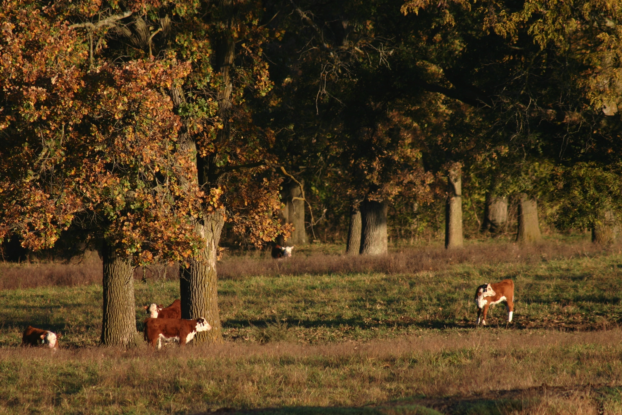
A Vision for Iowa’s grassland & grazing

Slide 2
5 Questions…
What is my 10 year vision for the future of Iowa’s land and water?
What will success look like and how can it be measured?
What will it take to achieve this vision – funding, education, policy?
What obstacles stand in the way?
What actions can we take today to move forward?

Slide 3
Why isn’t rural Iowa more prosperous?
Notes:
Since that wasn’t complicated enough, I added a 6th question. For all our problems Rural Iowa is still where I want to live and it still has resources and oppertunities. My vision is an abundant landscape that provides not just corn, soy, and livestock. but also wild places for hiking and canoeing, abundant wildlife for hunting and birdwatching, one with communities diverse enough to support locally grown farming ventures and large enough and young enough to meet the workforce shortage facing our state. To describe how grazing can help achieve my vision I started with this question….

Slide 4
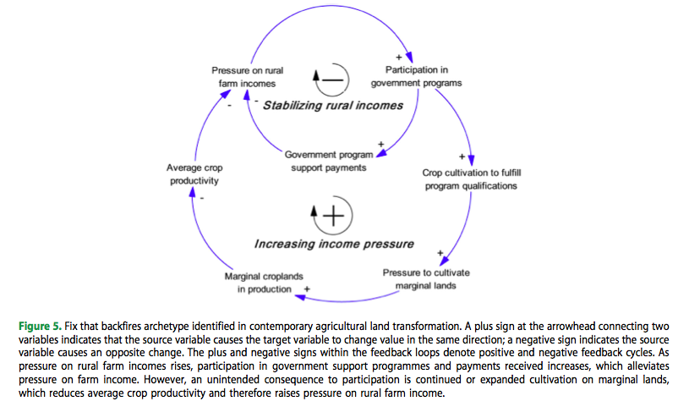
Let’s admire the problem…
Notes:
I’ve found that the most important part of having a vision or developing a strategy to improve a system, is first to understand where you are, how you got there, and how your current system works. This diagram does a good job of helping us understand the good intensions of our farm bill along with the negative unintended consequences they have had on our landscape.

Slide 5
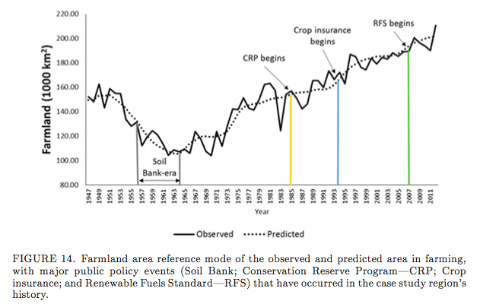
The road to hell is paved with good intentions…
Notes:
Iowa’s climate and soil combined have made us possibly the best place in the world to raise corn. With technology, cheap fossil fuel, and subsidies we can now raise corn on land that our ancestors would never dream of farming. But just because you can do something doesn’t mean you should. The result is we have lost the perineal cover and divesity of our landscape…

Slide 6
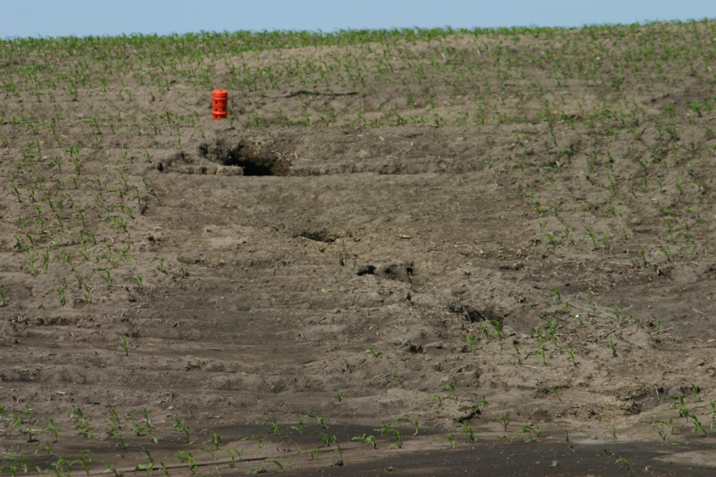
As our landscape erodes so has our rural economy…
Notes:
The unintended consequences of these well intended policies have resulted in marginal land (pasture, hay ground, crp) being converted to crop production. Here’s the problem…

Slide 7
Our land:
Farm Bill incentives have led to farming land better suited for grazing.
Pasture is becoming rare and much of whats left is being overgrazed.
Soil loss as high as 100 tons per acre in some counties
Our water quality is going down.
Wild species are decreasing.
Our Communities:
Aging population and aging farmers
Decreasing workforce
Declining enrollment in our schools.
Increasing number of public school students receiving free and reduced lunch (range is 46% to 68% on the districts we pay property taxes to).
Increasing costs to municipalities to treat polluted water.
Decreased opportunities for outdoor recreation.
Page County, where I live currently has the highest cancer rate per capita in Iowa.
Adams, Taylor, & Page Counties (where I farm) are 8,9, & 10 for poverty.
Notes:
Our current system has removed perineal cover from our landscape. As we lose cover nature loses her ability to protect our water and the habitat she needs to maintain a healthy ecosystem- a landscape that is out of balance. To regenerate our land and communities we have to regenerate our Natural resources. I believe doing this creates an incentive for people to move to and visit our rural communities. As this happens I believe there will be real oppertunities for successful small scale diverse farming enterprises

Slide 8
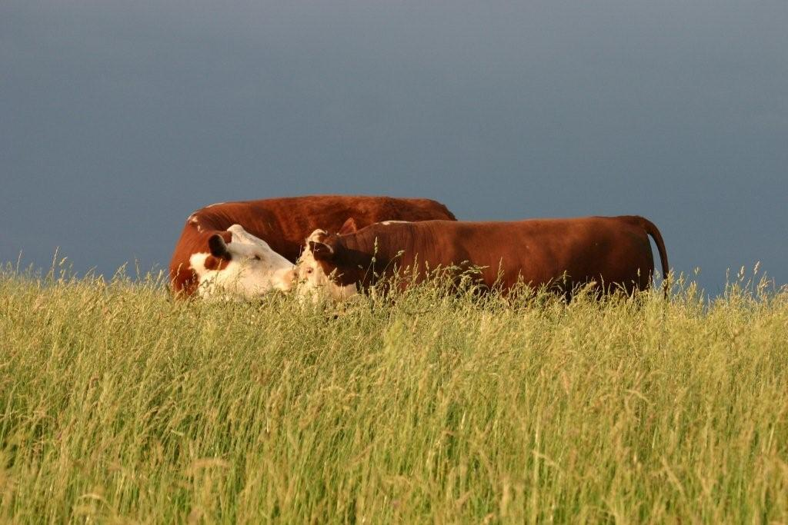
My Vision for Iowa’s land, water, & grazing… (it’s not the cow it’s the how)
Notes:
My vision is livestock and grazing can be a leverage point to creating a more verdant and diverse landscape in our state. with the right approach good grazing can be a powerful tool in regenerating our natural resouces, farm incomes, rural economic development oppertunities and ultimately create real oppertunities for young people wanting to start farming, return to a family operation, or simply enjoy the quality of life that rural Iowa still has the potential to provide.

Slide 9
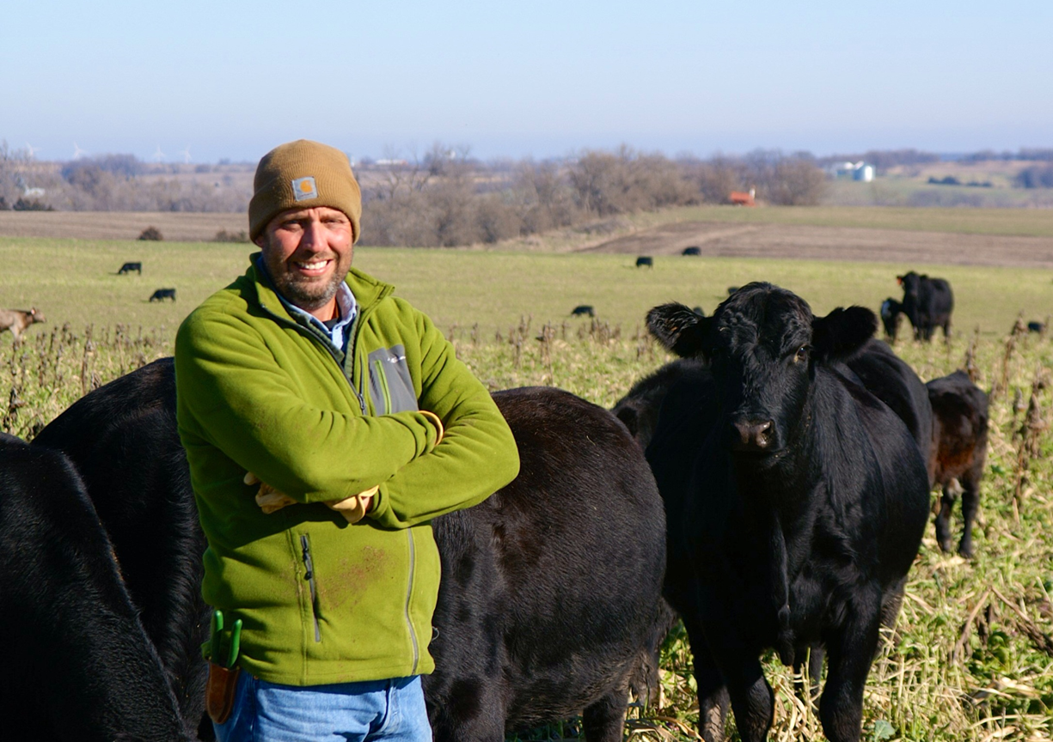
How is grazing good for Iowa’s farmers?
Notes:
The resources Iowa Agriculture has become dependent upon are either running out Rock Phosphate or becoming very expensive and harder to get out of the ground: Fossil Fuel that we depend upon for our diesel, chemicals, nitrogen, etc…The beauty of livestock is they can recycle these nutrients back on the land for you while rapidly improving the health of your soil at the same time. A good friend says it best “once we remember cattle have legs we wont need feedlots’ My vision is that over time we decentralize our livestock industry both with more smaller scale feeding operations that graze calves longer on crop residue and both summer and winter cover crops. But also through custom grazing oppertunities where a larger feedlot would contract with a beginning producer to custom graze calves to heavier weights to reduce stress.

Slide 10
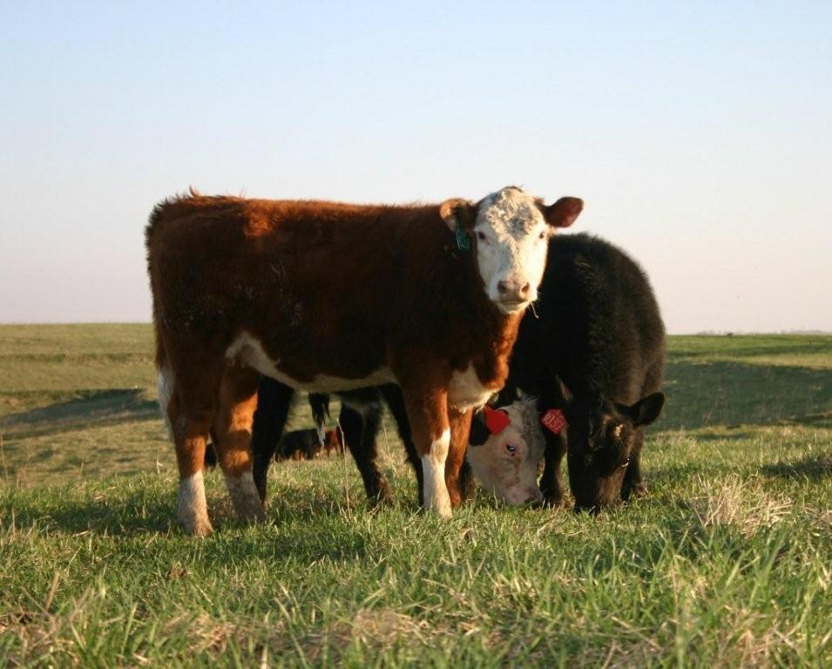
Better grazing will allow Iowa’s farmers to maintain market share.
Notes:
Staying in business isnt all about growth. It’s also about meeting consumer demand to maintain market share. Walmart wants to remove one gigaton of Carbon From its supply chain by 2030. To achieve this Iowa’s Farmers will have to reduce Fossil Fuel use (chemicals, diesel, N) all require fossil fuel and increase practices that sequester C: Nature is give and take & ruminants create pleanty of methane. However, Perineal Forage, cover crops, and ideally planting trees, & protecting the trees we still have instead of converting them to crops to create Carbon sinks that more than offset the methane produced by ruminants- cant just blame cattle for this includes sheep, goats, deer, giraffes, antelope, some kangaroos…. Second, Costco and McDonalds have stated that they want antibiotic free beef within the next ten years. The natural instinct of a ruminant is to graze. Allowing animals to express their natural instincts reduces stress and when you reduce stress you reduce the need for antibiotics. Having the forage resources to help Iowas farmers graze calves to 900 to 1000# instead of 500# will reduce costs and increase demand for our cattle

Slide 11
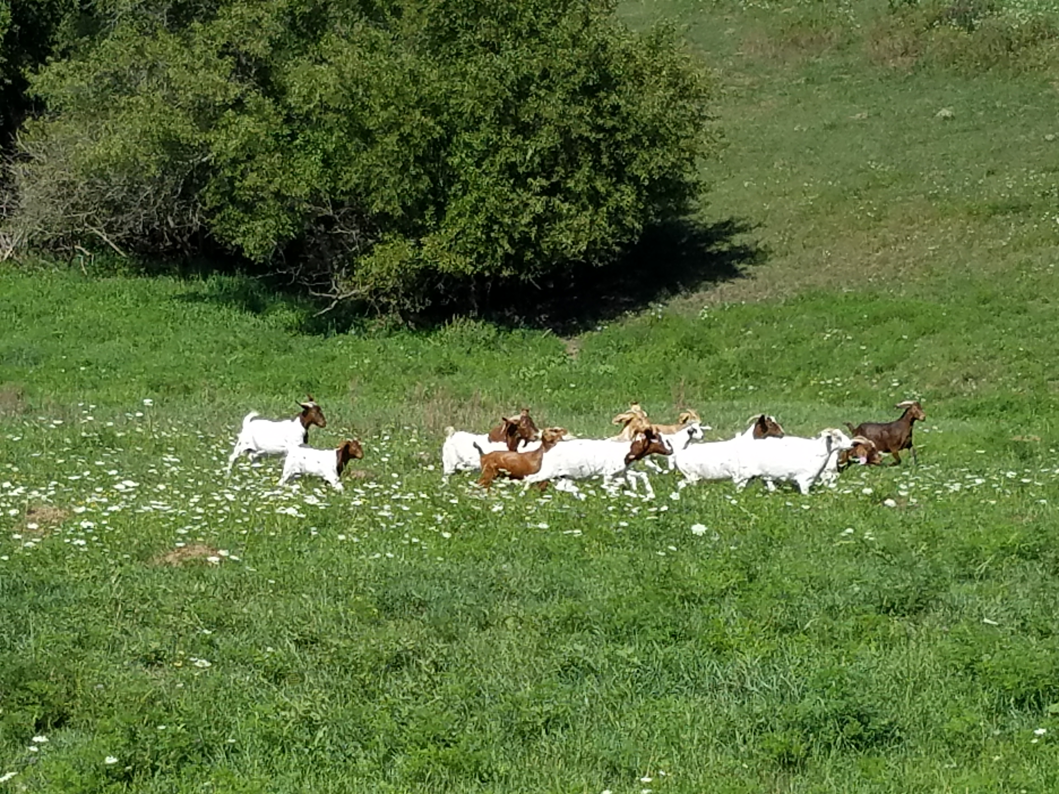
Opportunities for beginning farmers…

Slide 12
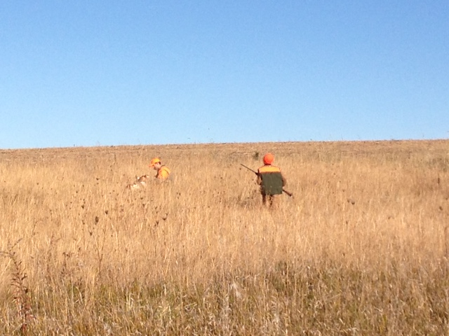
Hunting, because we’ve never filled our local motels and cafes for corn season.

Slide 13
What will success look like?
People choosing to live in Rural Iowa because we have great outdoor activities.
Young people building good futures by raising livestock.
Soil staying on the land.
Water quality improving.
Rural communities embracing immigration instead of fighting it.
Farmers bragging about restored habitat areas and wildlife populations, as well as, yields.
School kids raising and preparing their own lunch

Slide 14
What will it take to achieve this vision?
Funding for Infrastructure, specifically exterior fence and water systems to optimize grazing
Packing plants – not the most popular topic, but essential
Embracing immigration – we need people who want to raise livestock
Teaching Agriculture as an Art & a Science – better grazing requires Animal Husbandry
Investment in research to develop a Carbon Neutral Food System – There’s plenty of private and public funding dedicated to teaching me how use chemicals and fossil fuel to raise crops without livestock. I don’t think having a research institution and farm dedicated to raising food without dependence on finite resources is an unreasonable request…
Helping Farmers and Policy makers see the true value in our natural resources through research, outfitting, and leadership to accept responsibility for our current food systems impact on our landscape.

Slide 15
What obstacles stand in the way?
Funding – our current infrastructure is shot and it will take cost share to bring it back
Current Farm Bill – Our Farm Bill has to focus on the regeneration of resources, not production.
Current out of state regulations for whitetail deer tags
Reluctance to put personal opinions aside to solve problems

Slide 16
What actions can we take today?
Treat fencing and water systems for grazing as a rural economic development priority. I’d argue this is every bit as deserving as a fertilizer plant.
Find a compromise on our out of state tag requirements – one that helps outfitters, but also increases land available for public access.
Start planning a research farm / center dedicated to a Carbon Neutral Food System
Work with others (who we might not like) for the greater good

Slide 17
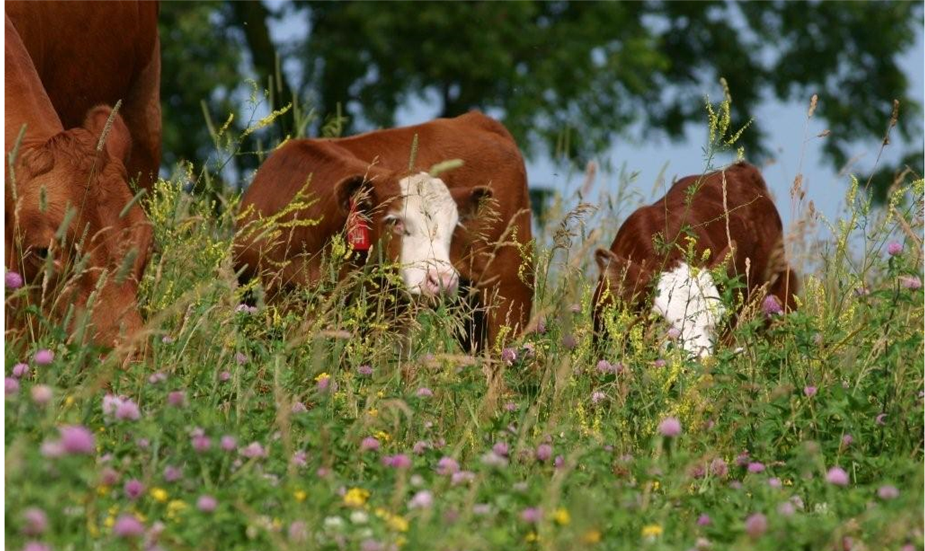
Thank you for seeing a brighter future for our State

