Slide 1
A Vision of Iowa’s Public Waters
Bill Stowe
CEO & General Manager

Slide 2
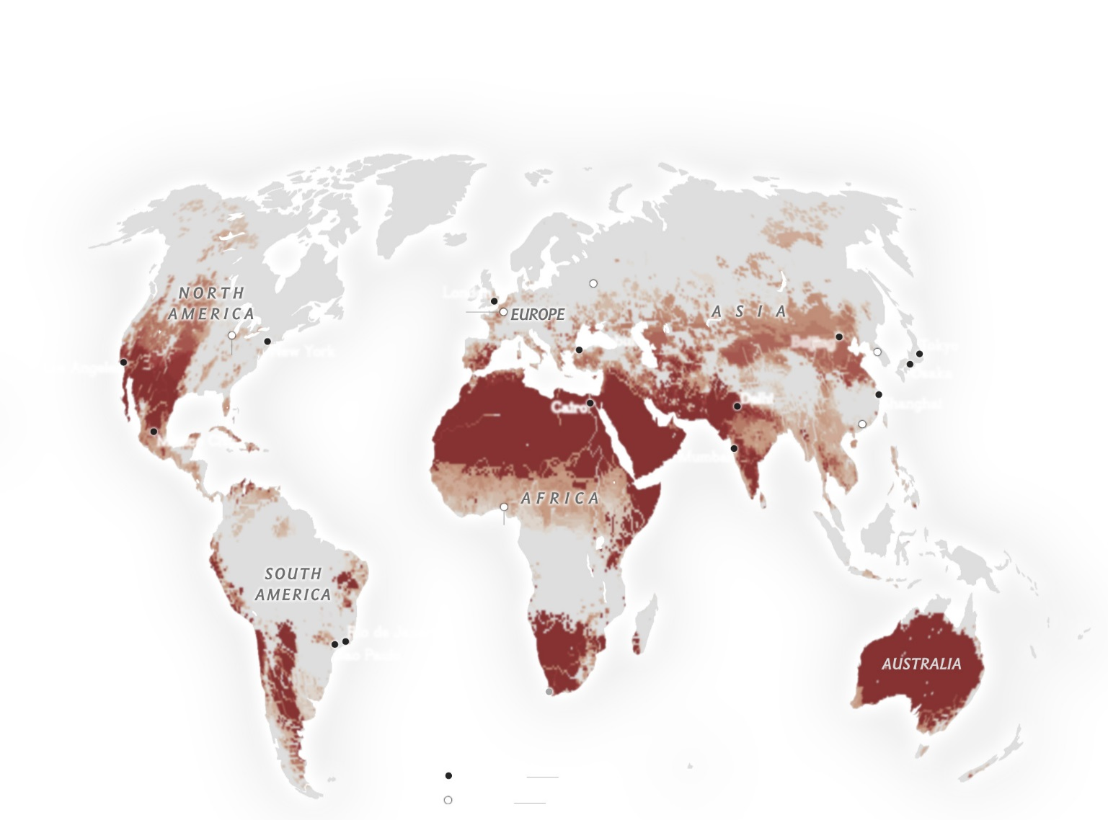
Global Water Scarcity: Water Quality, not only Water Quantity, is a Driving Factor in Assessing Water Scarcity
Des Moines, IA, USA
– National Geographic
Notes:
On a global view….

Slide 3
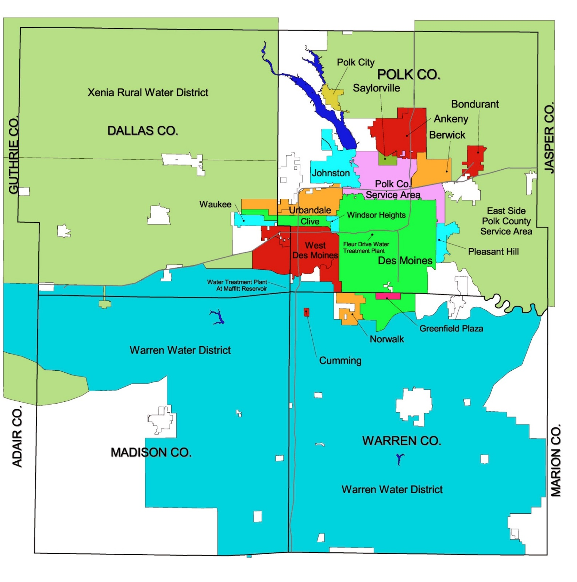
DMWW Service Area
Urban
Suburban
Rural
Serves 6 of the 10 fastest growing cities in Iowa
500,000 customers (one-sixth of Iowa’s population)
2 Rivers
2 Reservoirs
3 ASR wells
Notes:
A bit closer to home…. for background…
As the largest water utility in Iowa, serving one-sixth of Iowa’s population, and encompassing 6 of the 10 fastest growing cities in the state, Des Moines Water Works mission is to provide safe, affordable and abundant drinking water to our 500,000 customers in central Iowa.

Slide 4
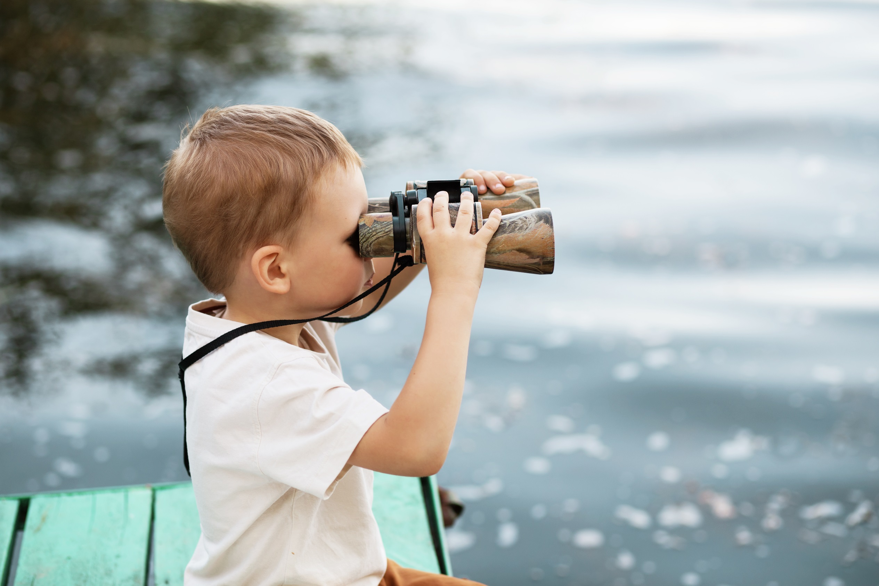
Reliable source water quality and quantity
Notes:
What is your 10-year vision for the future of Iowa’s land and water?
In order to successfully provide safe, affordable and abundant drinking water, Des Moines Water Works, likely other Iowa public water systems and many of my national peers depend on a reliable source water quality and quantity.

Slide 5
Natural Resources Potential:
Recreational
Economic development
Labor force
Role of Landowners and Individuals:
Producers pay
Role of Government:
Protecting the “commonwealth”
Role of the Public:
Source water advocacy
Role of Private Businesses and Economics:
Economic development → ag success and consumer confidence
Notes:
the natural resource potential:
recreational
economic development
labor force
the role of landowners and individuals
Producers pay
the role of the government:
Protecting the “commonwealth”
the role of the public and citizen groups:
Source water advocacy
the role of private businesses and economics:
Ag success and consumer confidence

Slide 6
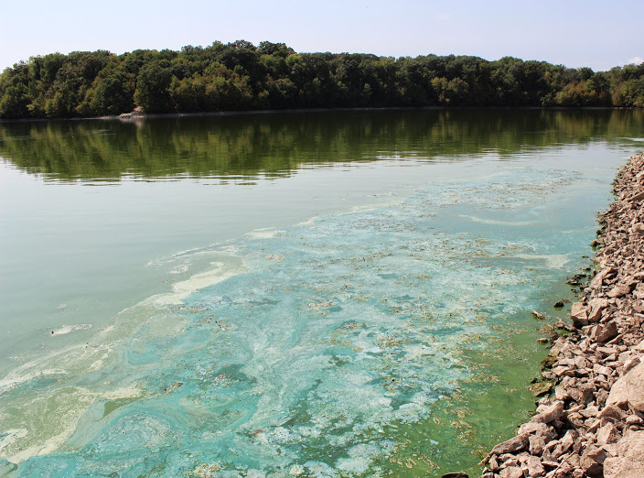
Where We Are
A persistent problem of unacceptably high pollutants in Iowa’s surface waters, especially nutrients

Slide 7
Where We Are
A persistent problem of unacceptably high pollutants in Iowa’s surface waters, especially nutrients
“Corn and soybean fields are the primary cause of nitrate in Iowa waterways.”
– Michael Castellano and Matthew Helmers, Iowa State University
The Des Moines Register, April 12, 2015
Nutrient Source
Anhydrous ammonia
Animal/human waste
Nitrogen → carried by water
Phosphorous → carried by soil

Slide 8
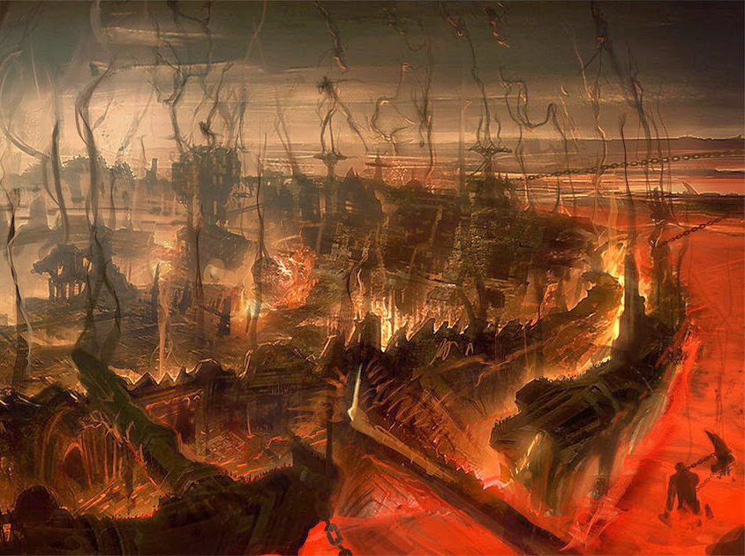
The ‘Dystopic Vision’ – Where We’re Going…

Slide 9
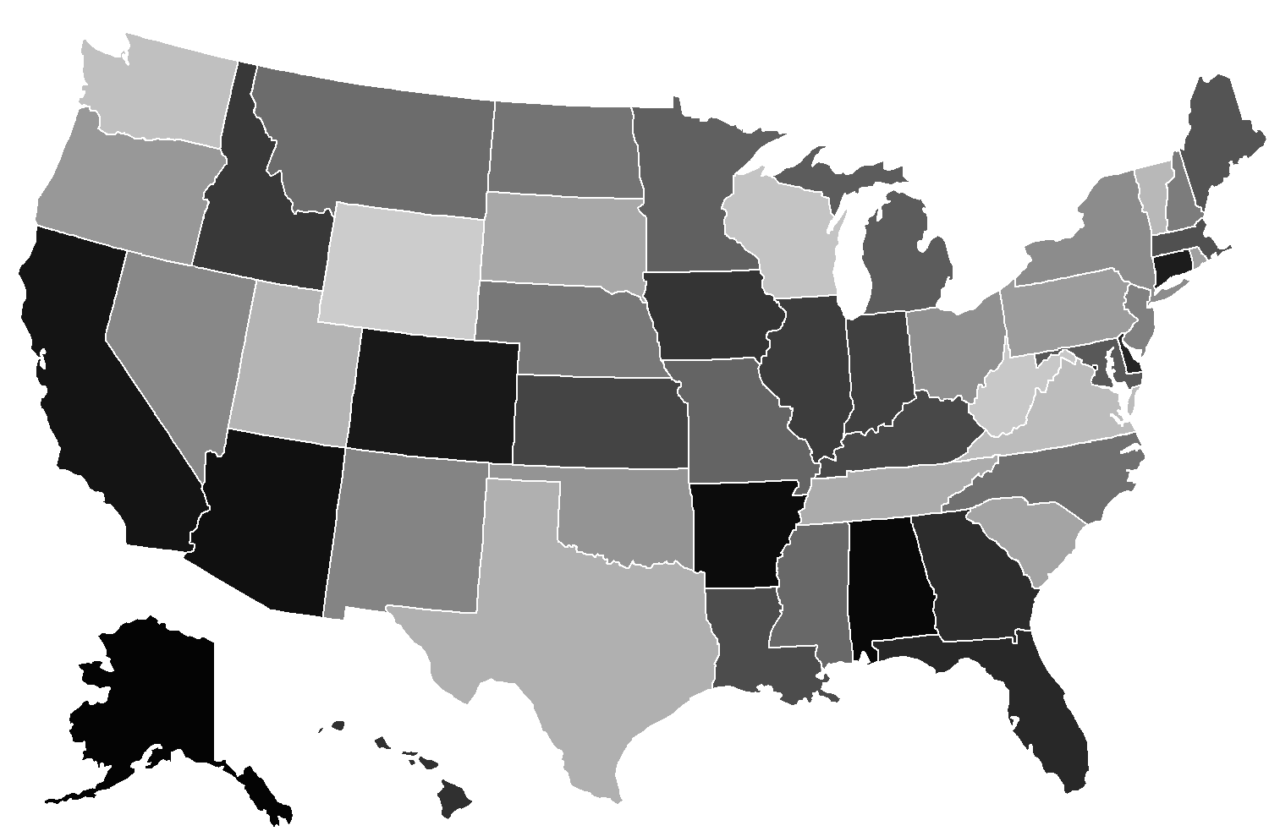
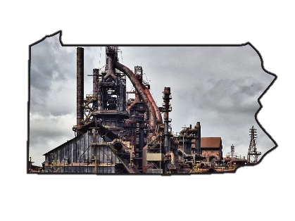
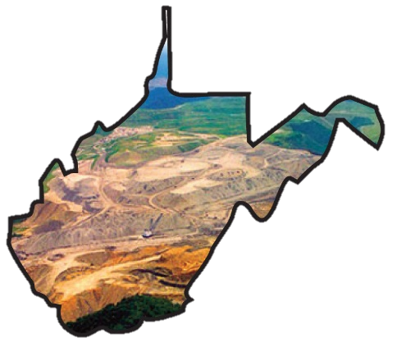
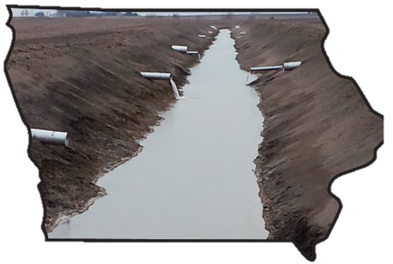
Tale of West Virginia and Pennsylvania: Failed Production/Lost Towns
‘Big Steel’
‘Big Ag’
‘Big Coal’

Slide 10
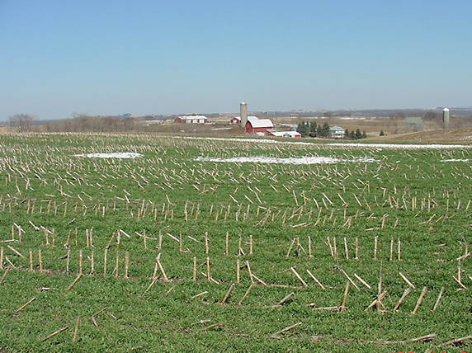
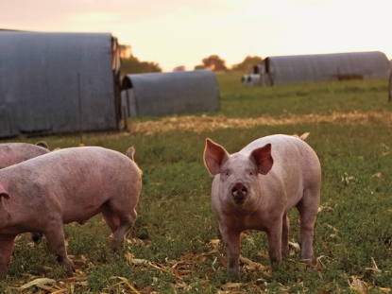
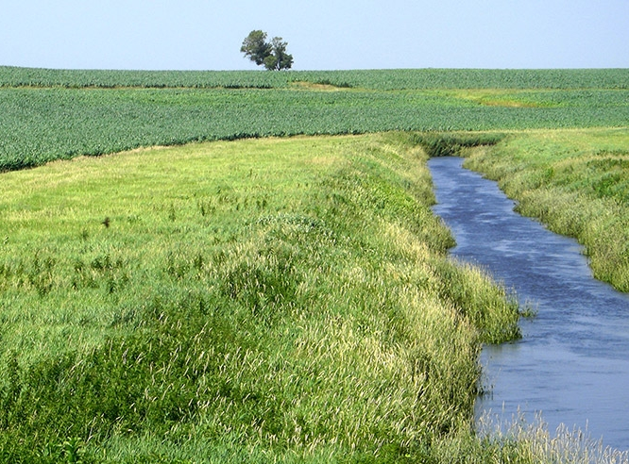
The ‘Utopic Vision’ – Where We Should Be… Sustainable Agriculture and Improved Water Quality
Green fields year round
Humane animal treatment
Clean surface water
Notes:
What will success look like and how will it be measured?
Improved water quality (not counting the number of acres in conservation)
Measured by access to public data

Slide 11
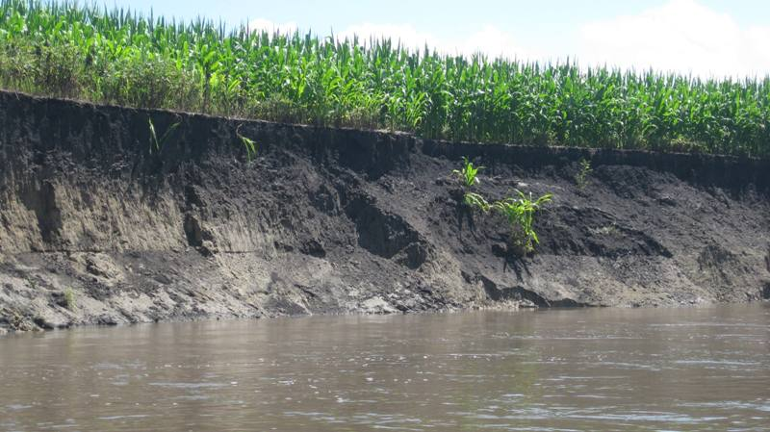
Obstacles:
Status quo agriculture
Policy discussions focused only on public responsibility
Notes:
What obstacles stand in the way of making progress?
For obstacles – each speaker should identify two significant obstacles in the way of achieving the vision, with ideas on how to overcome the obstacles.
Obstacles:
Status quo agriculture
Policy discussions focused only on public responsibility

Slide 12
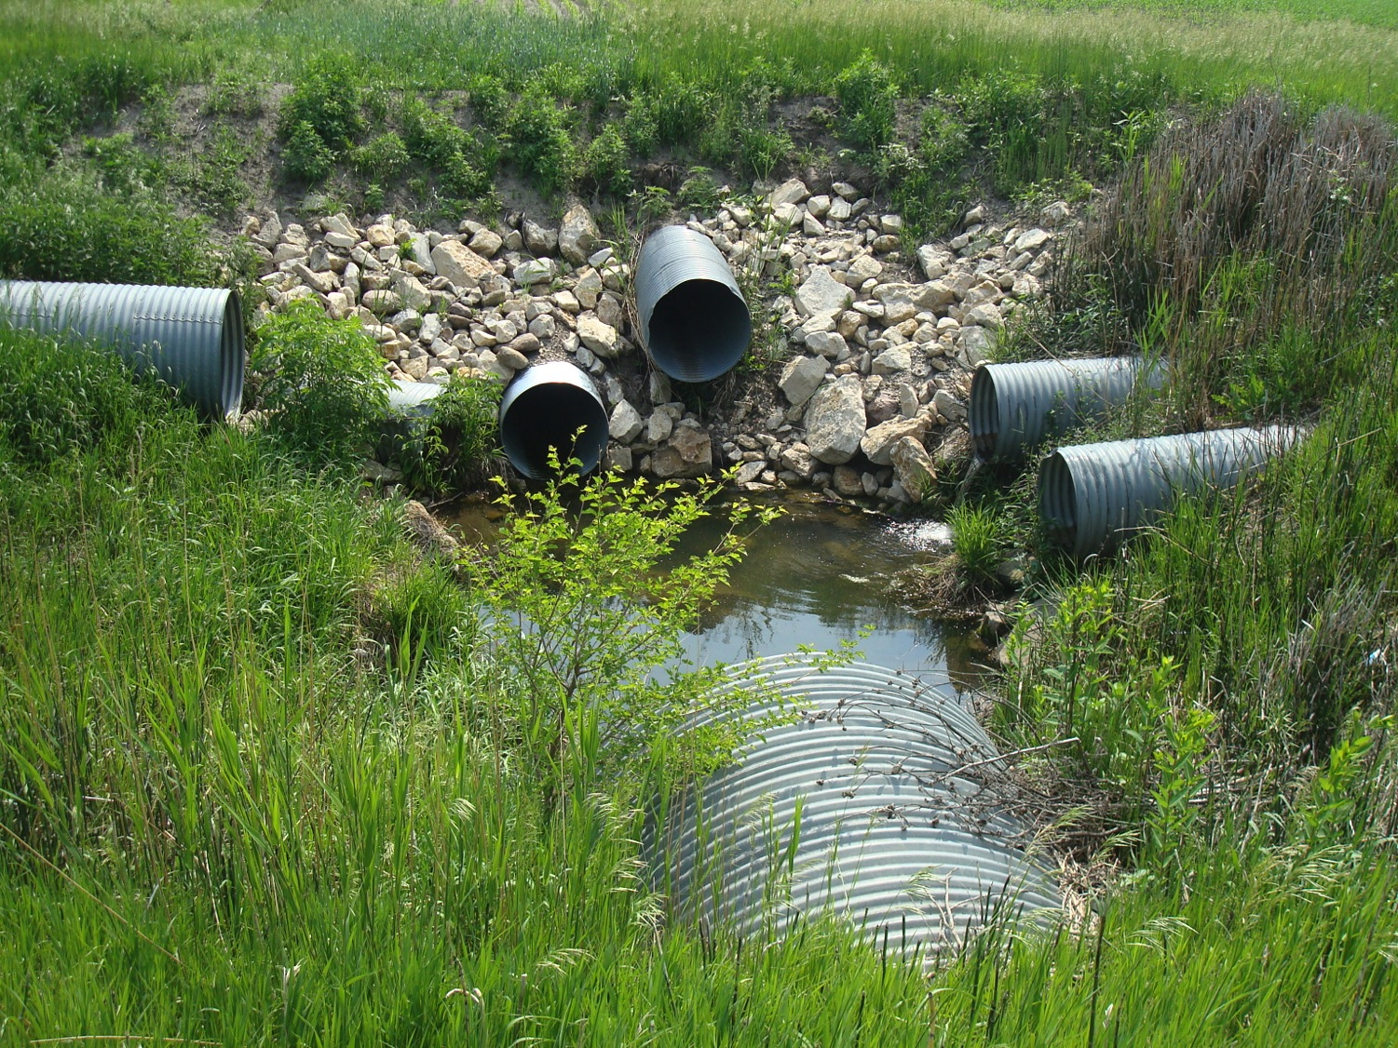
Serious Water Quality Issues
Require Serious Solutions
Prioritized and dedicated funding
Accountability
Policy
Sac County, Iowa
Notes:
What will it take to achieve this vision – funding, education, policy?
Prioritized and dedicated funding
Accountability
Policy

Slide 13
What Can Conservation Leaders Do?
Best management practices of neighbors
Leadership vison of Iowa as a clean water state
Community/political/stakeholder discussion of accountability (not just public resources)
Notes:
What actions can we take today to move forward?
For actions – each speaker should identify three key actions we can take in the near term that will help lead to the vision.
Best management practices of neighbors
Leadership vison of Iowa as a clean water state
Community/political/stakeholder discussion of accountability (not just public resources)

Slide 14
What Can Citizen Advocates Do?
Defend our friends
Leopold Center, Flood Center, DMWW (local control)
Support alternatives to Industrial Ag
Organic, local, CSAs
Promote environmental public discourse
Commit to environmental protection, regulation, and inspection
Science over emotion (“bottle bill,” measurement/monitoring, climate change, Nutrient Reduction Strategy)

Slide 15
is the time to get SERIOUS about our water (and soil)

