Slide 1
A Faith Based Vision for Iowa’s Climate Future
Matt Russell
Iowa Interfaith Power & Light
SOIL 2018 – Turning Our Vision for Iowa’s Water and Land in to Action
Drake University Agricultural Law Center
September 19, 2018

Slide 2
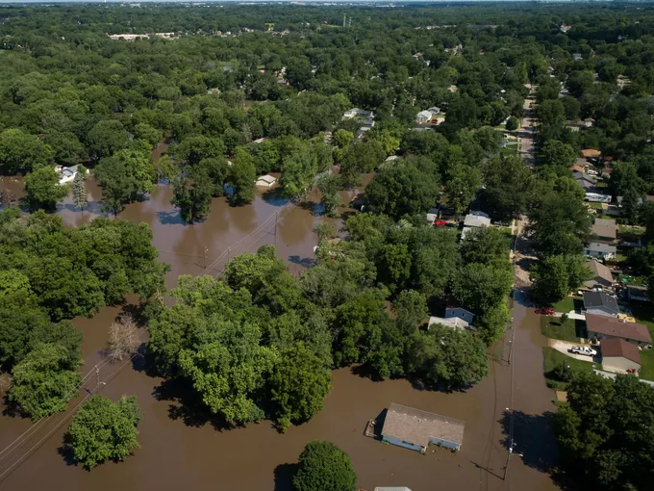
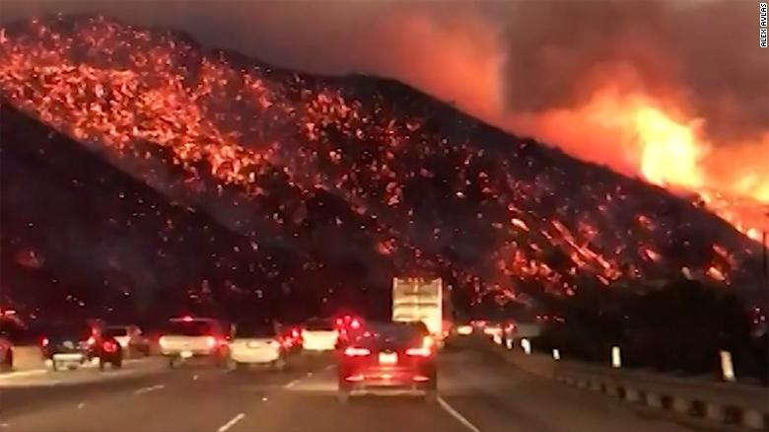
The Climate Crisis

Slide 3
The Paris Agreement
Commitment to adapt and mitigate
Global public policy framework
Markets built on policy framework
Monetization of carbon
Agriculture is in the mix

Slide 4
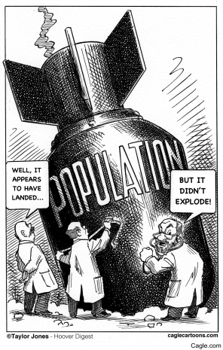
Population Bomb
Green Revolution
Iowa Leadership
Agriculture Major Tool
Iowa benefits
Moral view—Feed the World
Economic view—leadership and development

Slide 5
The Climate Crisis
Climate instability threatens more than population
Climate threatens agricultural production
Climate instability amplifies conflicts
Climate change is creating mass migrations
The world is demanding action to stabilize the climate

Slide 6
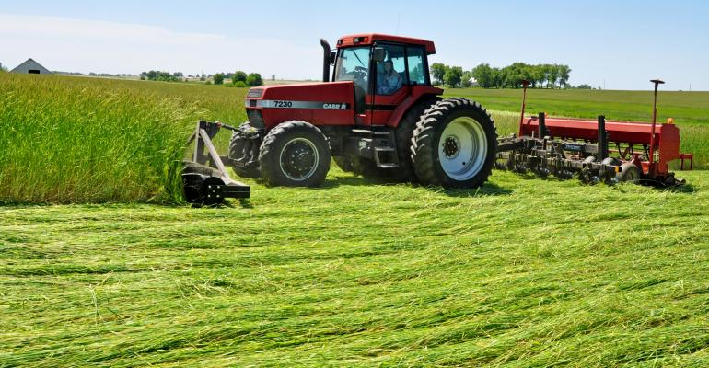
Iowa Farmers and Climate Services
Best soils on the planet
Existing infrastructure
Access to technology
Industry
Capital
Farmer political power

Slide 7
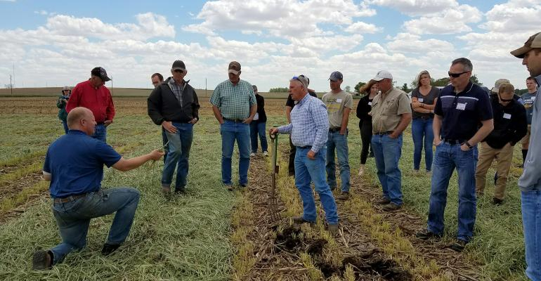
Farmer Innovation
Conservation tillage
Managed grazing
Cover crops
Crop rotations
Ethanol

Slide 8
Farmers can lead
A moral argument—faith
An economic argument—legacy

Slide 9
Climate services and water quality
Global demand for climate services creates huge potential pool of resources for mitigation—carbon sequestration
No such pool is likely to emerge for water quality
Overlap between water quality benefits and climate benefits from sustainable agriculture
Farmers can use climate service dollars to solve water quality, but not the other way around.

Slide 10
Organizing farmers to lead
Develop the agricultural practices to both adapt to and mitigate climate change
Advocate for public policies that empower farmers to deliver what the world is demanding—a stable climate
Unleash the power of farmer innovation to accelerate change
Partner with Iowa State University and empower their farm organizations to claim global leadership in climate smart agriculture
Keep the value of on farm environmental services for farmers and rural communities rather than having all of the value flow up the supply chain

Slide 11
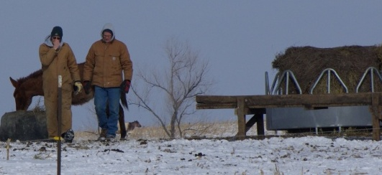
Iowa farmers helping solve climate change
Recruiting farmers who want to
Provide moral leadership
Innovate on their farms
Capture the economic benefits
Lead the policy development
Matt Russell, director@iowaipl.org
www.iowaipl.org

