Slide 1
Our Iowa:
The 21st Century Agricultural Economy
A vision advancing Iowa’s ecosystem leadership in agriculture & innovation.

Slide 2
Tell them what you’ll tell them, tell them, tell them what you told them.
Background, Vision, Mission
What are the issues facing Iowa Today?
  Agricultural economy broken, upside down
  Agricultural infrastructure (Soil and water) degrading fast
  Wasted and dislocated energy
  Rural Iowa (population, economy, quality) in a downward spiral
What are the solutions?
  Multiple diversified income streams from agricultural sector
  Regenerative practices and externality remediation
  Robust energy capture and utilization
  Create resilient, connected, innovative, educated, welcoming and wealth generating rural towns
Can you be more specific?
What do you think?

Slide 3
A Proposal for Iowa’s Food & Agriculture Businesses
A “Systems” Look at the Future of the 21st Century Agricultural Industry in Iowa
(and beyond)
Using the Businesses that work in the agriculture sector, to promote and impact real change, Iowa provides a sustainable food model for the world.
Notes:
What is your 10-year vision for the future of Iowa’s land and water? AND THE AGRIBUSINESSES AND ENTERPRISES CONNECTED TO THIS FUTURE? (Why only 10 years? The “Seven Generation” look by the Iroquois should be the vision.)

Slide 4
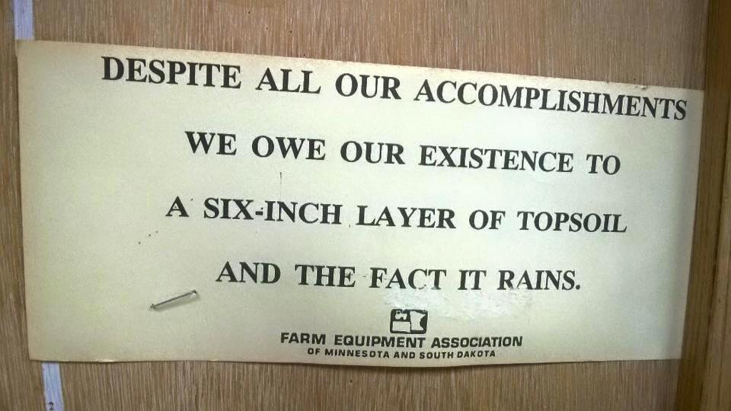
Notes:
Iowa is a land of farms because of its fertile topsoil known as “the black gold of Iowa.” All soils are not the same. In fact, Iowa has 479 different soil types.
Different plants help create different types of topsoil. Prairie grasses and flowers grow close to each other and have extensive, fibrous root systems. These roots help break up rocks and hold soil in place. The roots of most prairie plants are fibrous. This means they branch out many times from the base of the plant and keep branching out as they spread in to the soil. This massive network of fine roots serves the plant well, by being able to absorb even the smallest amount of rainfall.
Iowa’s rich soil developed under prairie plants and was held tightly by them. When prairie plants die, their decomposition returns nutrients to the soil, creating a rich, black silty soil.
When Iowa land was first plowed, the settlers found 14 to 16 inches of topsoil. By 2000 the average was six to eight inches. When the prairie plants were plowed under, the soil was to exposed and vulnerable to erosion. Soil erosion is the process of removing soil materials from their original sites by water or wind. Hard rains that wash across bare soil move Iowa’s black gold into gullies and streams. During dry weather winds can carry loose soil across the countryside. If nothing is done to stop the erosion, the rest of Iowa’s topsoil could be gone in the next 100 to 150 years.

Slide 5
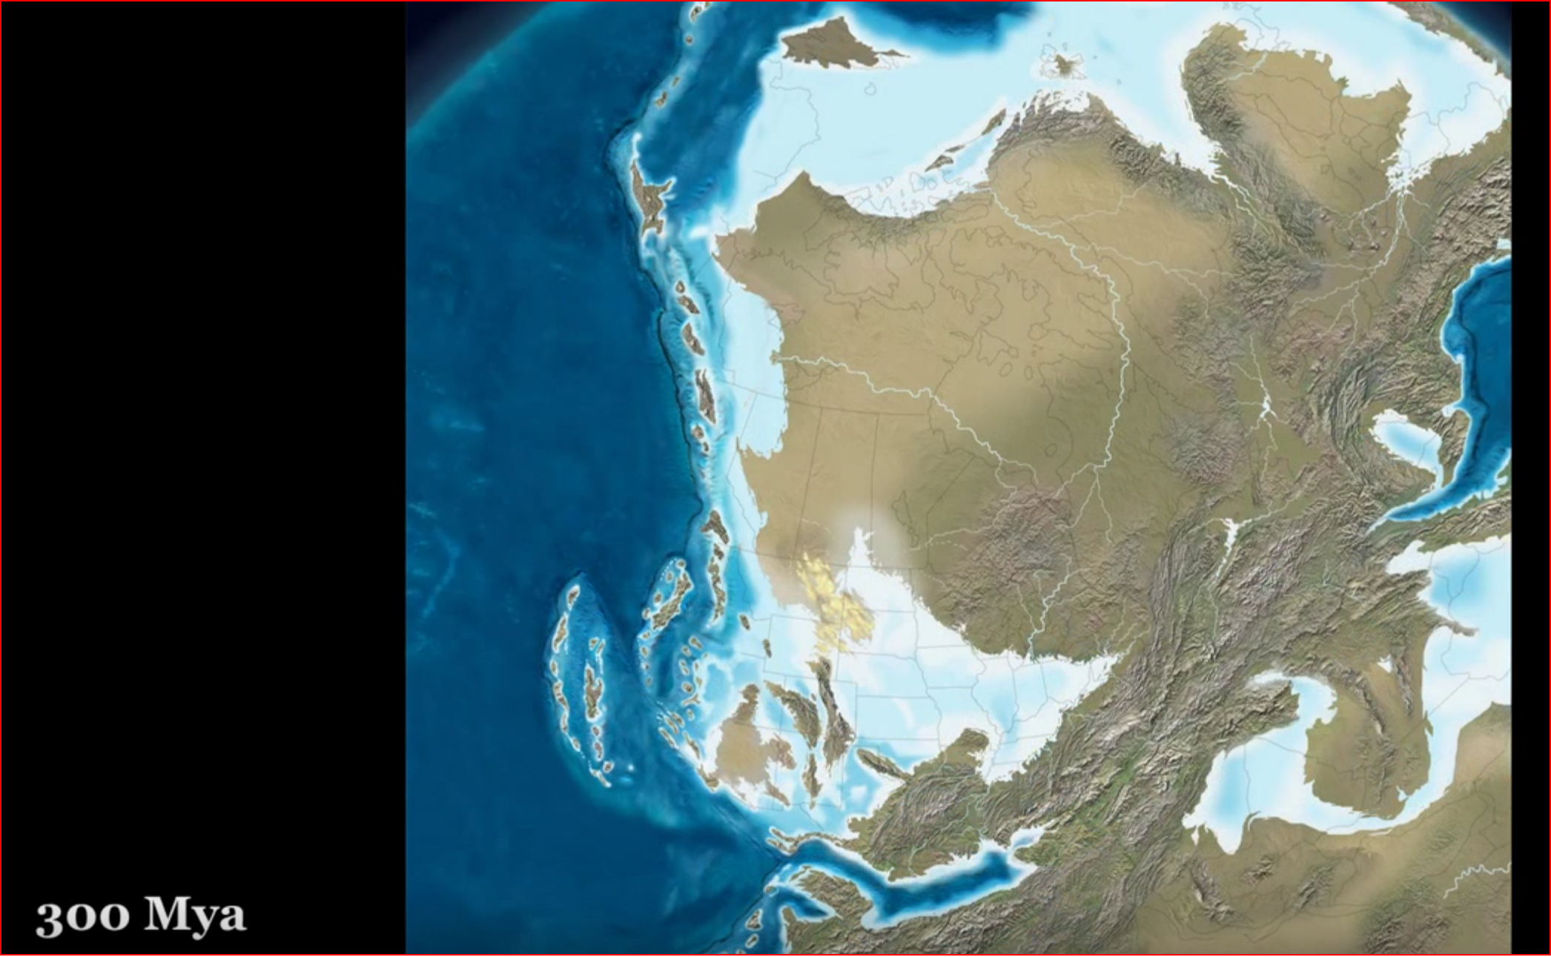

Slide 7
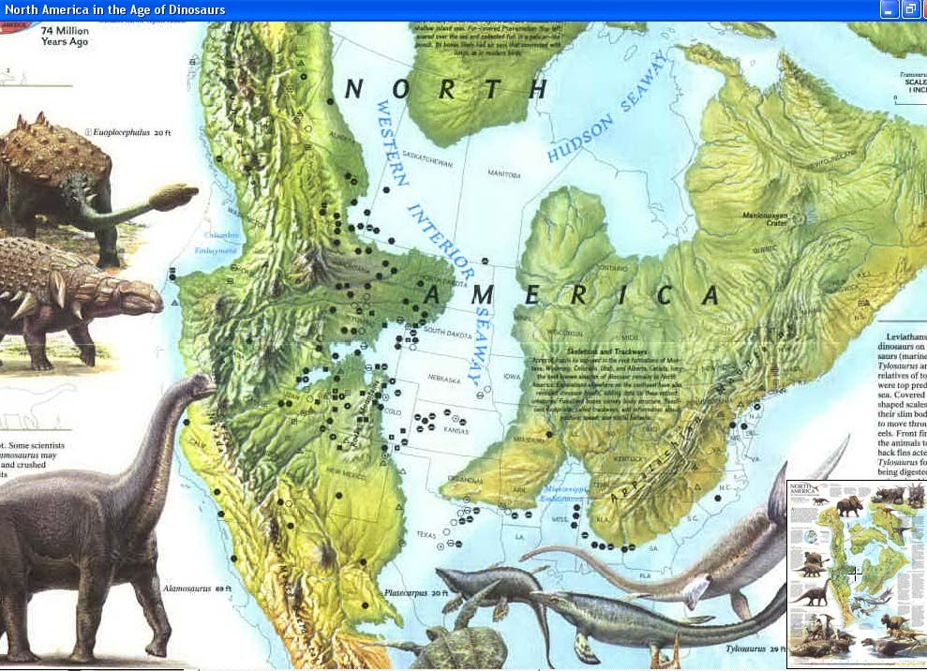
Notes:
74 million years ago

Slide 8
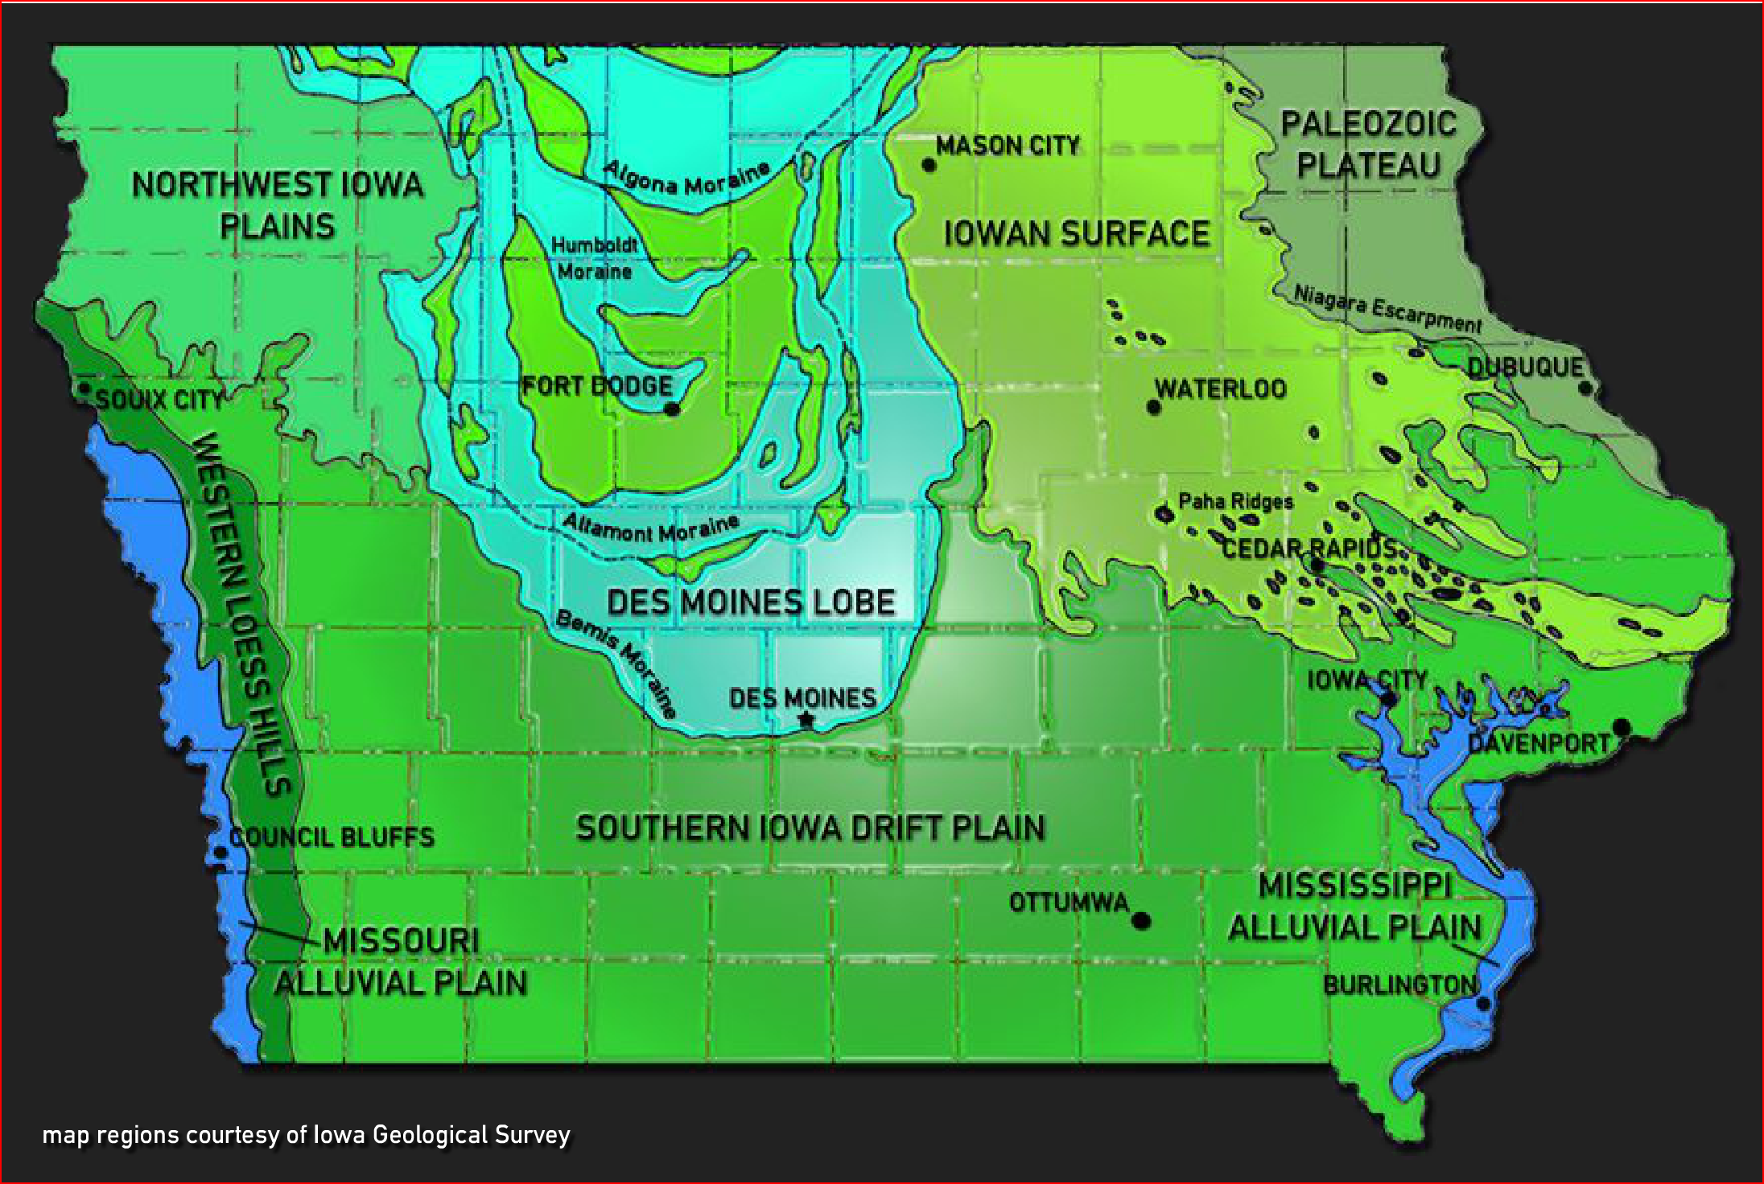
Notes:
2 million years ago, the glaciers showed up, and left around 12,000 years ago.
Long time no sea.

Slide 9
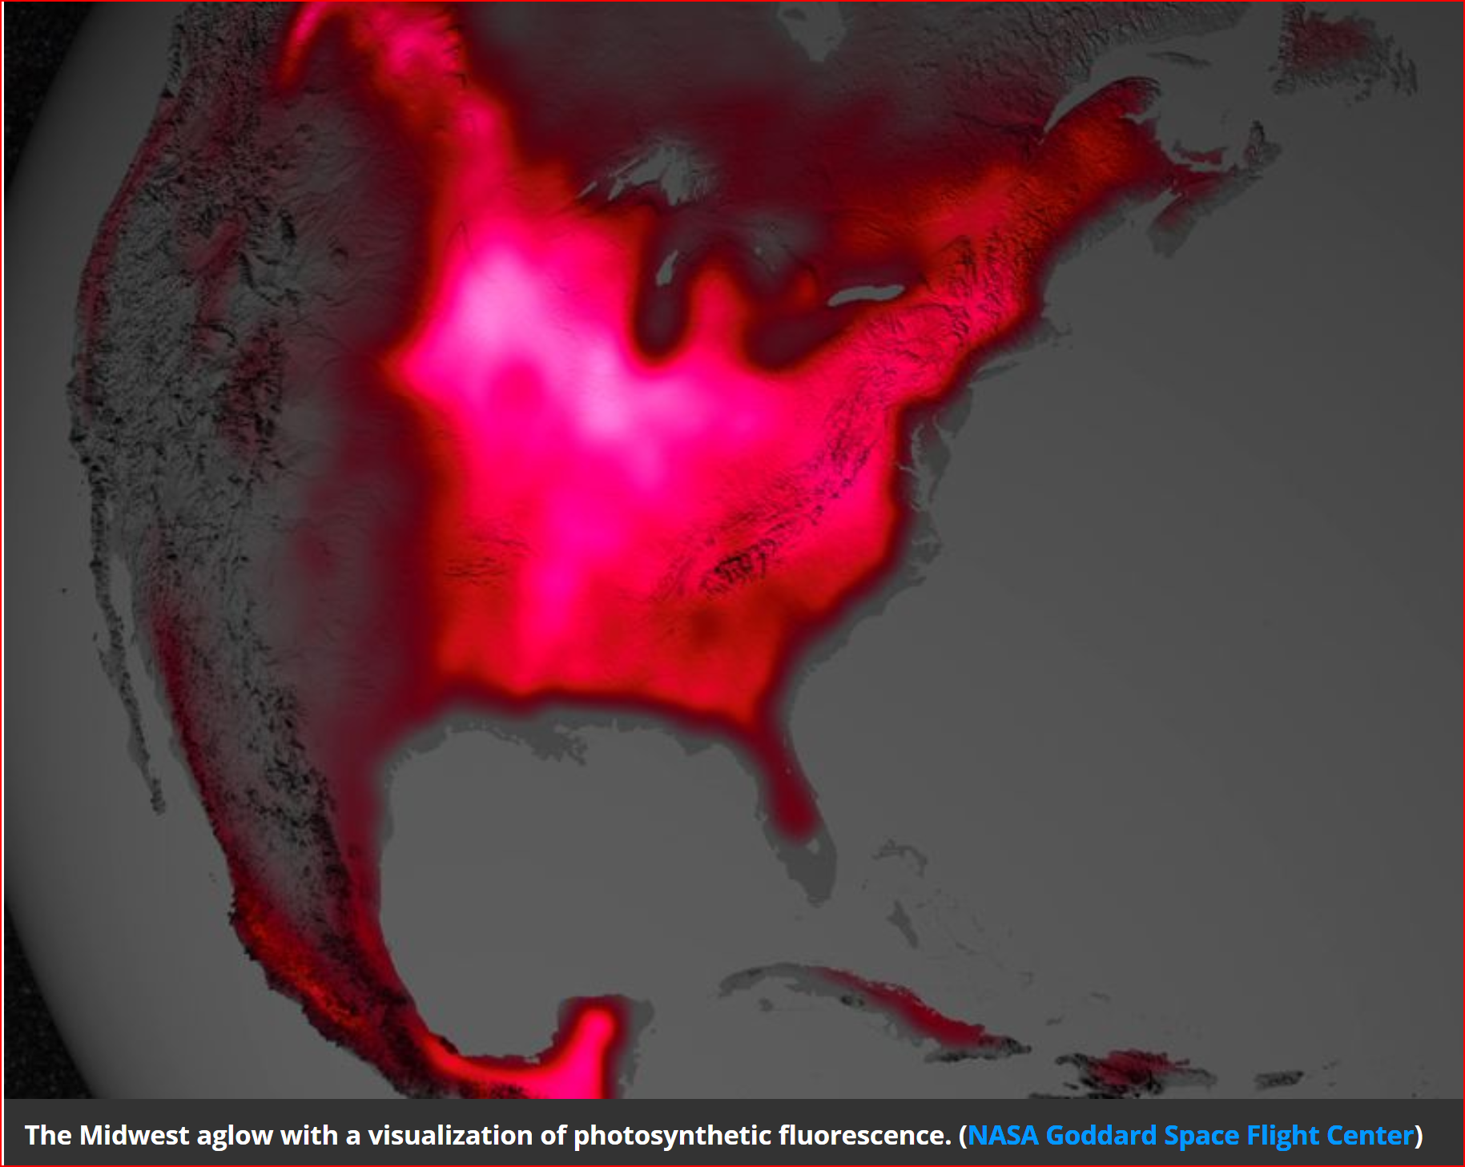
Notes:
This coincidence of 300 million years of activity has produced the most biologically productive, photosynthetically active location in the world.

Slide 10
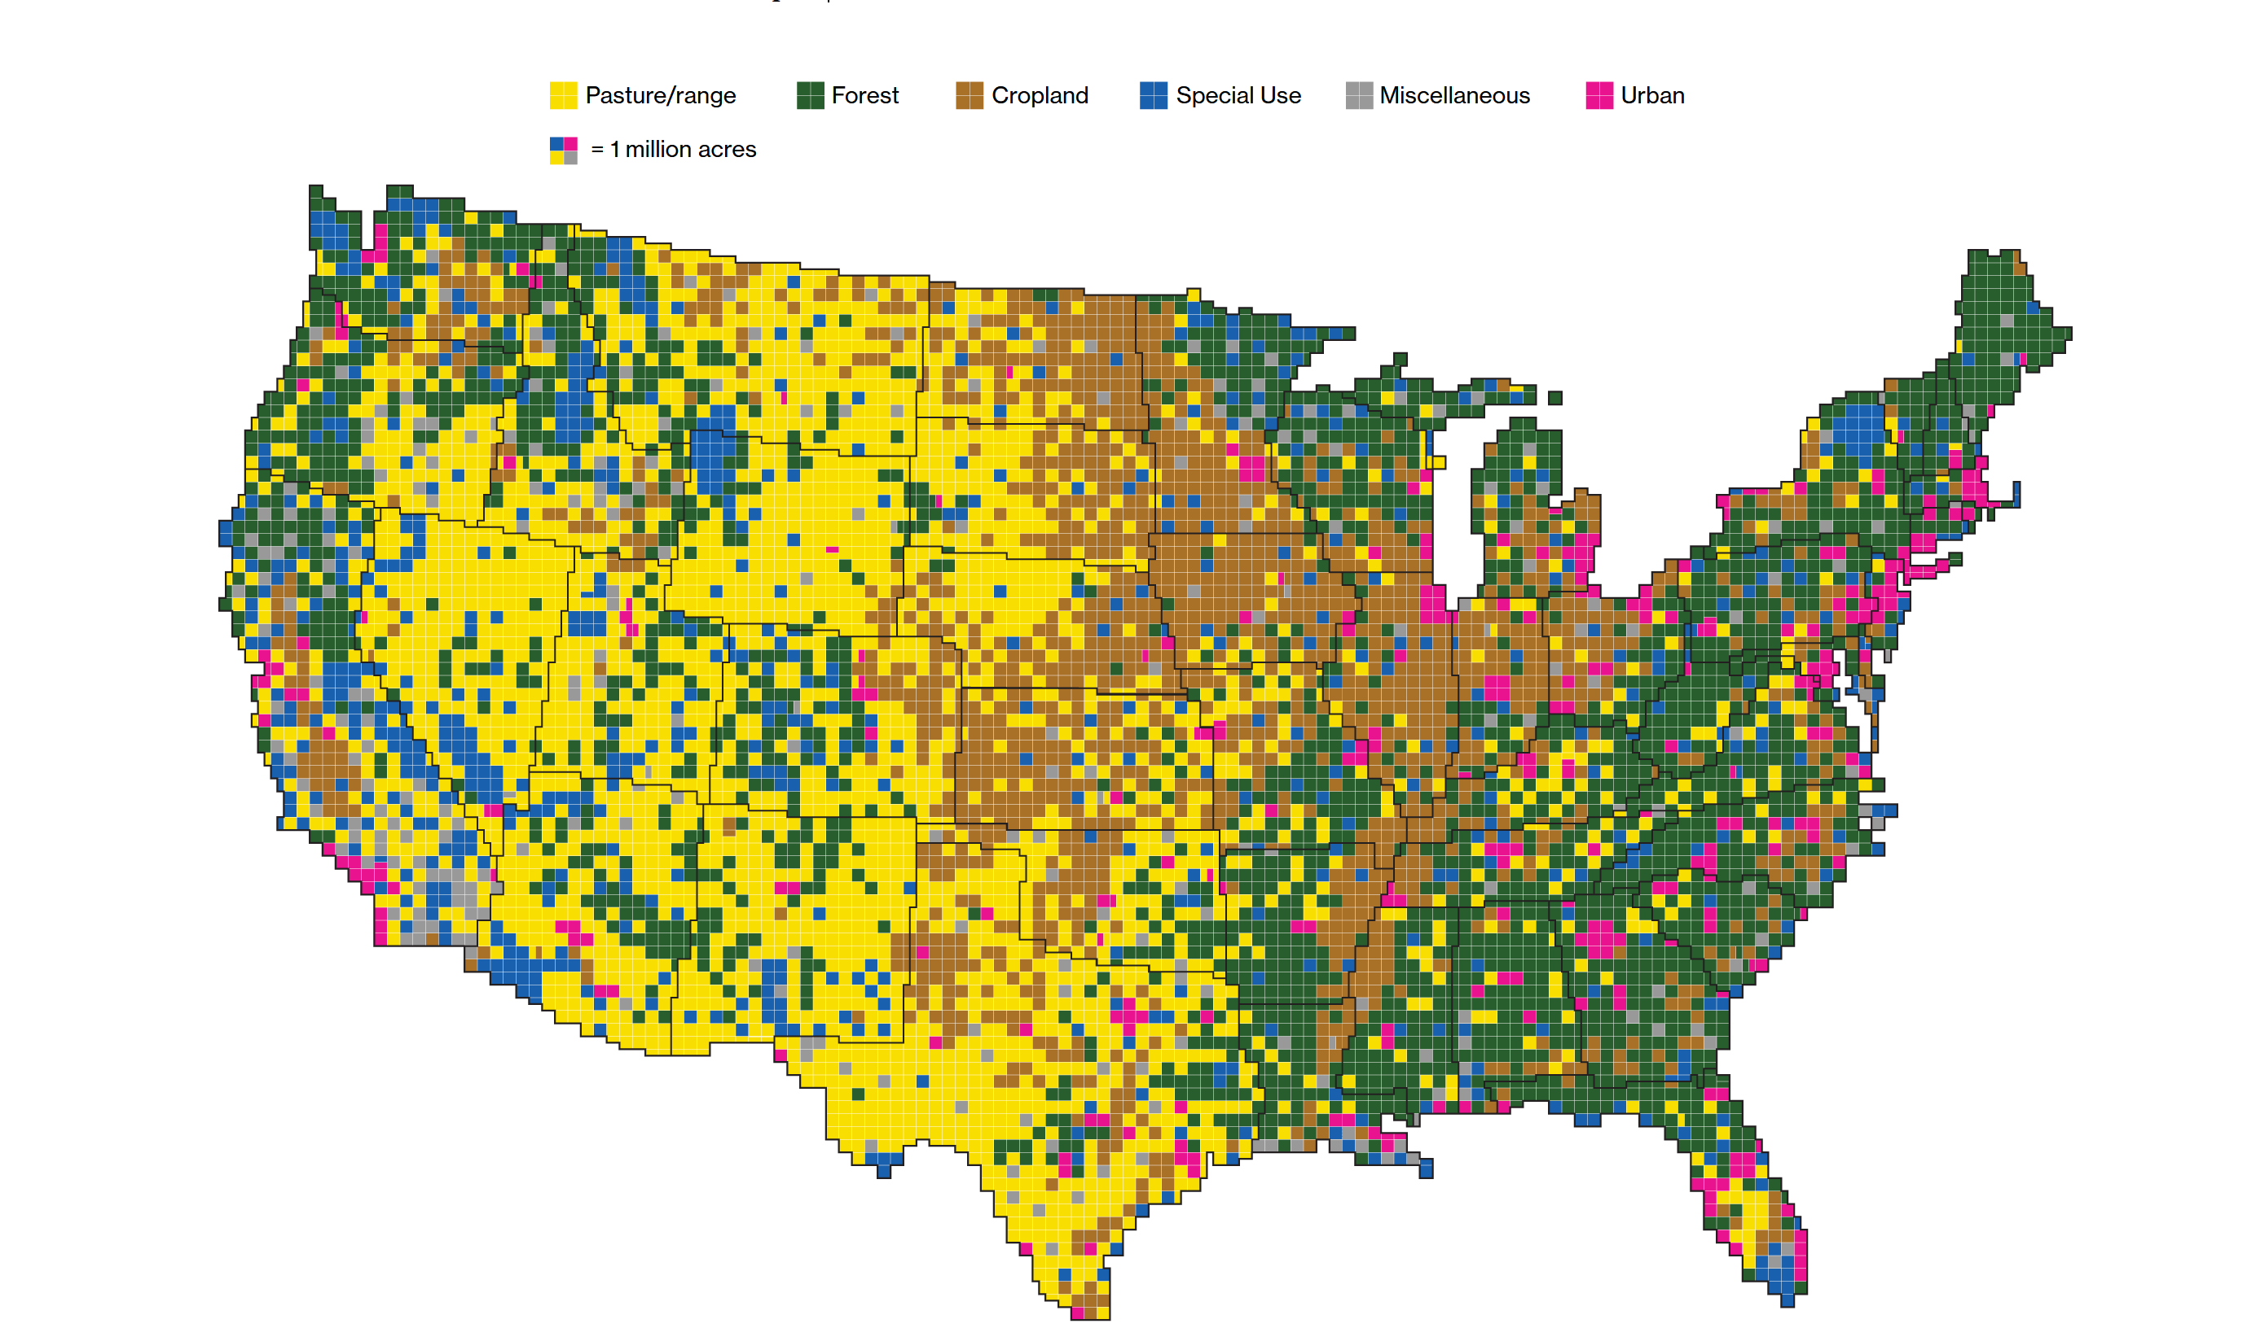
Notes:
As we look at the various uses, you can see the brown counties on this map are primarily crop acres, and the yellow are pastures and rangeland.

Slide 11
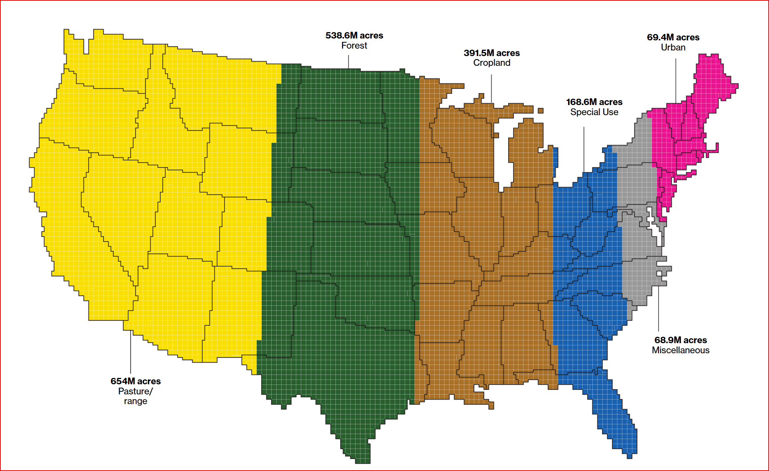
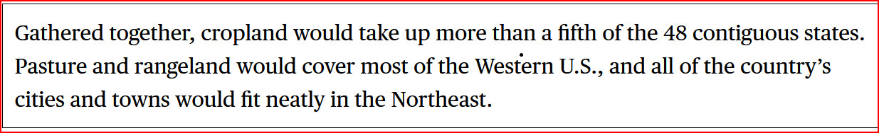
Notes:
Summarized, accumulated and gathered together, cropland comprises a total of 391 million acres.

Slide 12
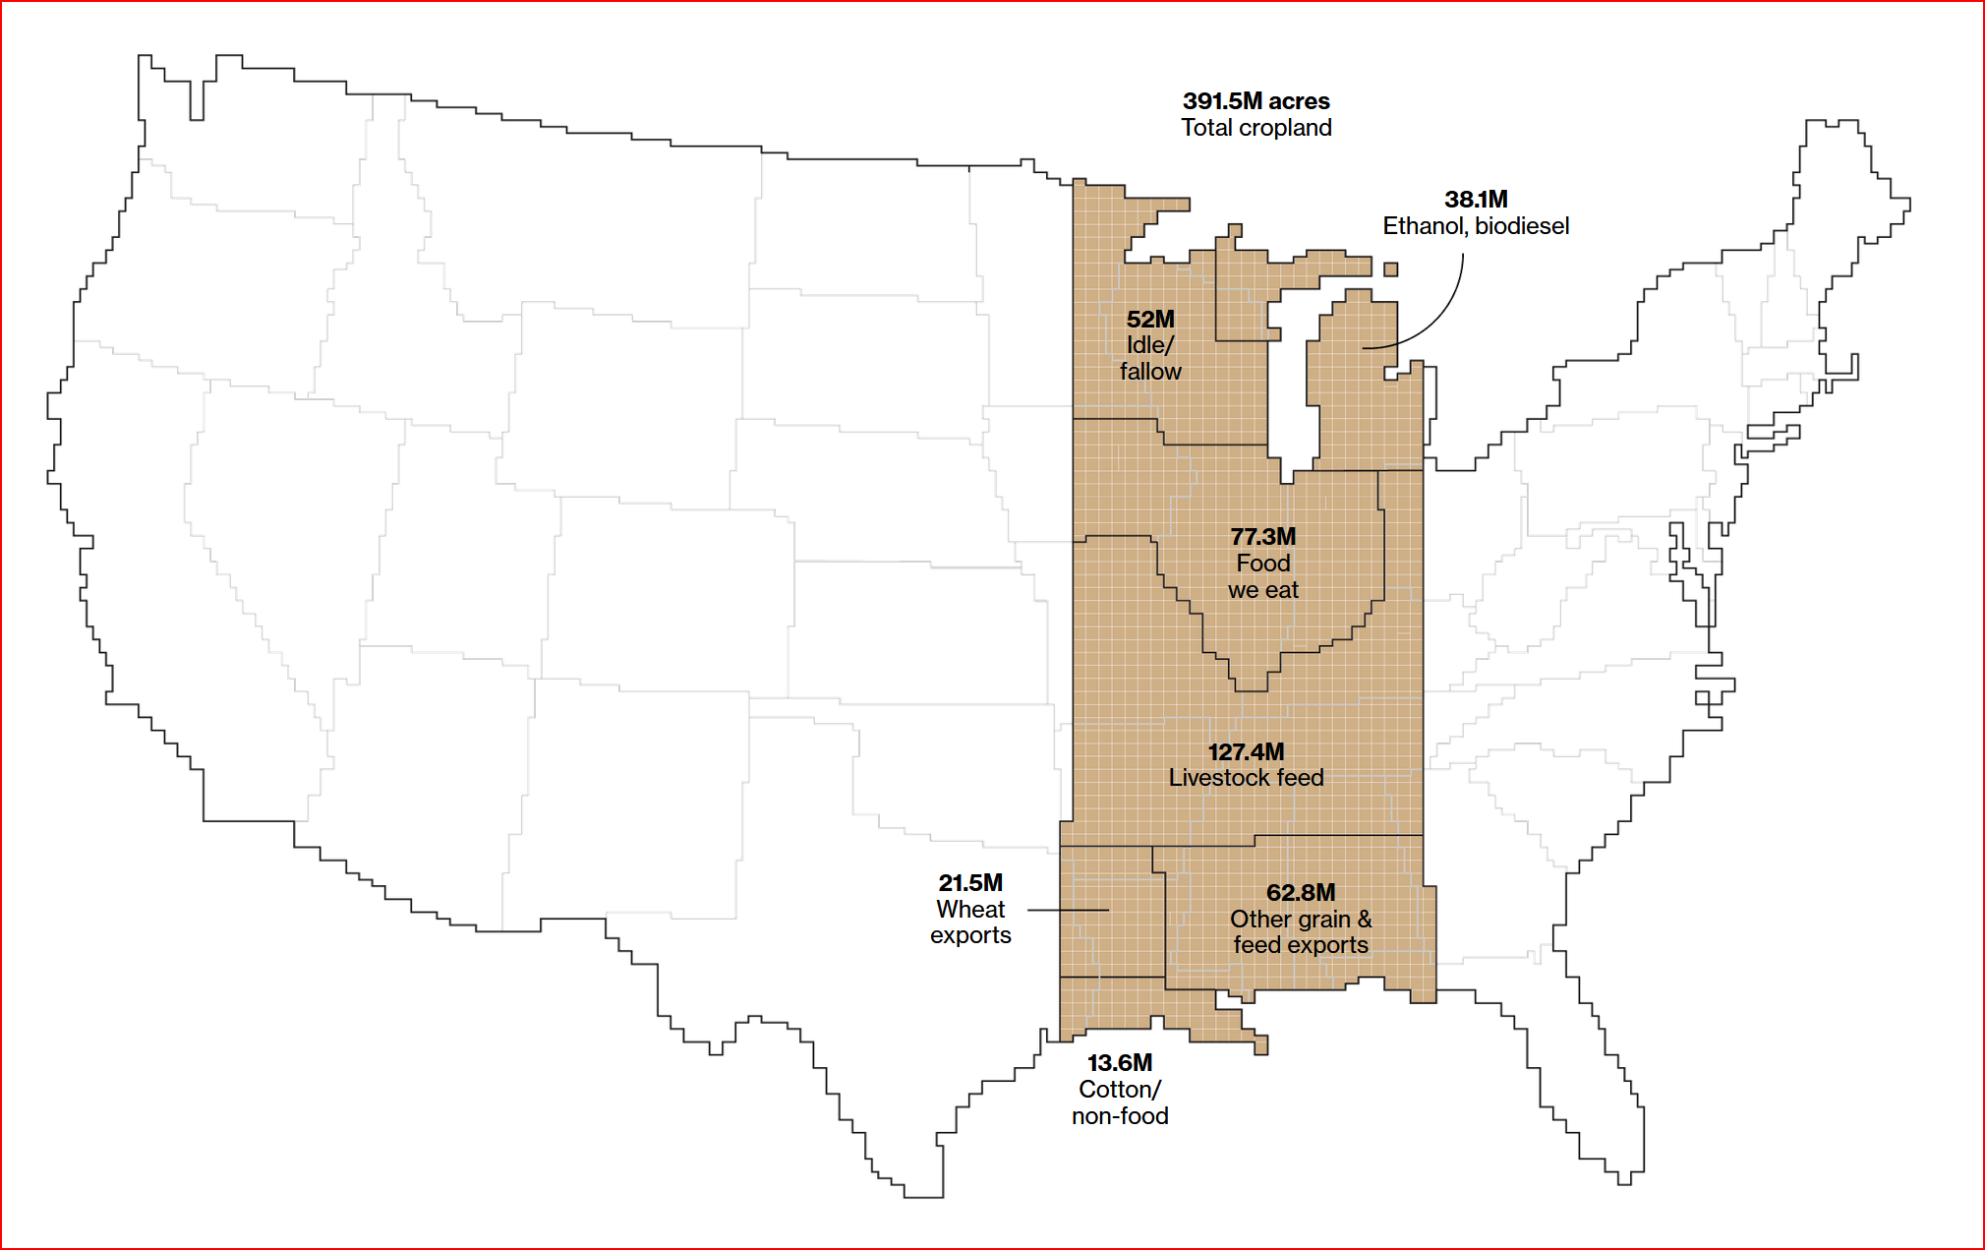
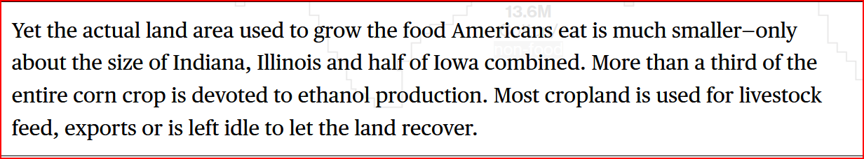
Notes:
Of this 391 million acres, 38 is used for ethanol and biodiesel
127 for livestock feed, and 77 to feed people.

Slide 13

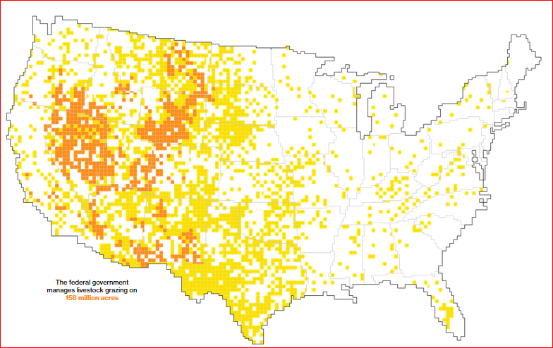

Slide 14

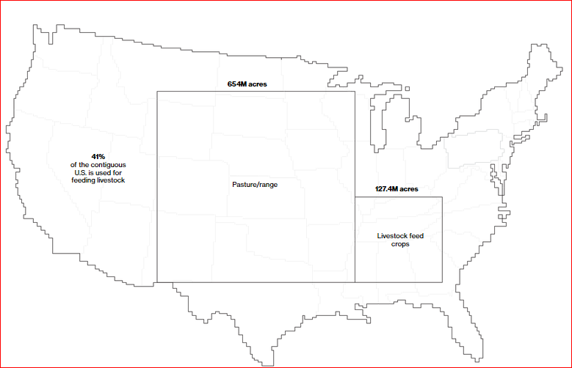
Notes:
So, of the 1,583,000 acres in crop/pasture/forest, almost all can be managed for carbon sequestration and ecological services.

Slide 15
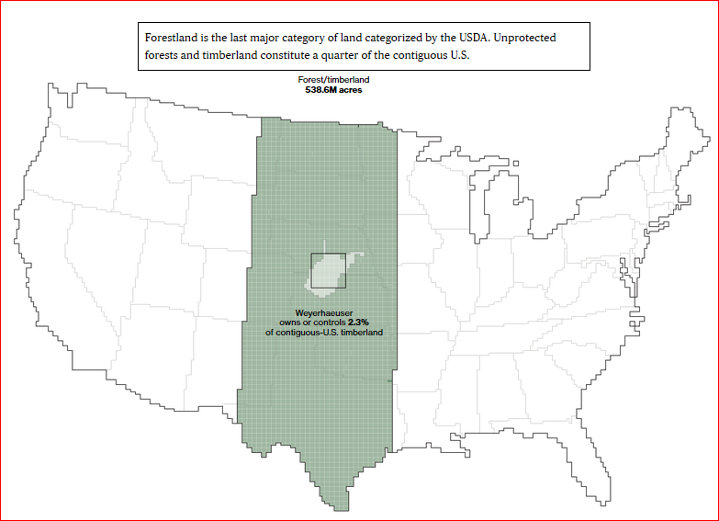

Slide 16
How can we utilize the agricultural farmland, the pasture and grazing systems, and the forests to actively sequester carbon, conserve and replenish soil through row crop, pasture and forest management practices, and be paid for it?
A Carbon Tax.
Ecological Credits.
Externality Pricing.
Agriculture will be one industry, if managed correctly, to capitalize on these monetized “eco-credits.” Iowa, with a culture of innovation, can be the leader.
AND, save the world.

Slide 17
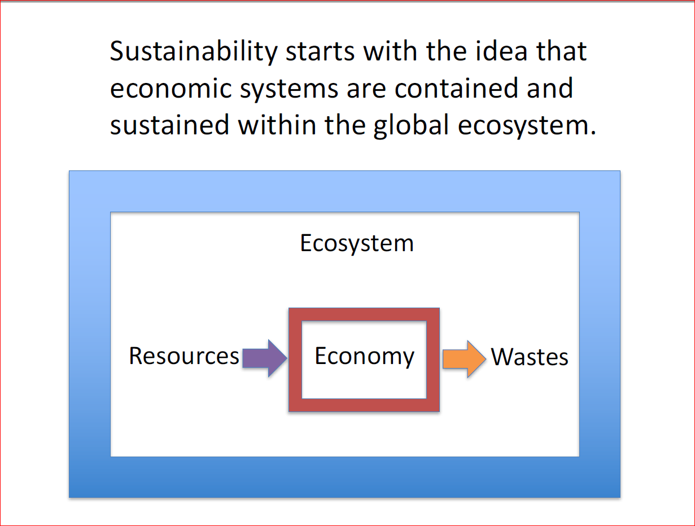

Slide 18
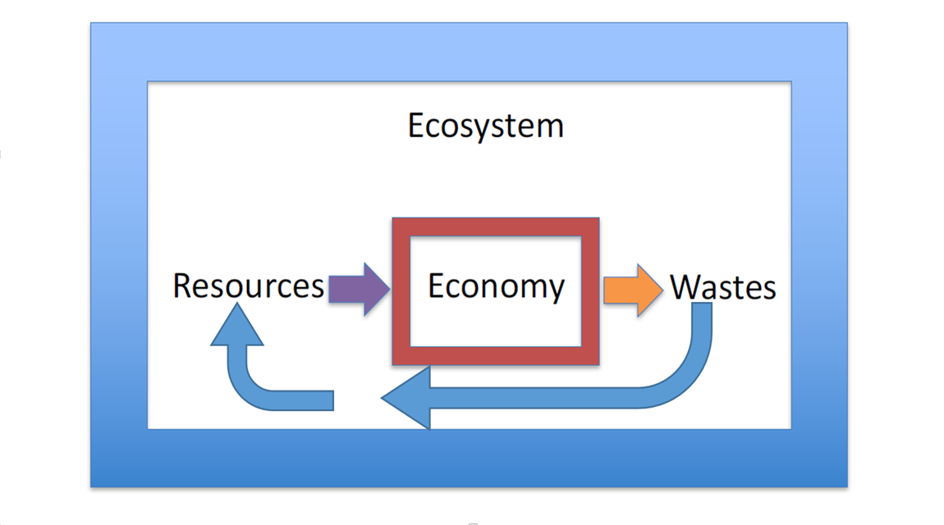
Reduce, Reuse, Recycle, Regenerate takes sustainability to the next level – utilizing the earth’s capacity and our boundless ingenuity to re-build the resources we have lost to a new level, better than when we began.

Slide 19
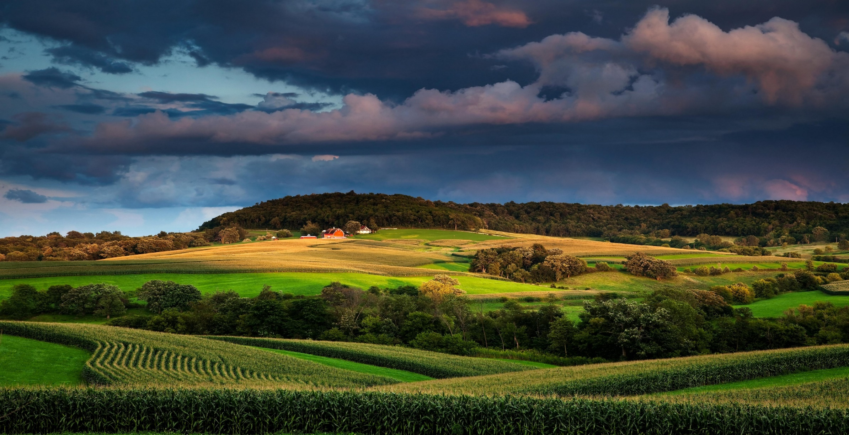

Slide 20

VISION: Our Iowa - Our soil, water, energy, food and fuel
  Iowa, the epicenter of modern agriculture, will leverage our innovation and “can do” spirit, to achieve the “Our Iowa” ideal – soil, water, energy and rural vitality that is regenerative, robust and resilient, the same as our healthy, imaginative and connected rural economy.

Slide 22
We will achieve this by:
Re-igniting and re-aligning Iowa’s lasting values with rural-urban and public-private partnerships rooted in our agricultural psyche, (“If you’re from Iowa, you’ll understand”) adding to the value and wealth of Iowa’s landscape and families. We accomplish “Our Iowa” – for us, the nation, and the rest of the world – through the development of multiple business models within the agricultural sector.

Slide 23
We will tie these models to ecological services and additional, related rural enterprises. We monetize our land ethic and the externalities that agriculture uses, and that Iowa provides. The Iowa “franchise” will be copied throughout the world. This is the re-invention of the “boom or bust,” “make more for less” model that has been the broken hallmark of agriculture for decades.

Slide 24
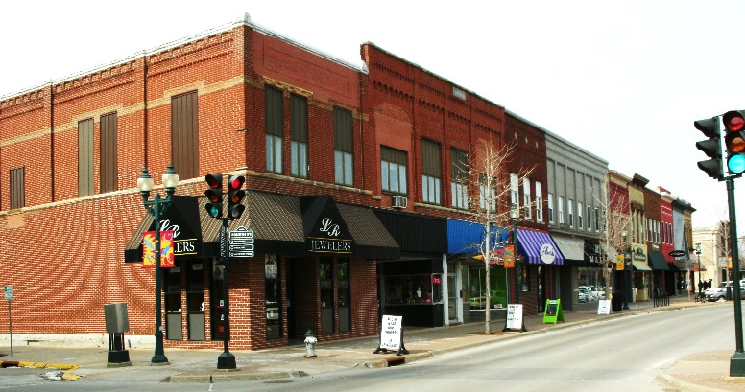
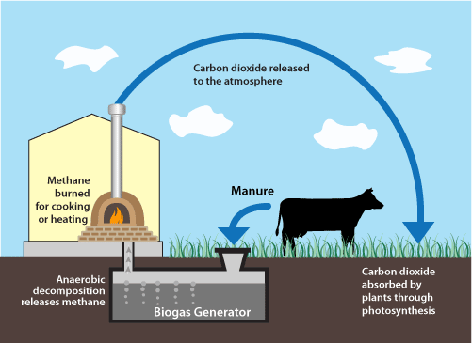
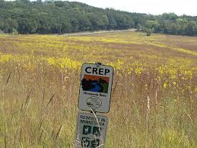
The Spiral of Decline: Iowa’s natural infrastructure and Ag Economy
Soil and water health
Iowa loses an average of 5 tons per acre of soil very year.
Stagnant rural economy, Pockets of Poverty & Hunger
Lack of variety of income streams, consolidation of large farm operations, low innovation and connectivity have decimated rural Iowa.
Wasted and Dislocated Renewable energy
Trillions of BTU’s are not utilized for energy where we need it, when we need it. Ethanol, biodiesel, wind, biogas, etc.
Degraded Agricultural Economy
Half of Iowa’s water bodies are unsuitable for drinking, fishing.
Input costs and off-farm damages exceed declining crop values

Slide 25
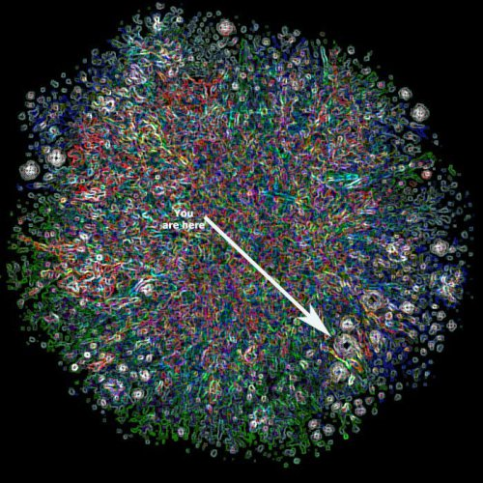
Challenge: Building the 21st Century Ag Economy from the bottom up
Restored Soil and water health
Healthy soil that stays in place cleans our water and preserves our heritage, guarantees our future.
Resilient rural economy, Wealth Creation
Adding innovation, connectivity and service for the agriculture sector
Robust Renewable energy
Optimize the harvest of photosynthesis and biomass and agriculture by- products to generate energy where we need it.
Regenerative Agriculture
Diversified Income Streams, building Soil and Resilience

Slide 26
Plan, Do, Check, Act = Desired Outcomes
Restored Soil & Water Health,
Diversified, year round income streams, multiple ecological benefits
Animal strategies - ruminants, nutritional grasses back to the prairie, manure producing units, bridge the nutrient gap
Regenerative Agriculture
Retain and Rebuild the health of our soils, adding carbon, building wealth
Slow the Flow, preventing floods, cleaning water
Building Soil Organic Matter and resilience in ag at the same time

Slide 27
Plan, Do, Check, Act = Desired Outcomes
Robust Energy Supply
Resilient Long-term Wealth Generation
New industries emerge to service growth in income streams and best practices
Continue build out of wind energy
Production of bio-gas and energy from ag products
Practices & Policies are scalable, flexible, market based
Broadband to support local service centers for Regenerative Ag
Convert Biomass to Fuel and Electricity

Slide 28
Solutions and Outcomes –
Widespread adoption of Innovative, Diversified and Regenerative Agriculture, providing resilience to food companies & consumers
  Diversified, multiple year round income streams from crops and ecological practices
Restored Soil and Water Health, Economic Development
  Retain, rebuild and profit from the health of our soils by adding carbon
  Slow the Flow, preventing floods, cleaning water, transferring risk
  Animal strategies - ruminants, nutritional grasses back to the prairie, manure producing units, bridging the nutrient gap
  Building soil, and resilience in agriculture simultaneously, profitably
Continuous Improvement – Plan, Do, Check, Act, Send Invoice
Notes:
Sir Thomas More’s Utopia describes a society where there are no markets, payments for grain, and excess is freely given to those in need.
With various programs of re-distribution in the US, from faith based pantries, to Iowa Food Bank systems, to corporate and industry contributions to food deserts, to PL 480 surplus food exports, to Supplemental Nutrition Assistance Program (SNAP) and Women, Infants and Children (WIC) programs, we are effectively using the government to re-distribute the excess. It has its detractors, inefficiencies, and cultural issues. And, of course, there is the tendency for the agricultural sector to practice massive confirmational bias. Deriding “welfare queens” while collecting crop insurance and direct payment subsidies for their operations is perplexing. Especially when SNAP and WIC are buying their products. We are living in More’s Utopia, and hate it.
Upton Sinclair, the famous “muckraker” of the gilded age, used to say, “It is difficult to get a man to understand something when his salary depends upon his not understanding it.” And yet a salary is not unique in this respect. We regularly rationalize, justify, and otherwise employ our cognitive faculties toward all manner of goals other than objective accuracy. This is often called “motivated reasoning”. I focus here on ideologically motivated reasoning (IMR), taking as a prime example the role of free-market ideology in climate change denial in the US. Ideology provides an especially potent example of what can garner our allegiance and warp our cognition, because when we become invested in it, we easily become identified with it. Importantly, this happens in a social context: all too often, shared ideology is our ticket to community, to belonging, which for a human animal is closely tied to survival.

Slide 29

Notes:
Its called systems thinking. Should be taught, along with Logic, in grade school. The interconnectedness of all things.
You can’t do one thing without something else being affected.

Slide 30
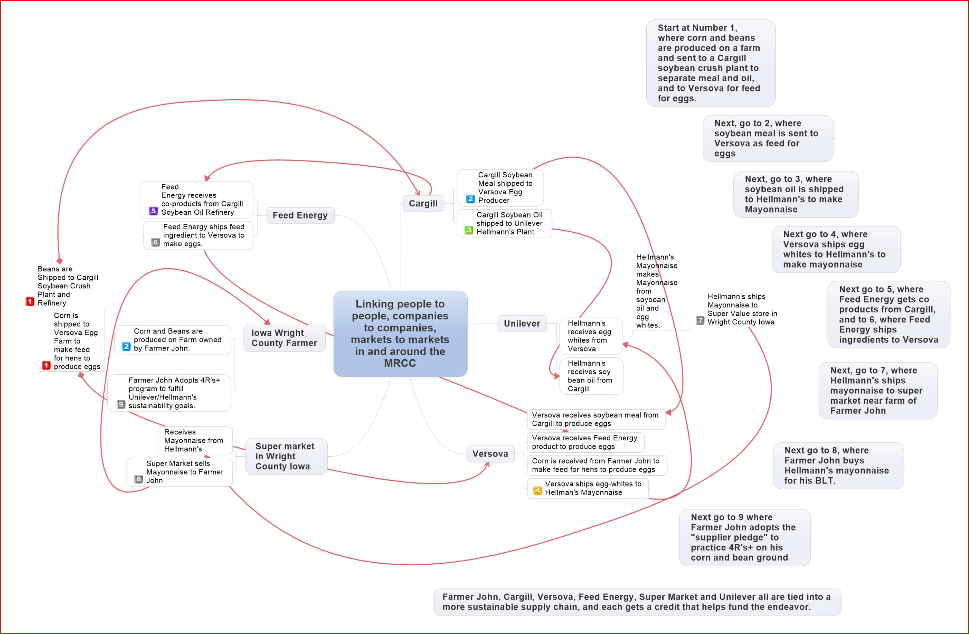
An Example of Supply Chain Sustainability and Value-added externality payments

Slide 31
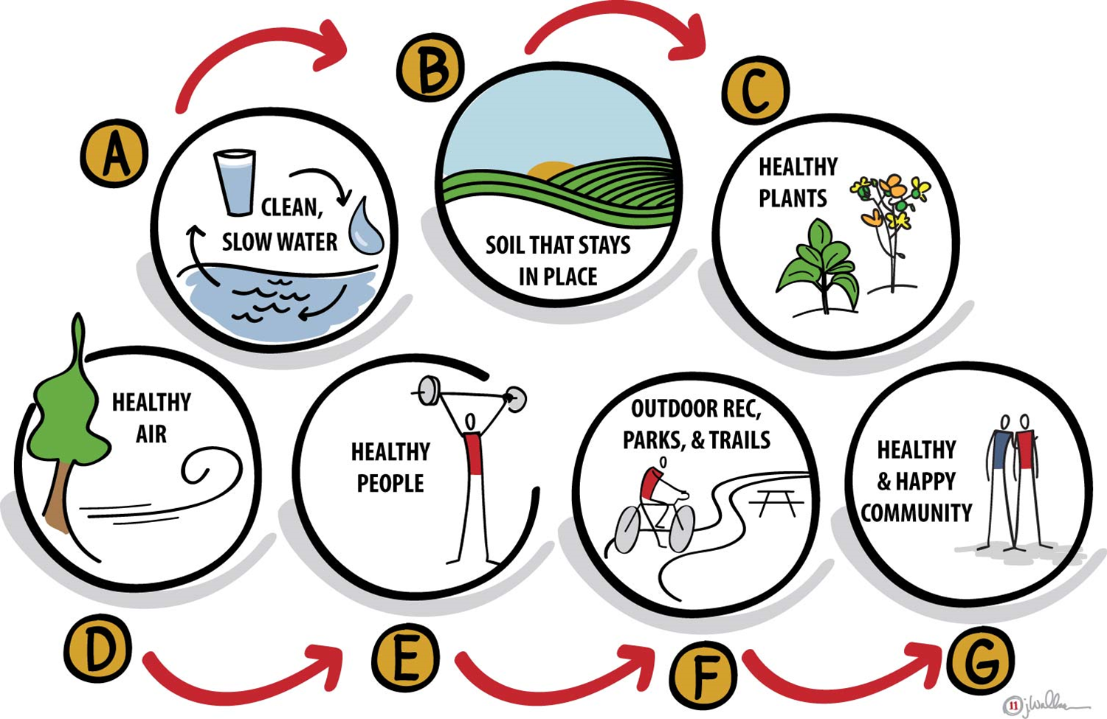
Notes:
This is a slightly adjusted look at the systems we all know and love, but puts emphasis on
The unfamiliar things in our world that promote sustainability.
When one part is ignored, the system teeters, wobbles, collapses and breaks.
highlighting the interconnectedness of forest ecosystems, the book offers fascinating insights about the fungal communication highway known as the “wood wide web,” the difficult life lessons learned in tree school, the hard-working natural cleanup crews that recycle dying trees,
Society will not allow the agriculture community to let that happen
Regulation will follow

Slide 32
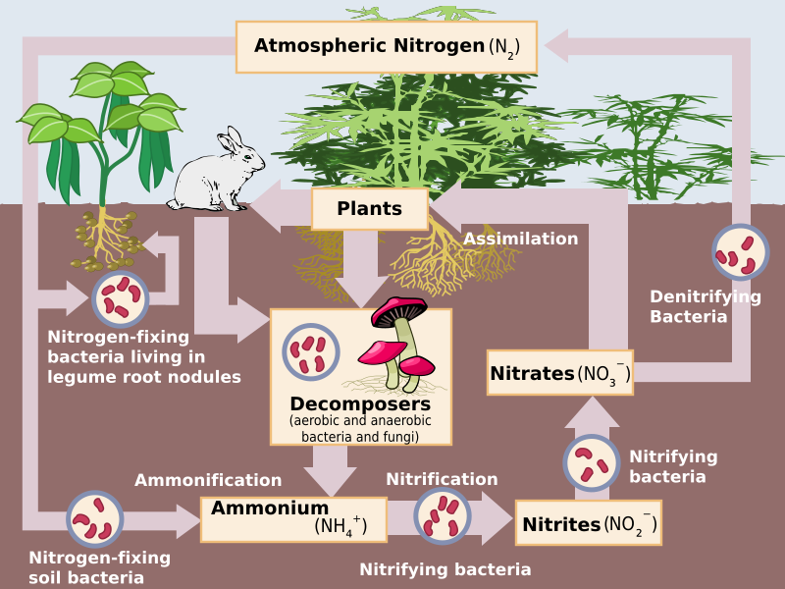

Slide 33
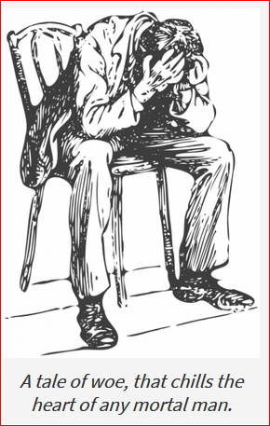
Policy from National and State Legislatures
A Last resort, taking into account their dysfunction.
Notes:
Ptsd, and borderline personality disorder are rampant.
This is a sidebar about the mental health issues in rural Iowa – ptsd, bPD, opiods, obesity,
Chaos -→ PTSD -→ BPD
Uncertainty about the future
Anxiety
Children will not succeed
Money will be insufficient
Time is our enemy
Jobs are fleeting, unstable
Loss of locus of control
Cycle of anxiety
Depression
Hopelessness
worthlessness
Helplessness
Resignation
Woe is me
Why try
Deck Stacked against me
I'll just give up
Fixation on past failures
Fear
Rejection by society
Separation from family
Abandonment by friends
Suspicion of others
Good - evil - good cycle of outlook on friends
Mood swings with Chaos as norm to be sought
Hoarding, Selfish - not enough to go around
Increased cravings
Over eating
Frenzy, Nervous, Jumpy
On edge
Volatile
Snappy outbursts
1/2 cocked in pissed off position, irritable
Controlling, dictatorial
Seeing everything as a stroke of luck or chance
Promotes risk taking and gambling
Discounts that chance favors the prepared mind
Will substitute/procrastinate to allow for "ship to come in" - seems lazy

Slide 34
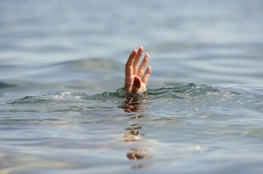
Notes:
Many towns and counties in Iowa feel like they are drowning.
Should we let them drown? Close the school, the post office, making sure the ratio of people paying taxes fits the services that are rendered?
Do we allow our rural communities to be the keeper of the poor, the meth and opioid addicts, poor transportation options, no general health care within 30 miles,

Slide 35
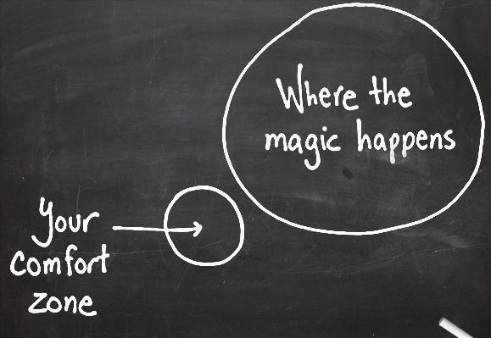

Slide 36
What did I tell you - “Our Iowa” Wants you to:
Through innovation and internet connectivity, jump start rural economic development.
Adopt the “Our Iowa” Grand Strategy
  Use our land for multiple ecological services & benefits
Devote Permanent, Reliable, Adequate and Timely public & private funds, plus smart policy to this strategy
  Demand measureable results, leverage and metrics from the Iowa Nutrient Reduction Strategy to legitimize public and private investment
Through innovation and internet connectivity, jump start rural economic development.
Ask each Legislative and Executive Candidate to Adopt these approaches

Slide 37
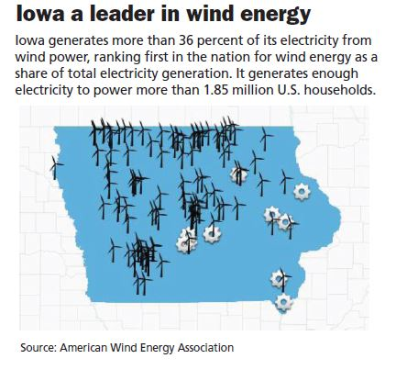
Notes:
What is the top capacity for windmills in Iowa? How many can we handle? Transmission?

Slide 38
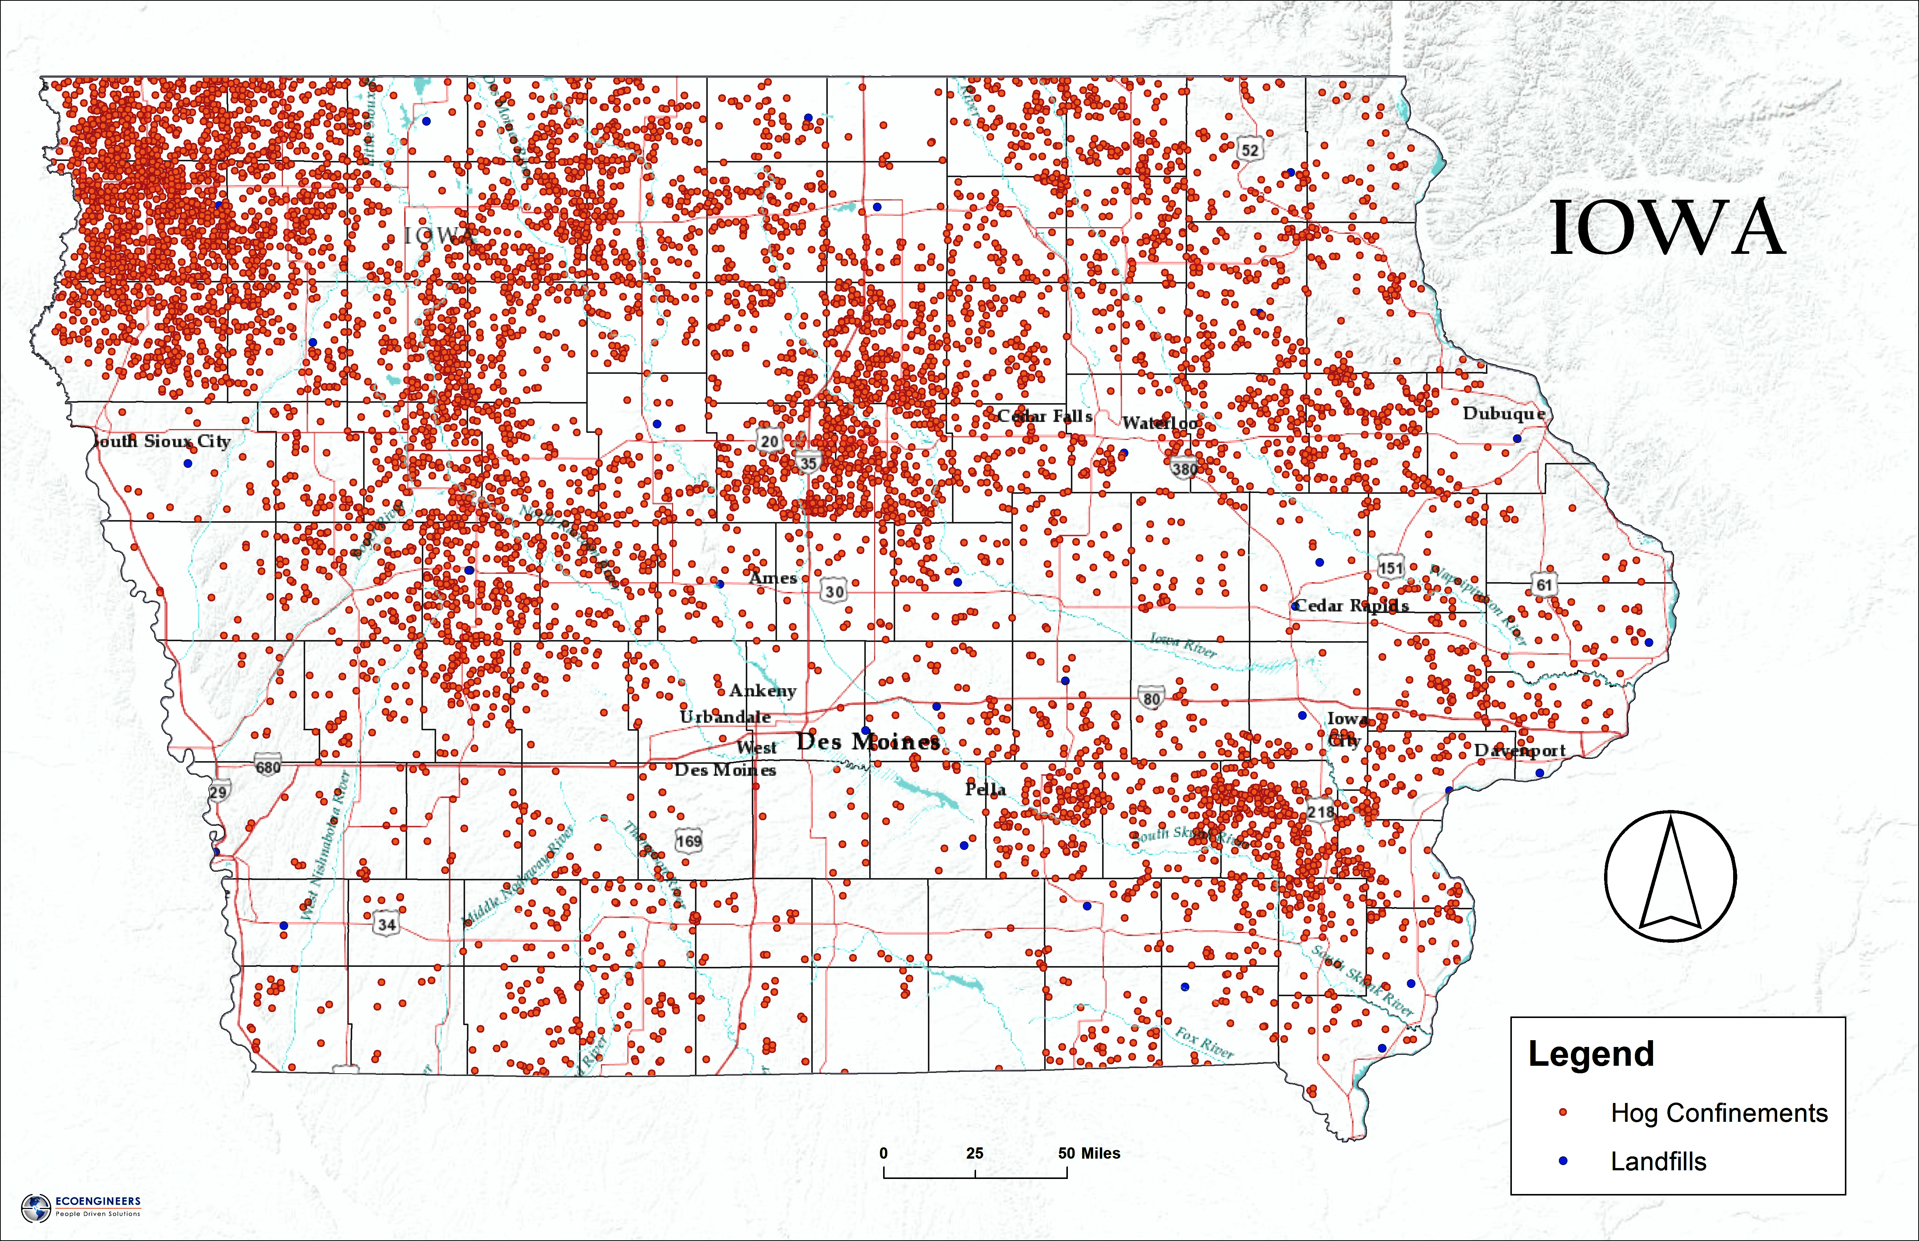

Slide 39
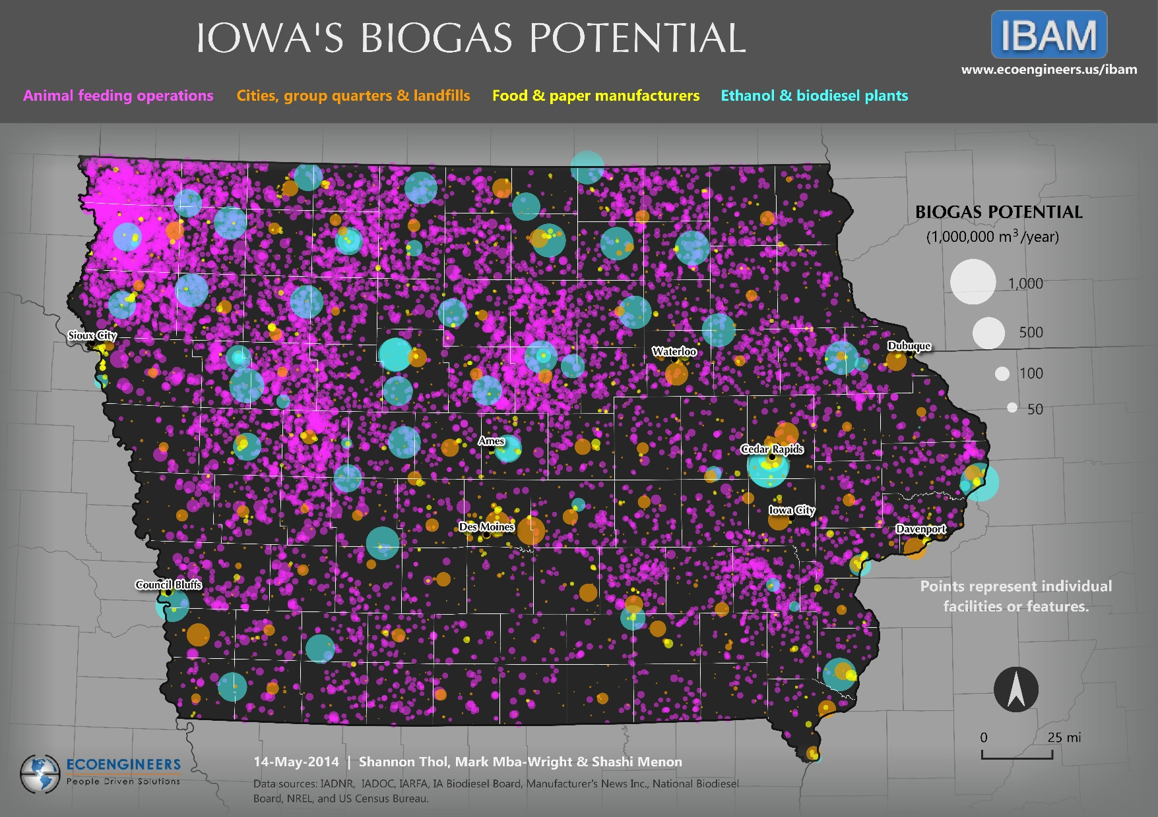

Slide 40
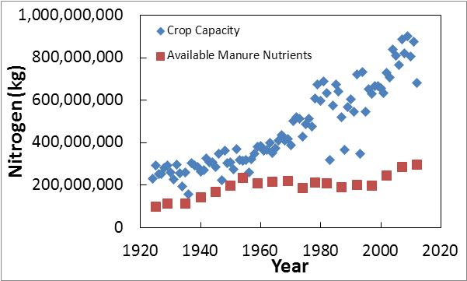
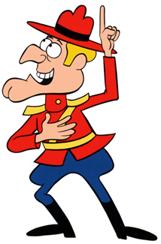
More Manure for the Nutrient Gap?
Notes:
Sir Thomas More’s Utopia describes a society where there are no markets, payments for grain, and excess is freely given to those in need.
With various programs of re-distribution in the US, from faith based pantries, to Iowa Food Bank systems, to corporate and industry contributions to food deserts, to PL 480 surplus food exports, to Supplemental Nutrition Assistance Program (SNAP) and Women, Infants and Children (WIC) programs, we are effectively using the government to re-distribute the excess. It has its detractors, inefficiencies, and cultural issues. And, of course, there is the tendency for the agricultural sector to practice massive confirmational bias. Deriding “welfare queens” while collecting crop insurance and direct payment subsidies for their operations is perplexing. Especially when SNAP and WIC are buying their products. We are living in More’s Utopia, and hate it.

Slide 41
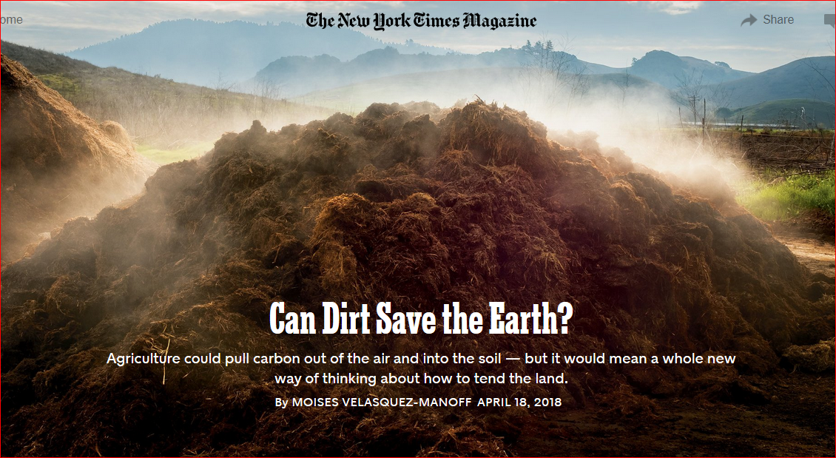

Slide 42
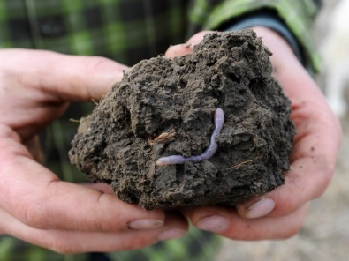
Hmmm. Maybe we should start a Center at ISU that does ag innovation and sustainability, like Aldo Leopold preached… Wait, been there, done that, got the T shirt.
Image: USDA NRCS

Slide 43
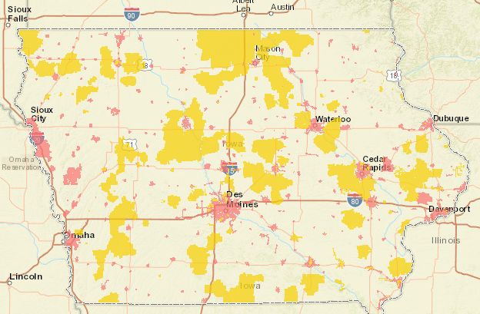
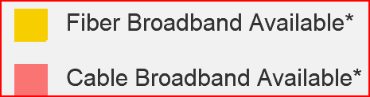
Glass Fiber & Cable Broadband Coverage - Iowa
http://www.connectiowa.org/mapping/_interactive_map_interface/?q=map

Slide 44


Slide 45
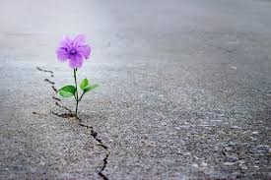
Iowa is not a place where hope goes to die… Iowa is a place where dreams go to thrive.
Notes:
Iowa is not a place where hope goes to die… Iowa is a place where dreams go to thrive.
Order
Certainty about the future
Belief in internal locus of control
Calmness
The children will prosper
We will have enough money
Things will unfold in due time
Confidence in society = job stability
Courage, bravery
Self-confidence and resilience
Self-sufficiency, strength that attracts
Success breeds camaraderie, trust
Virtuous cycle of community building
Stable personalities, predictable reactions, stable institutional baseline
Charitable, Unselfish - ever expanding pie
Peace of mind
Prepared for contingencies
Hope
Calm
Empathy for others
Open to consensus
Systems Thinking -
Connected Universe
Logical outcomes
Resilience
Positive Mental Attitude

Slide 46
As Churchill said in June of 1940
“In casting up this dread balance sheet and contemplating our dangers with a disillusioned eye, I see great reason for intense vigilance and exertion, but none whatever for panic or despair.”

Slide 47
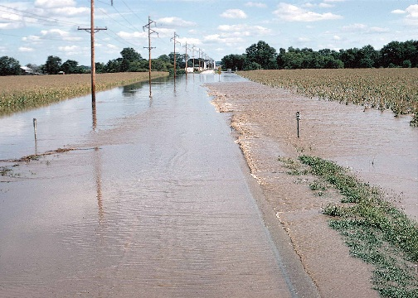
Pay Attention to the Externalities
“Do unto others downstream as you would have those upstream do unto you.” – Wendell Berry

