Slide 1
Vision for Private Land Protection 2018 SOIL CONFERENCE Joe McGovern President
Notes:
Start with introduction of yourself and how you became involved with INHF.

Slide 2
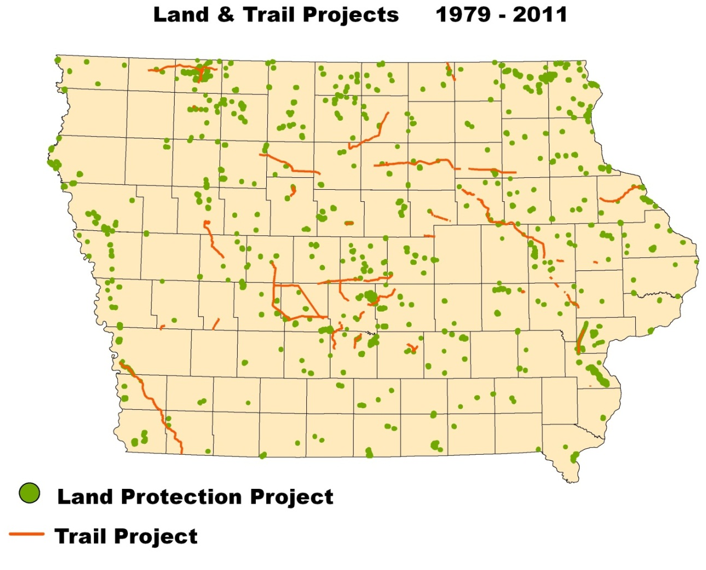
Land and trail projects
Land and Trail Projects
168,000 acres (nearly 1300 sites)
96 counties
Public Parks, Conservation and Wildlife areas
Rail-trails
Privately protected Conservation Easements
Celebrating our 40th Anniversary in 2019
Notes:
2

Slide 3
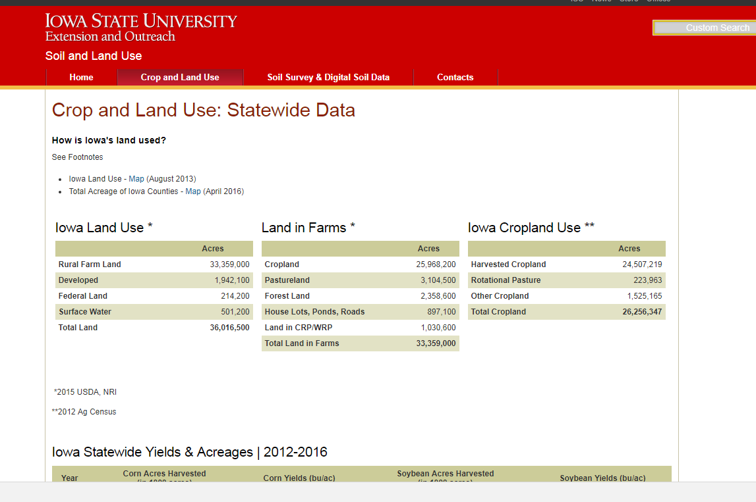

Slide 5
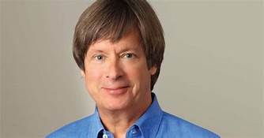
“The one thing that unites all human beings, regardless of age, gender, religion, economic status, or ethnic background, is that, deep down inside, we all believe that we are above-average drivers.” ― Dave Barry, Dave Barry Turns Fifty

Slide 6
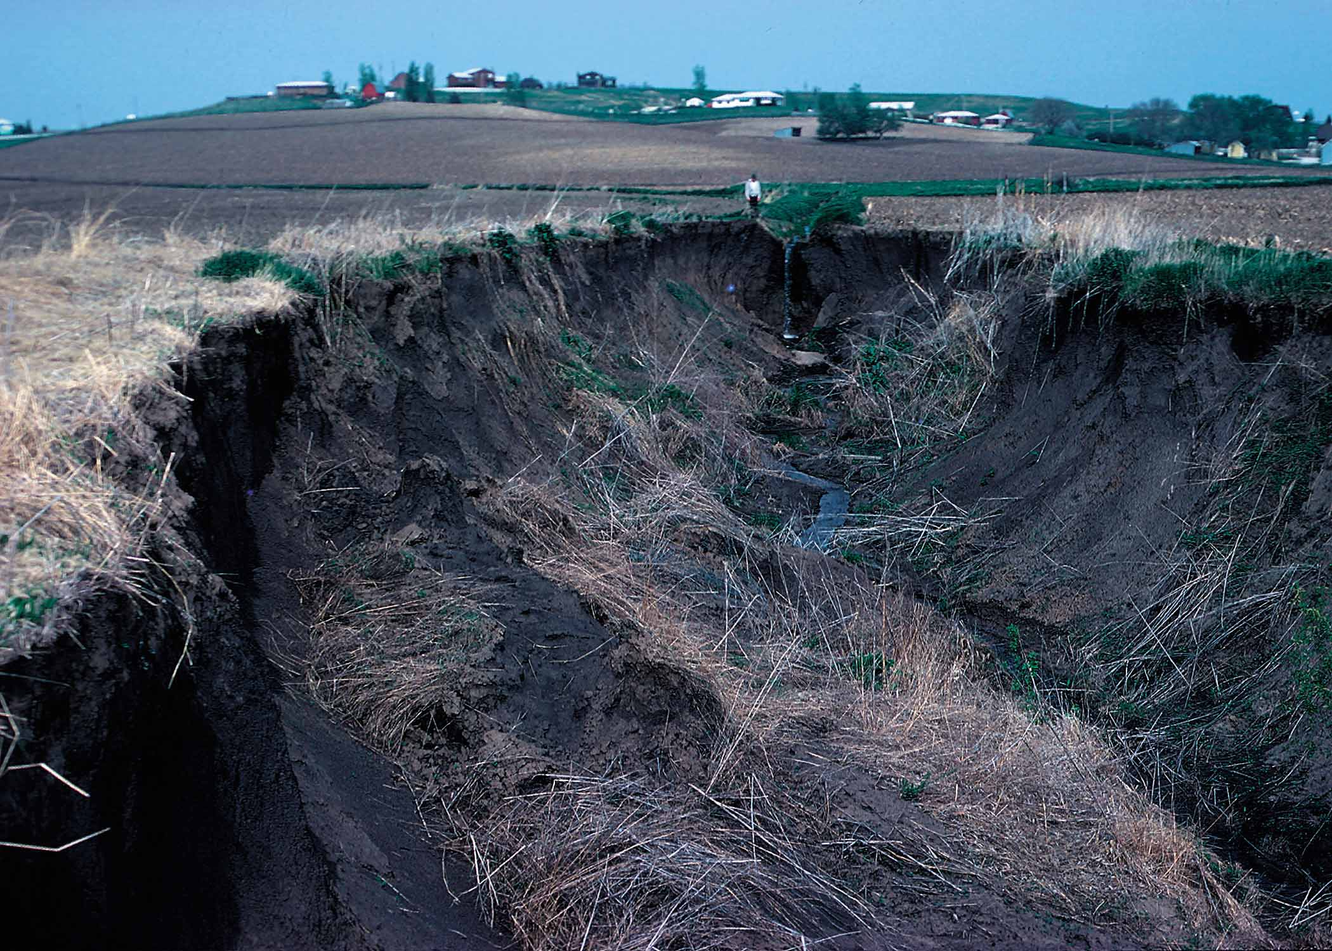
Who’s Fault?
Responsibility?

Slide 7
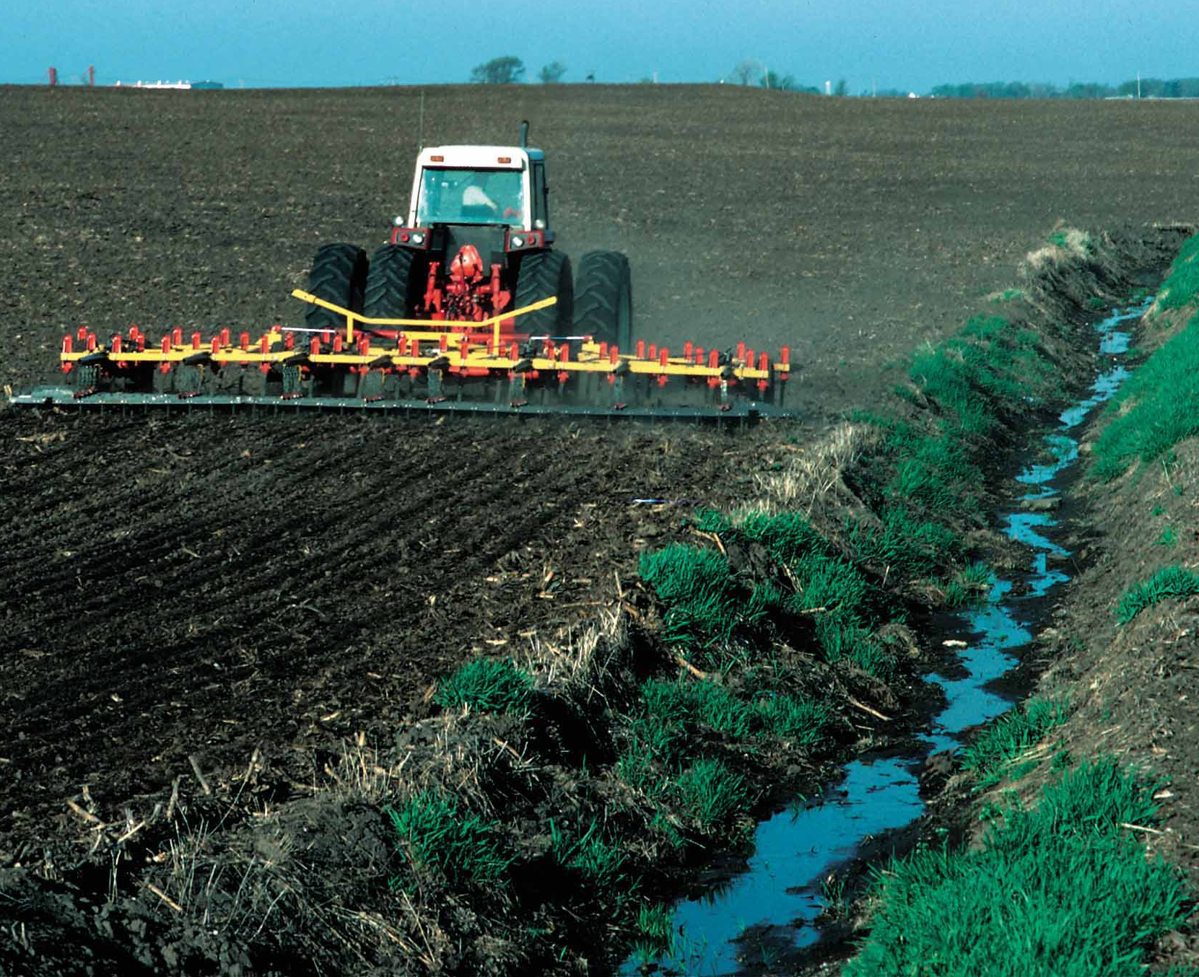

Slide 8
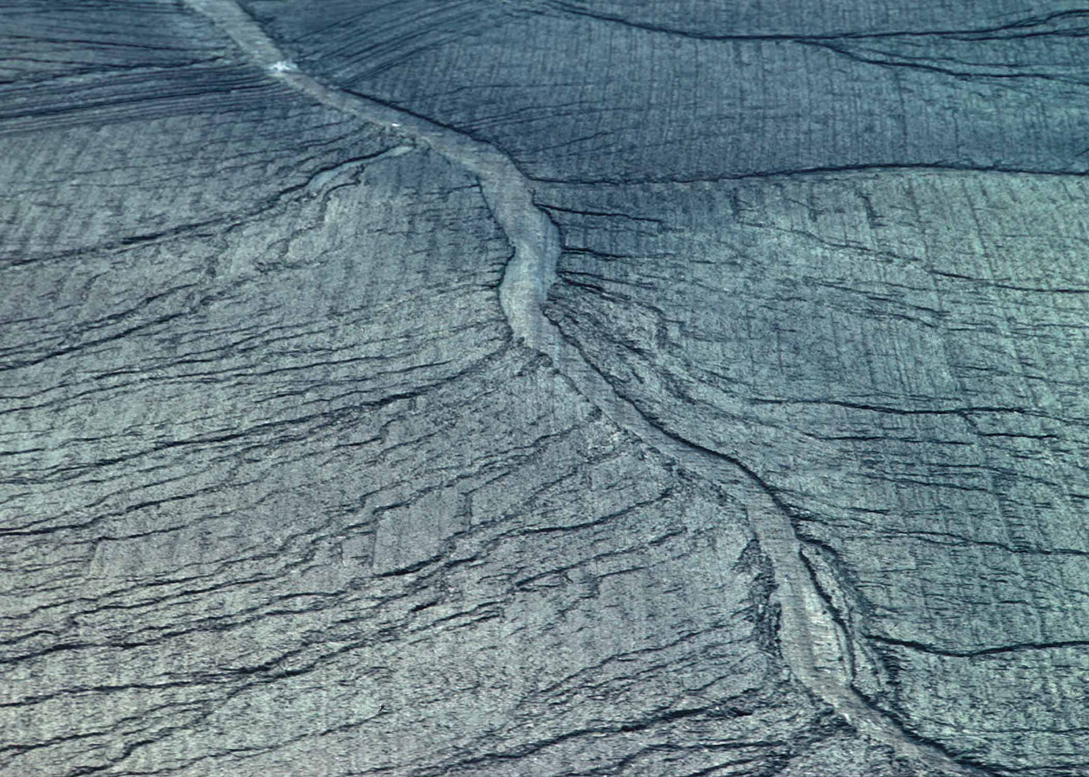

Slide 9
Notes:
?

Slide 10
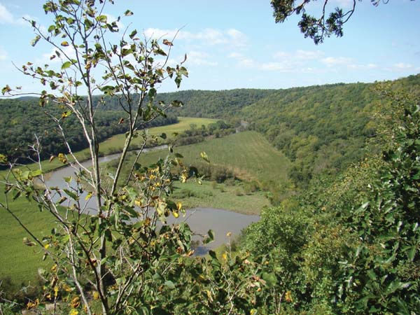

Slide 12
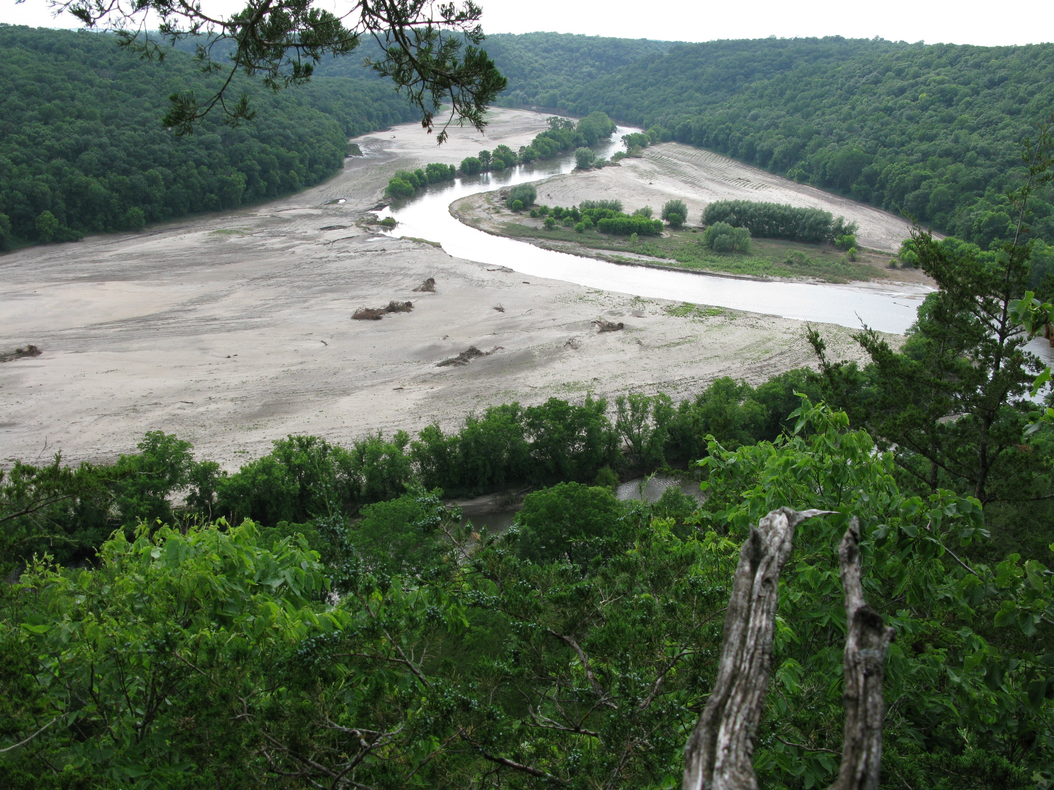

Slide 13
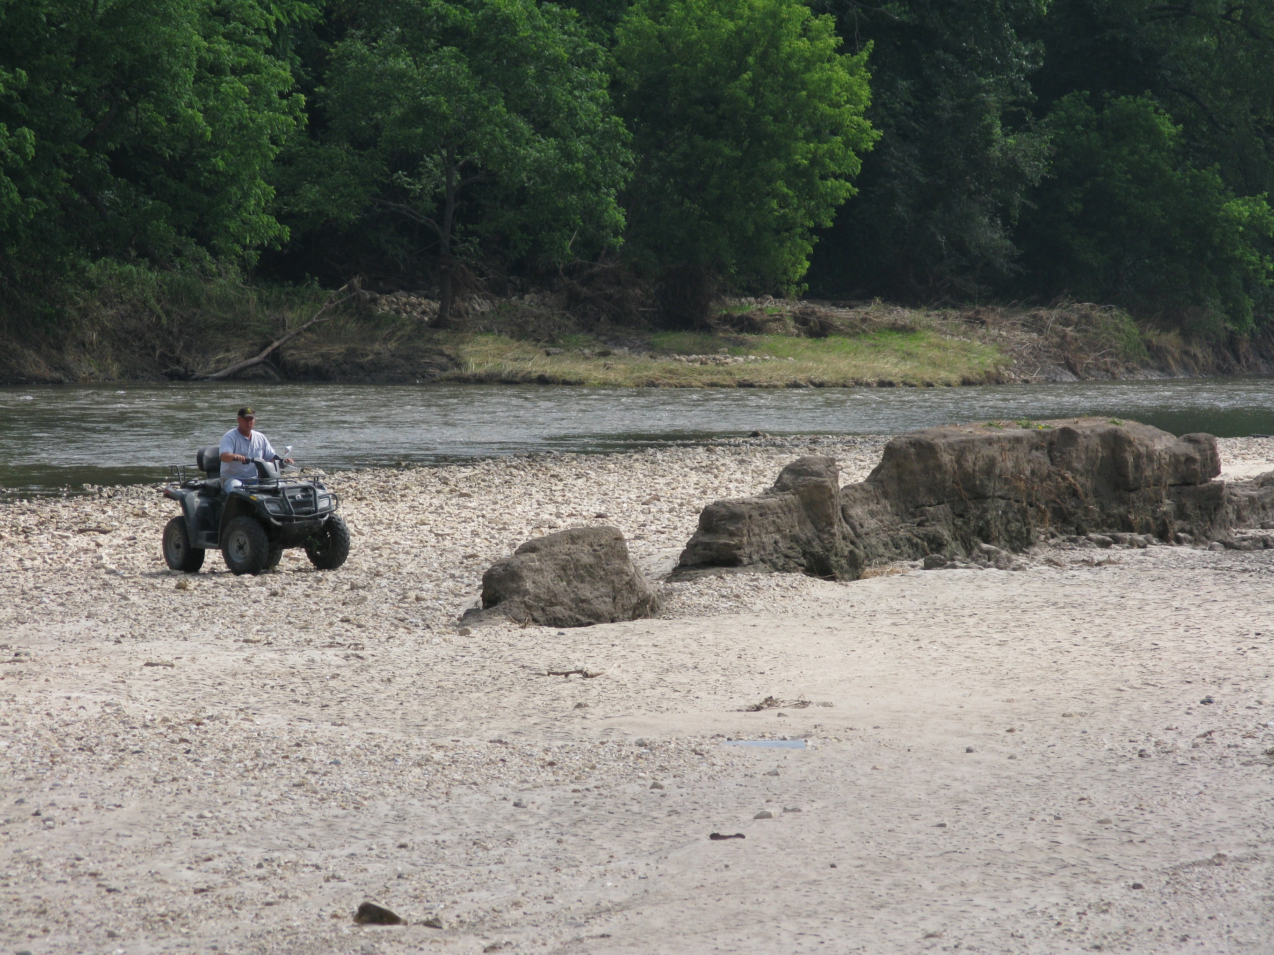

Slide 16
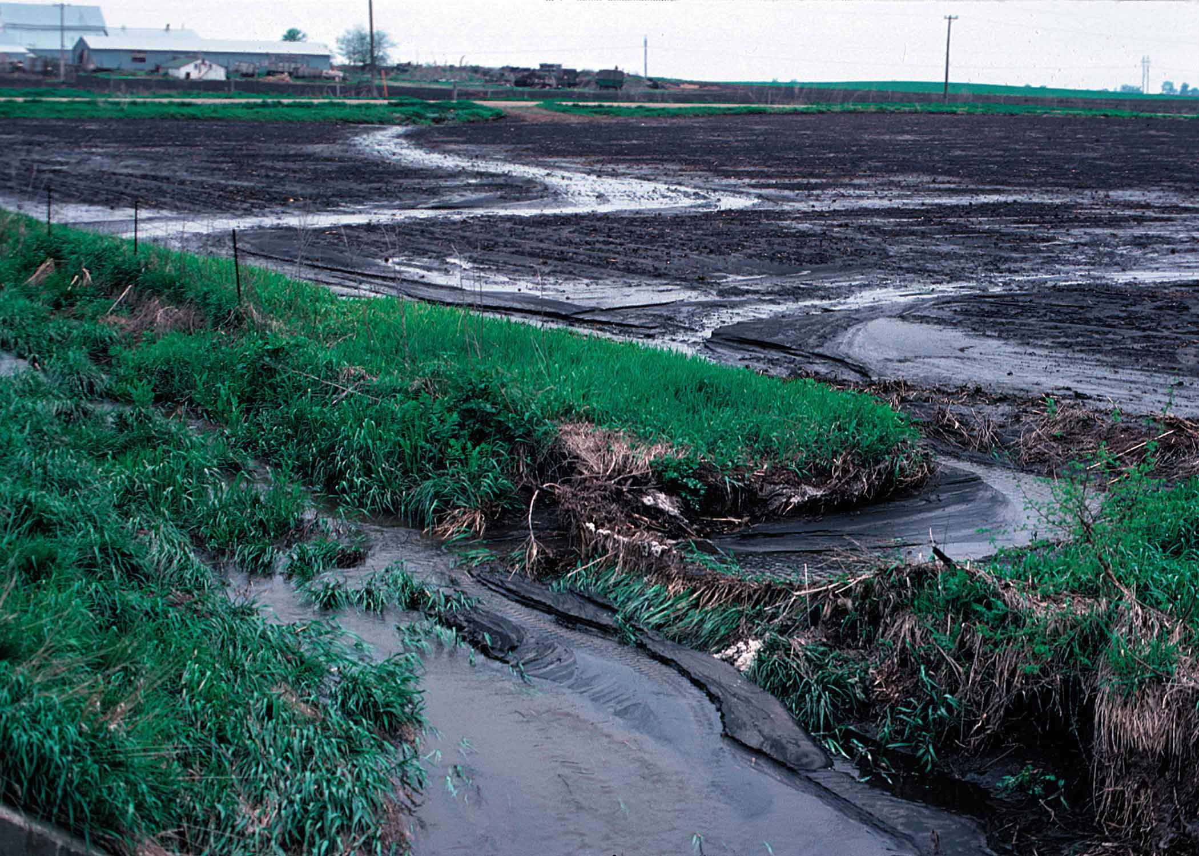

Slide 17
Swan Lake: September 2018

Slide 19
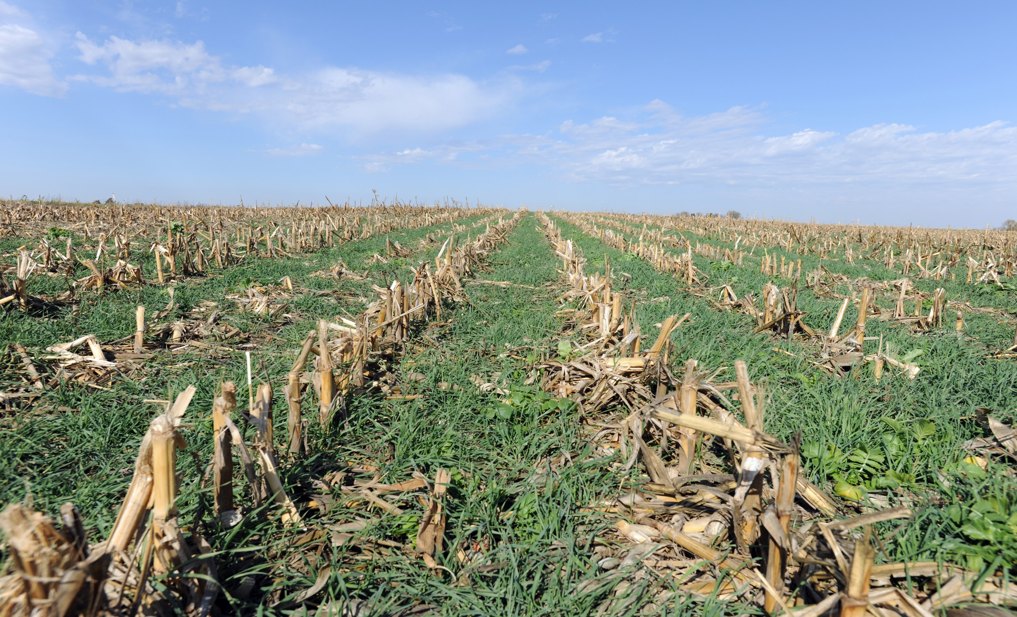
Soil and Water Conservation
Cover Crops
Notes:
19
This is what those investments look like: Cover Crops

Slide 20
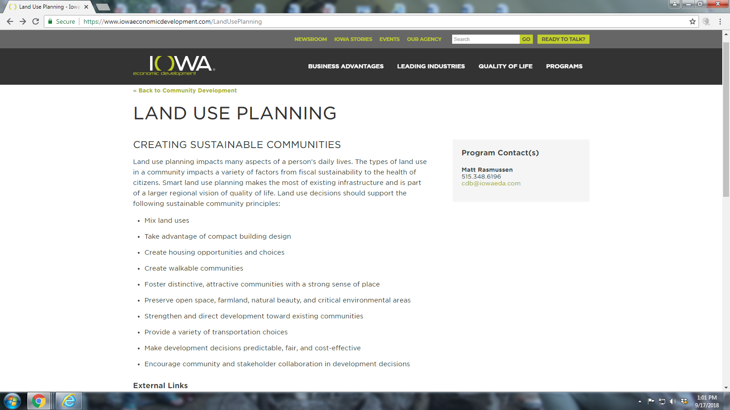

Slide 21
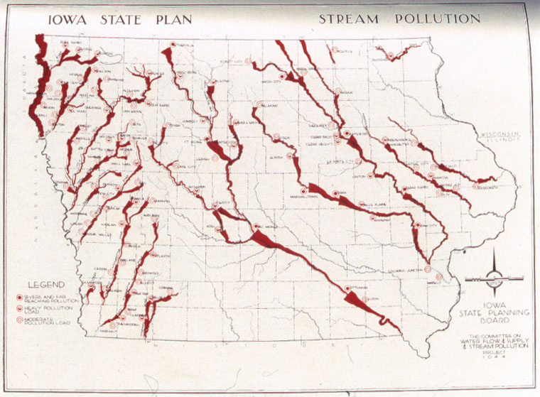
1935

Slide 22
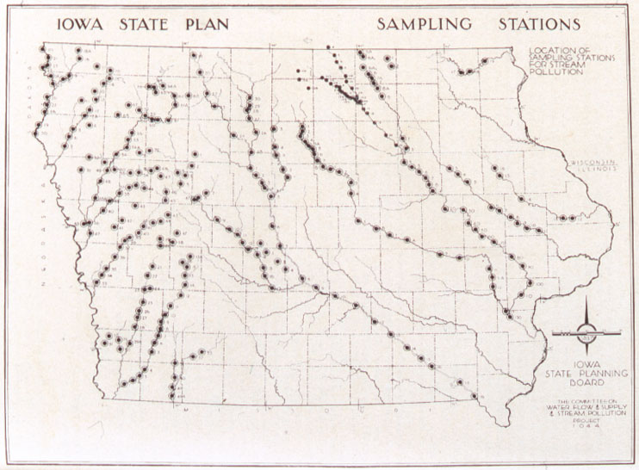
1935

Slide 23
1978
State of Iowa Water Plan
1999
+ 1970’s Basin Studies
1999

Slide 24
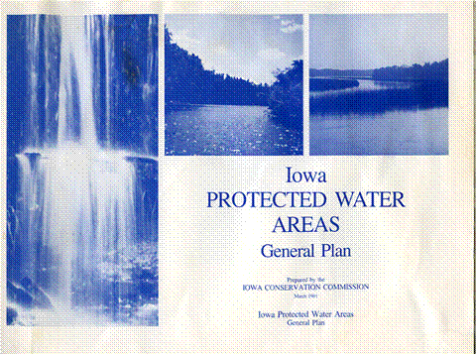
1981

Slide 27
Statewide Land Use Plan?
Iowa 97% Privately owned
Comprehensive for all land uses
Cost of permanent protection?
Pros and Cons
Political will?
Private Land Protection as the main tool?
Would we even need it, if we had good stewards everywhere?

Slide 28
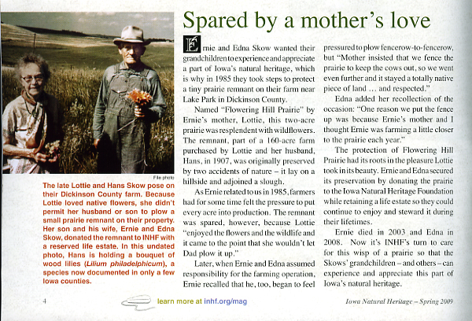

Slide 29
Cover crops planted July 28, 2018

Slide 30
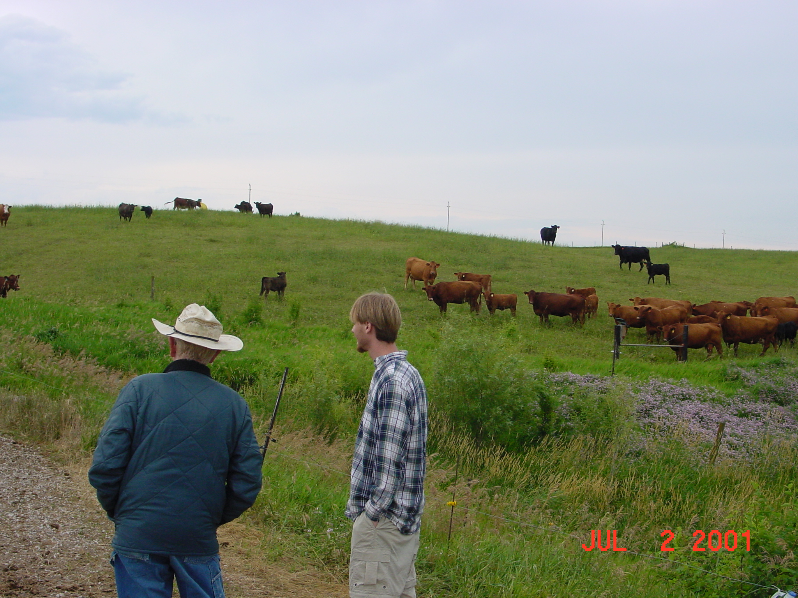
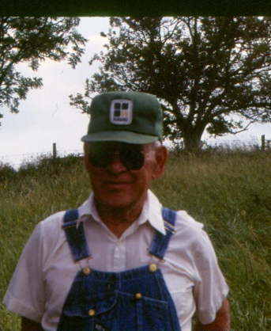

Slide 31
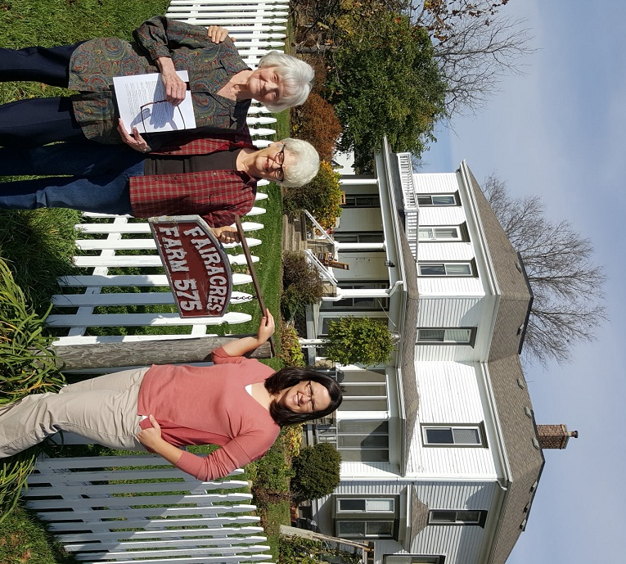

Slide 32
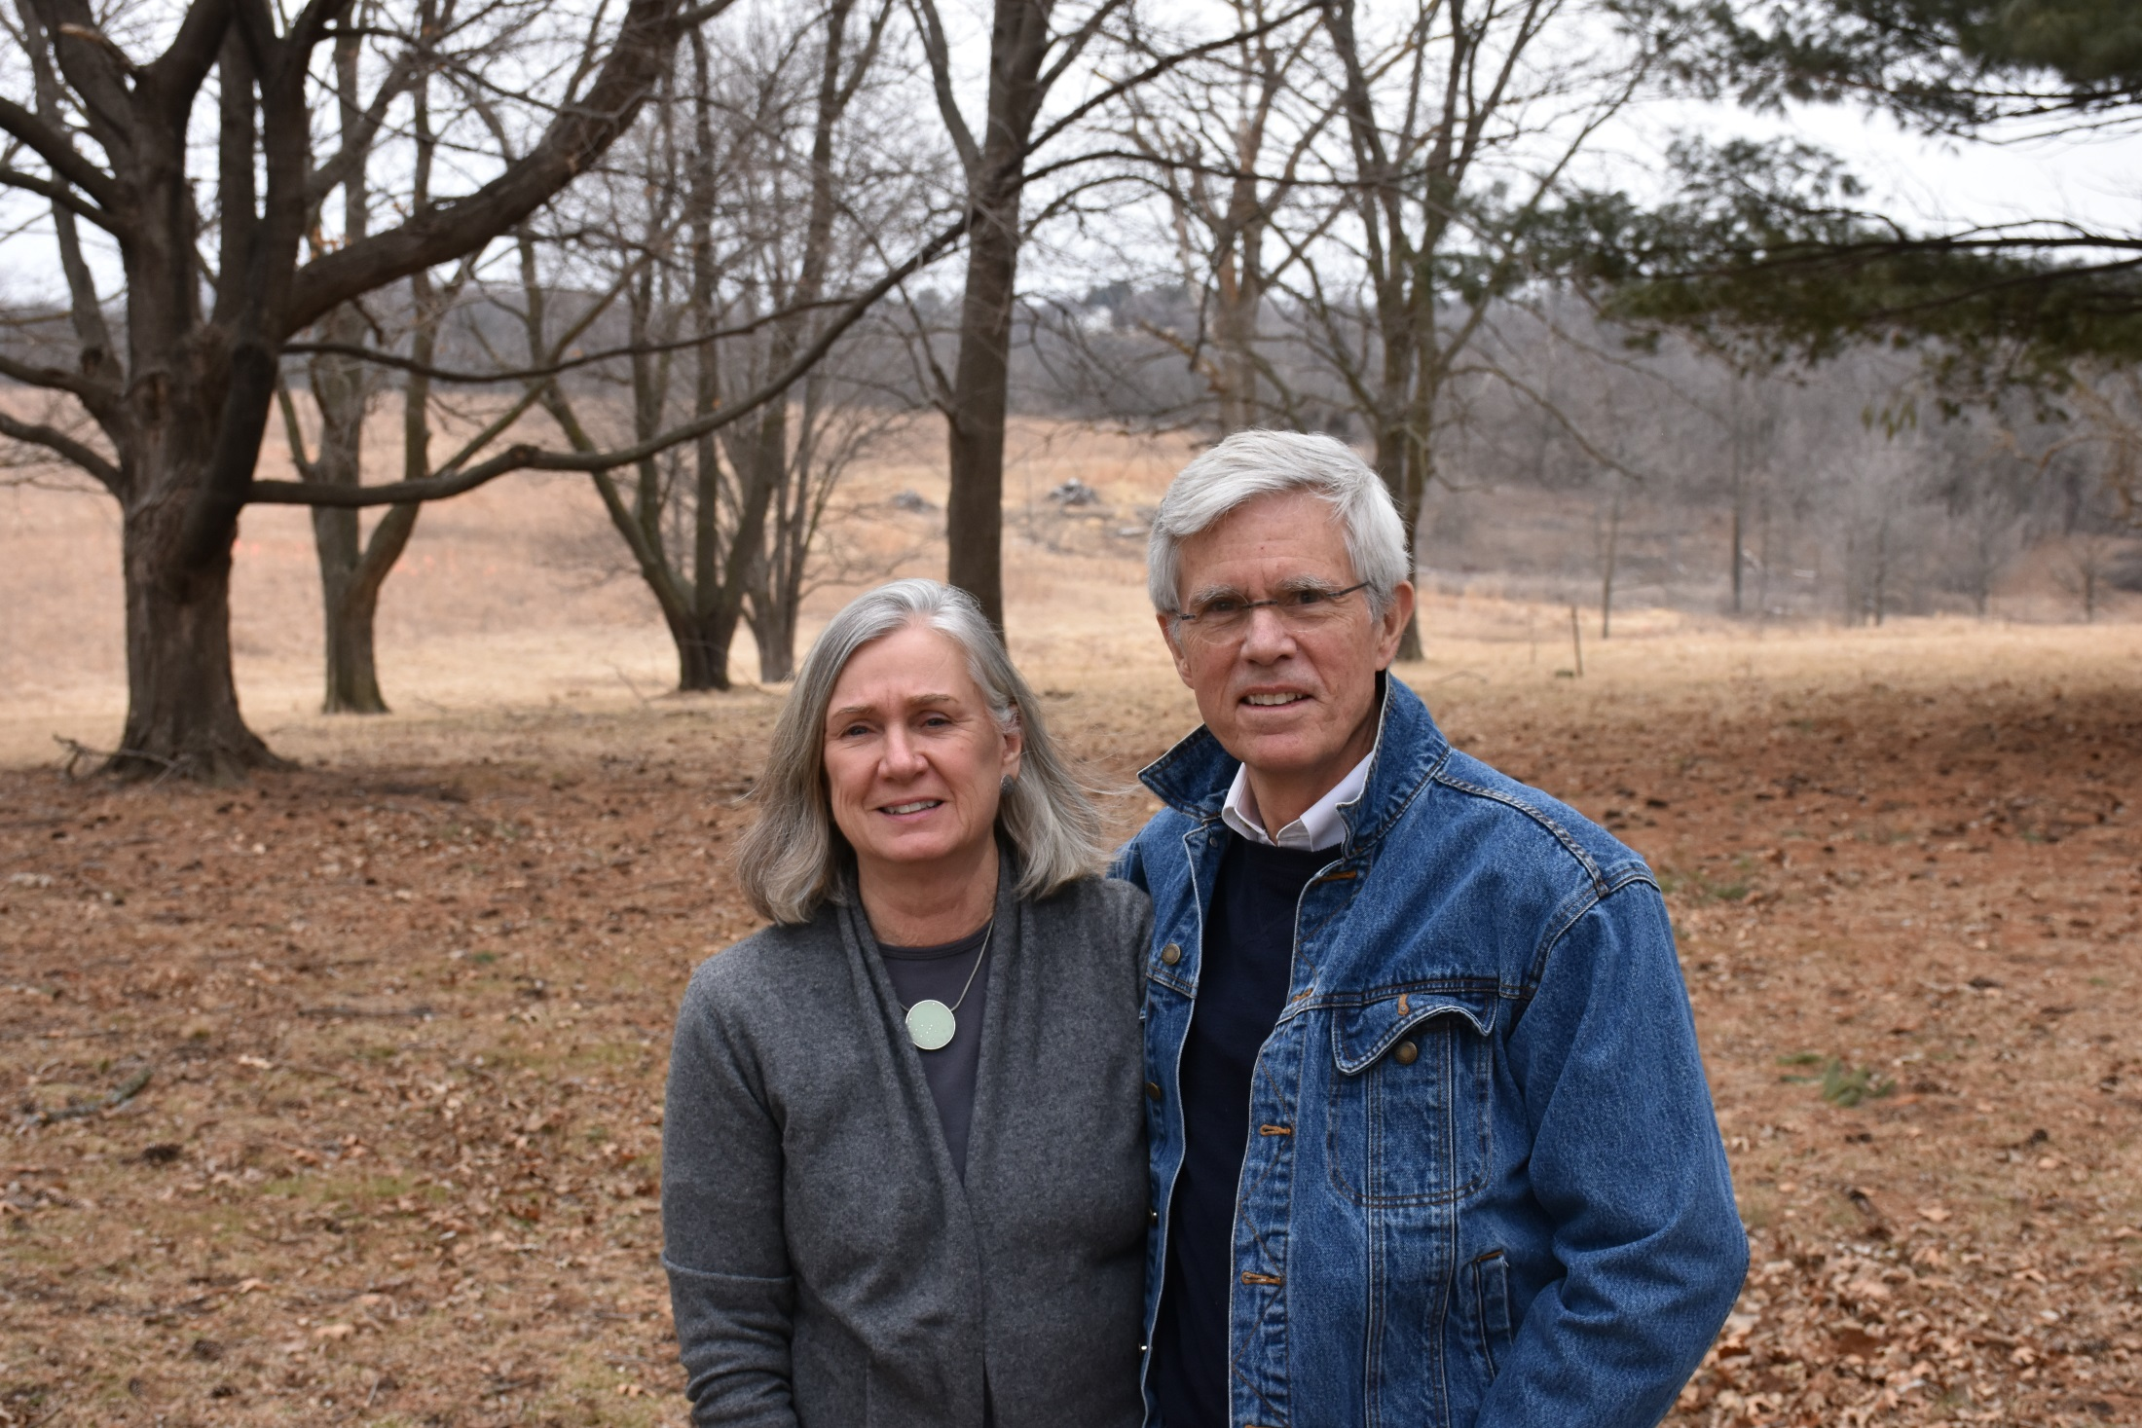

Slide 33
Key Components of Private Land Protection
Good Land Stewardship
Education/Teaching next generation
Good Estate Planning
Permanent Protection
Fee-title ownership (NGO, Public, etc.)
Conservation Easement (private land)
Flexibility
Resiliency

Slide 34
Conservation Easements
Strong backing of citizens/legislature
Strong incentives
Compensation
Cash
Tax Incentives
Land ethic
Estate Planning
Monitoring and Enforcing
Funding for Grantee
Insurance (Terrafirma)/Accredited Land Trusts

Slide 35
NRCS-Iowa

Slide 36
NRCS-WRP/WRE/CREP CE’s

Slide 40
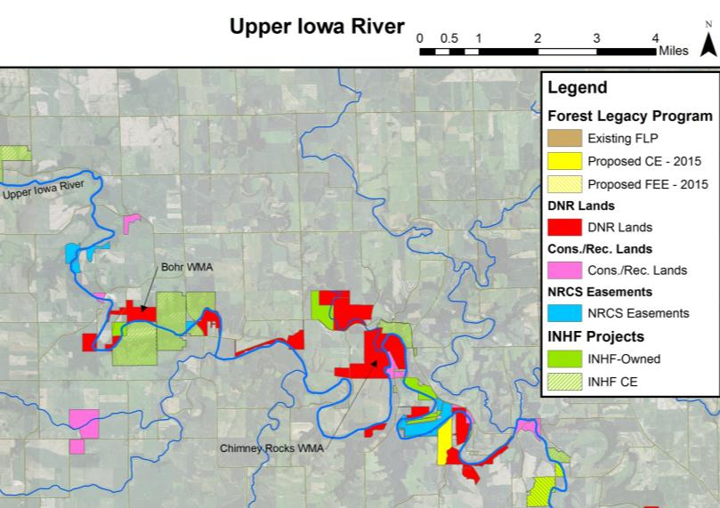
Regional Protection
Notes:
40
Public Land ownership, public conservation easement, private conservation easement, INHF owned, etc.

Slide 42
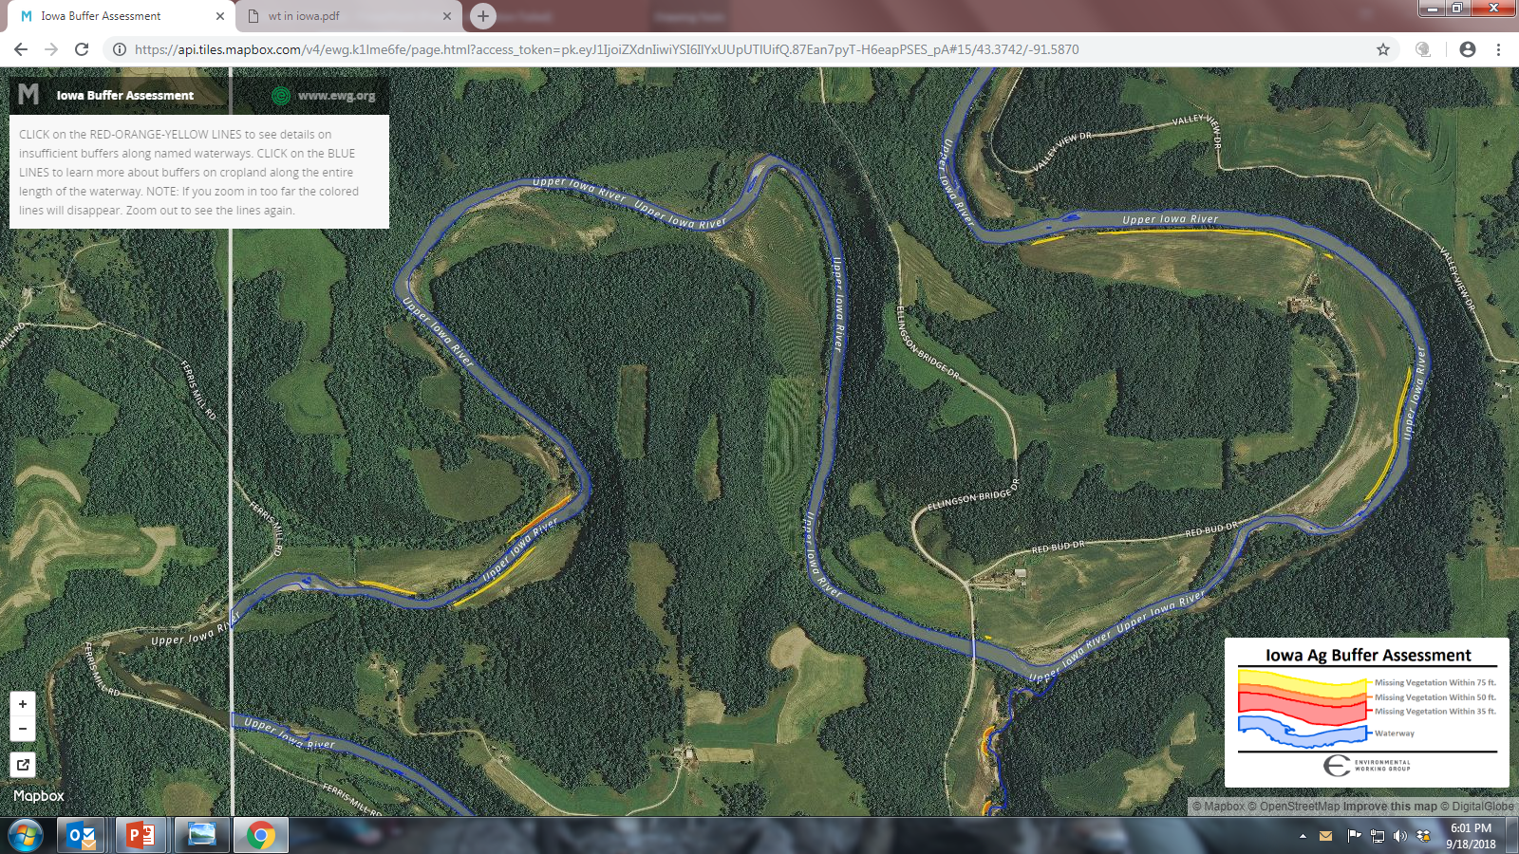

Slide 43
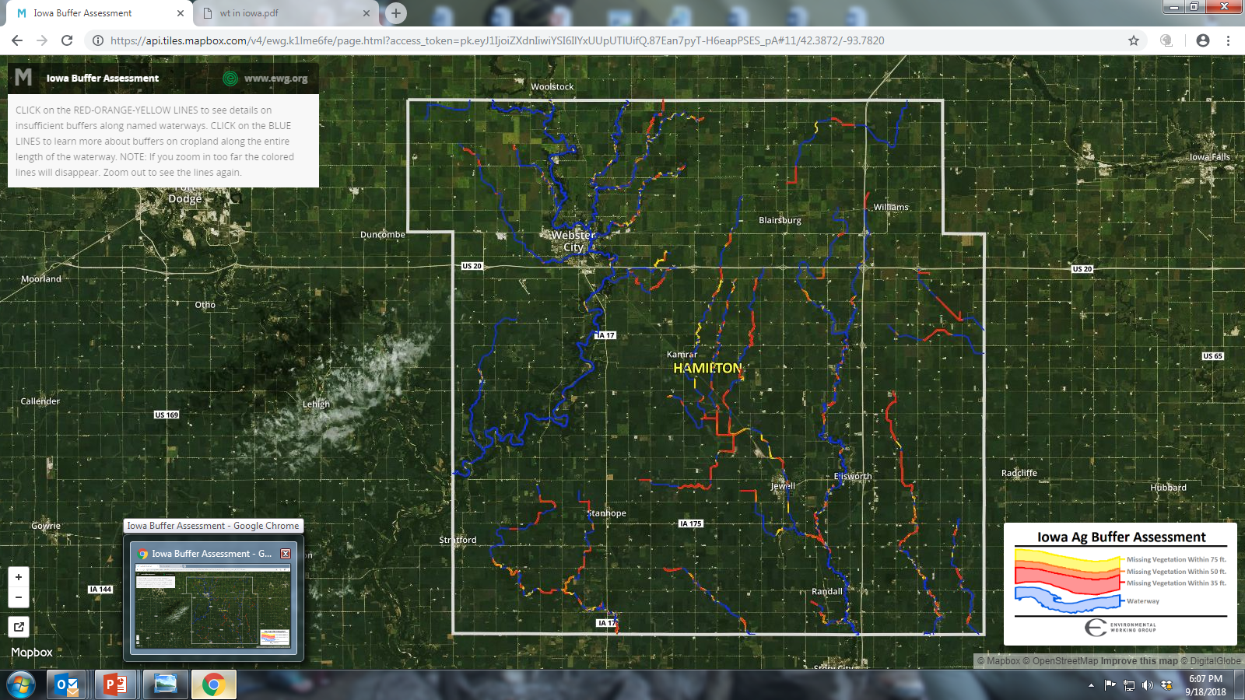

Slide 44
Potential Conservation Easements?
72,000 miles of rivers and streams
30ft buffer each side=524,000 acres
May not be realistic to survey or hold CE
Cost per acre $250/acre x 15years=$3750
One time payment to buffer permanently
Part of whole parcel Conservation Easements
Tax Incentives to offset cost

Slide 45
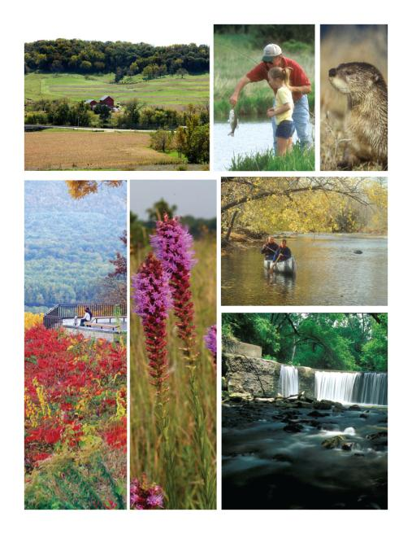
Sustainable Funding
The Natural Resource and
Outdoor Recreation Trust Fund
Notes:
The Natural Resources and Outdoor Recreation Trust Fund will provide a permanent and constitutionally protected funding source for Iowa’s natural resources to improve and protect our diverse natural environment and provide outdoor recreation opportunities for all Iowans.
Iowa currently ranks 49th in funding on natural resources per capita despite overwhelming public support for conservation funding. We can do better!

Slide 47
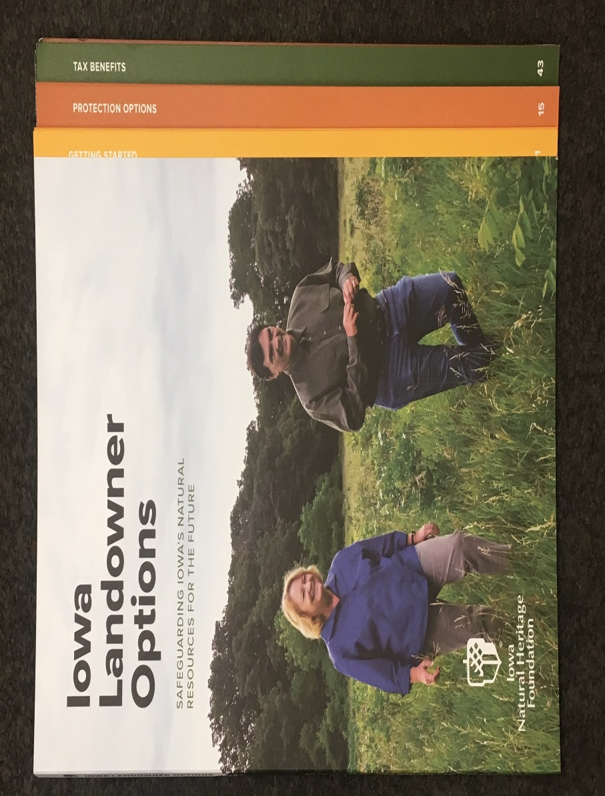
Consider permanent land protection
On land you or family own (or talk with others)
INHF has free resources, including Landowner’s Options book
Online Version
New tax credits and other support

Slide 48
Thank you!

