Slide 1
Iowa Environmental Council SOIL 2018 – “Turning Our Vision for Iowa’s Water and Land into Action” Drake University, September 19, 2018
Our Mission: A safe, healthy environment and sustainable future for Iowa http://www.iaenvironment.org/

Slide 2
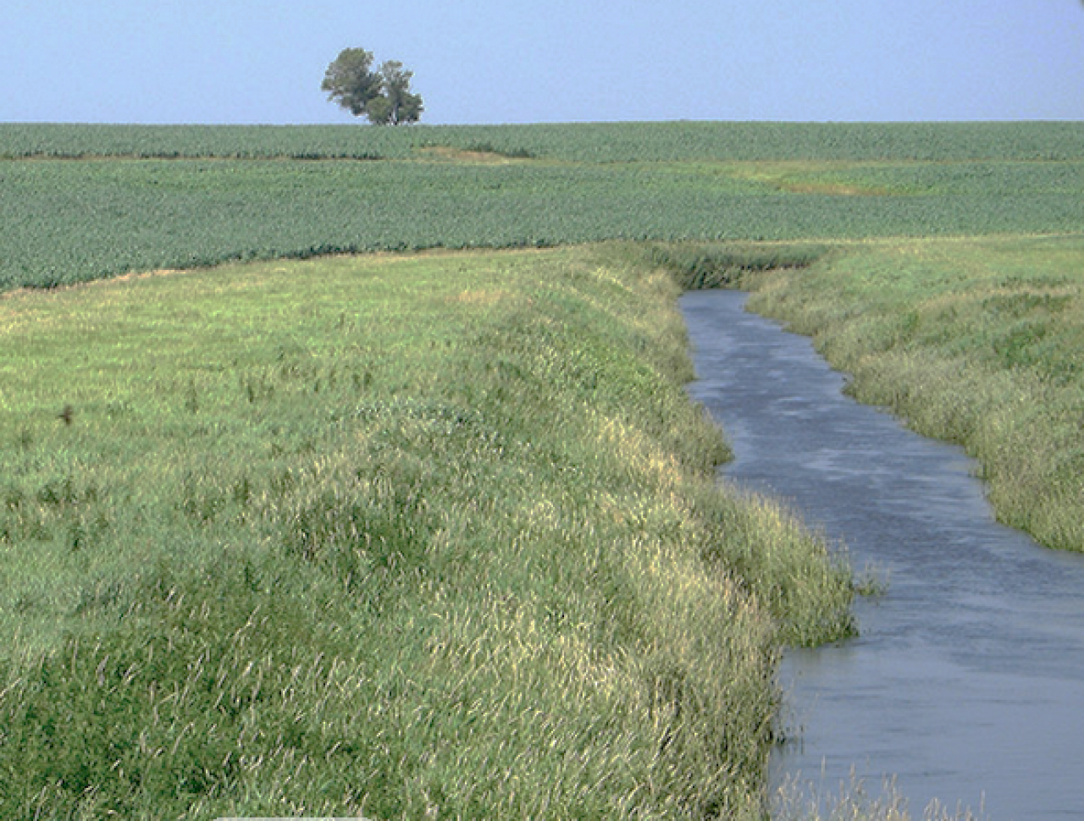
Iowa’s Land and Water:
Bold Action for a Brighter Vision
Road Map for Today:
10 Years Out: Three Bold Visions for Iowa
Current Status – Land and Water Challenges
Pathways Forward
Obliterating Obstacles
Bold Actions Today
Jennifer Terry
Environmental Advocacy Leader
Des Moines, Iowa

Slide 3
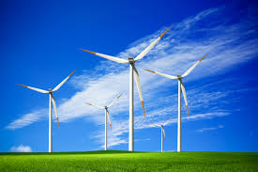
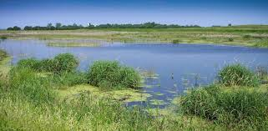
IEC In Its 23rd Year
Non-partisan alliance of 70+ diverse organizations and businesses.
Hundreds of individual members.
501(c)(3) non-profit, nongovernmental organization.
Members of regional and national coalitions for water, land and clean energy issues.
Shared goals and an amplified voice for Iowa’s environmental organizations.

Slide 4
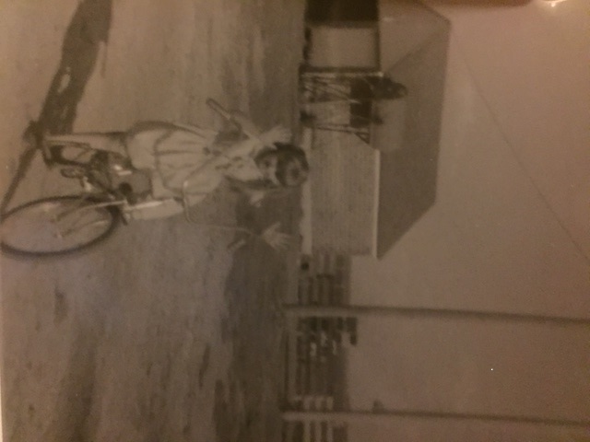
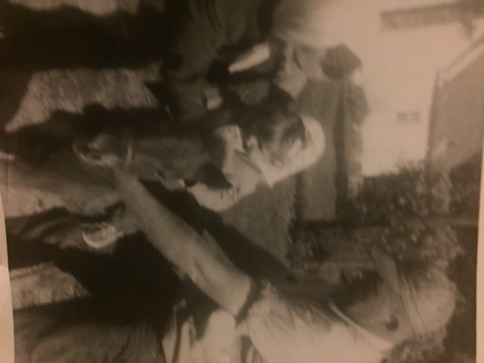
IEC’s VISION
Hardin County
Page County
Jasper County
Fayette County
Howard County
Polk County

Slide 5
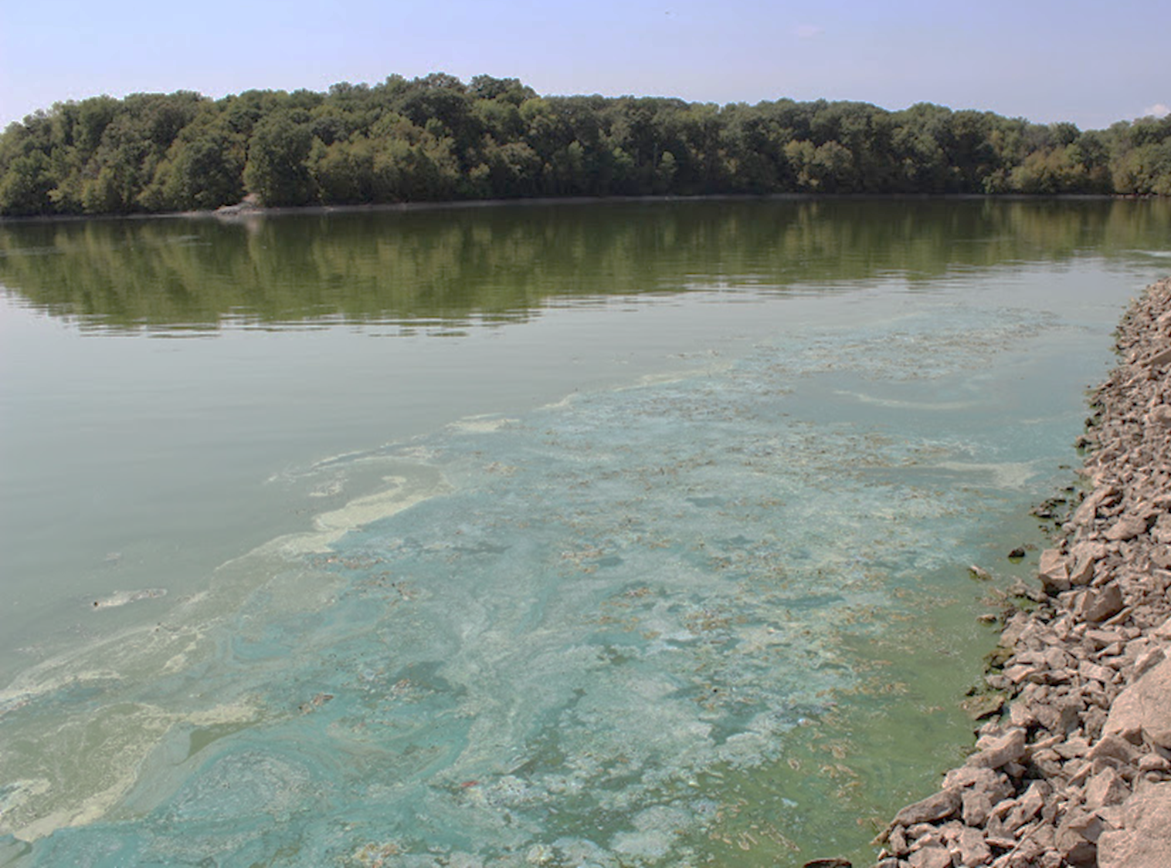
Our Lakes are Sick. We Need to Set Goals to Make Them Well.

Slide 6
Our Lakes are Sick. We Need to Set Goals to Make Them Well.
Nitrogen and phosphorus cause plants to bloom and grow. Algae, too.
Over-nutrification threatens RECREATION and DRINKING WATER SUPPLIES
Toxic blue green algae can produce harmful toxins
These toxins found in Iowa lakes and finished drinking water at least once.
Notes:
Nitrogen and phosphorus cause plants to bloom and grow. Algae, too.
Over-nutrification of Iowa waterways threatens RECREATION and DRINKING WATER SUPPLIES
Toxic blue green algae that develop can produce toxins – harmful, even lethal, to animals and people.
These toxins have been found in Iowa lakes and in finished drinking water supplies at least once.

Slide 7
Harmful Algae Blooms are a Growing Problem

Slide 8
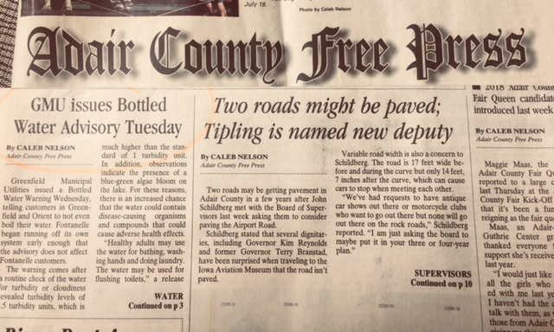
Lakes and streams are a source of recreation, revenue, and drinking water

Slide 9
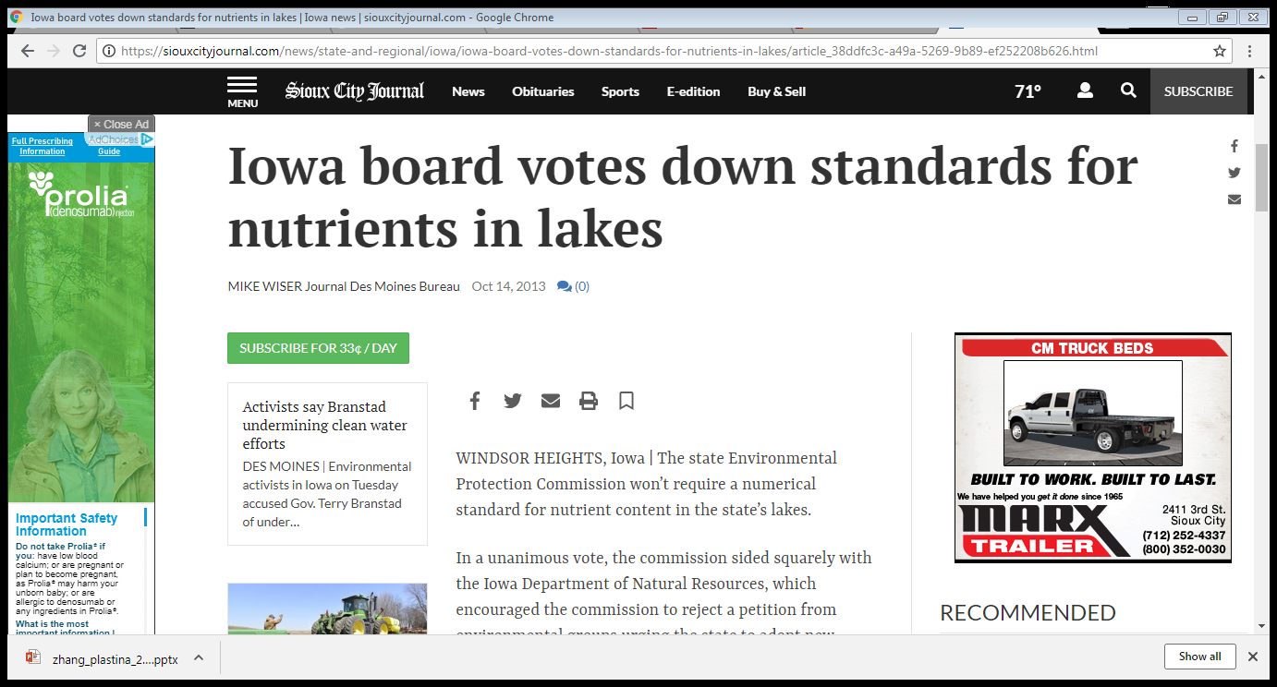
Iowa is not complying with the Clean Water Act
Setting water quality standards is not just an interesting idea. It is the law under the CWA.
Iowa must establish numeric goals for each lake in Iowa.
Notes:
Iowa must establish numeric, not simply narrative, goals for each lake in Iowa. LAW – you must set water quality for all water bodies. Set a use for each water body. Set a criteria to protect for that “designation” or use—can use either narrative or numeric. Right now we use a narrative criteria for algae. “Gross stuff” – NOT PROTECTIVE! So - - - it’s allowable, but it is not protective. There are not numeric criteria for nitrogen or phosphorus that cause algae blooms. What if our speed limits were subjective rather than numeric?

Slide 10
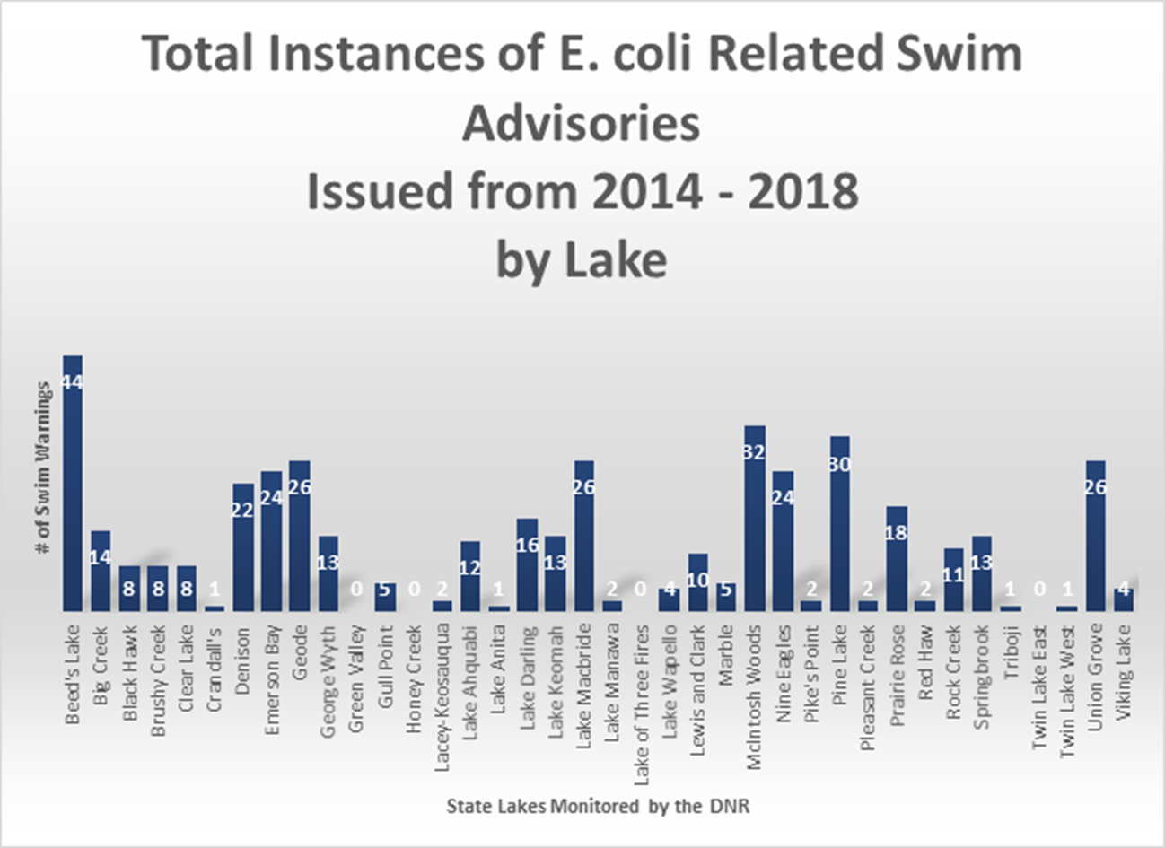
Bacteria: Threat to Waterways, Rural Economies

Slide 12
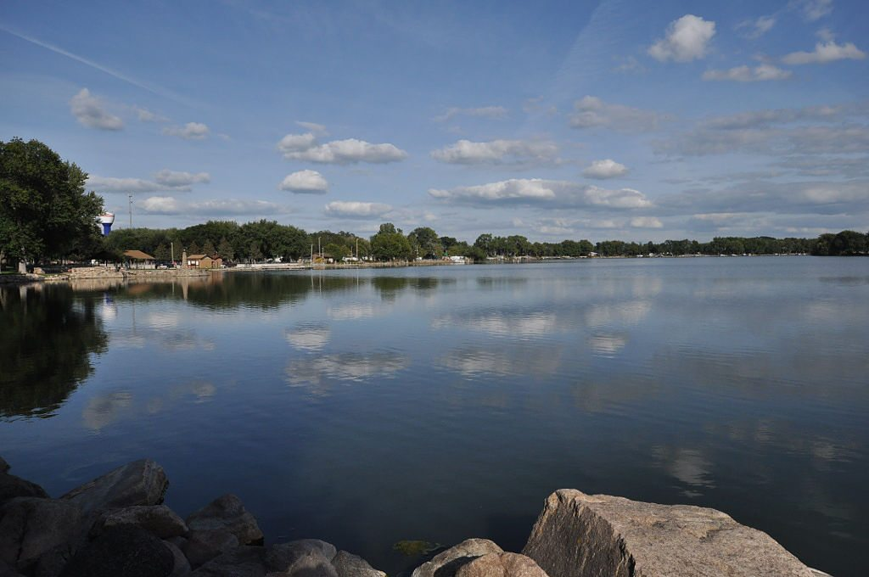
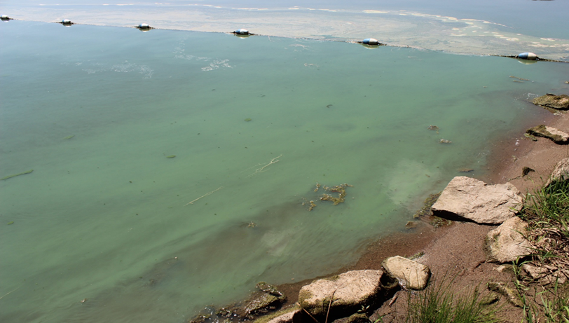
Bold Vision #1: Water that Makes You Go ‘Ahhh’ Not ‘Ewwwww”

Slide 13
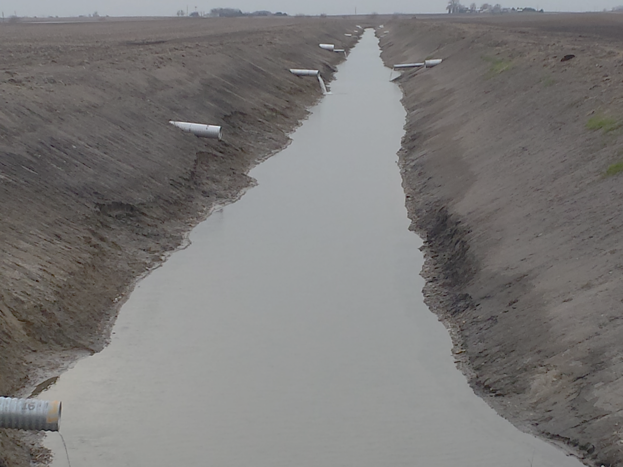
Strengthen environmental laws
Other states have laws in place: Minnesota’s buffer law, Vermont’s 2015 Clean Water Act
Water quality management plans gain protection from additional requirements/regulations
Suspend expansion and/or construction of new confined animal feeding operations until appropriate oversight
Hardin County, Iowa
Notes:
surface water provider
one of most heavily-agricultural watersheds in the nation with thousands of drainage districts in our watershed
Minnesota’s 2015 buffer law - required installation of vegetative buffers; Vermont’s 2015 Clean Water Act, Act 64: “Required Agricultural Practices”, vegetative buffer provision
Water quality management plans gain protection from additional requirements/regulations
Suspend expansion and/or construction of new confined animal feeding operations until appropriate oversight

Slide 14
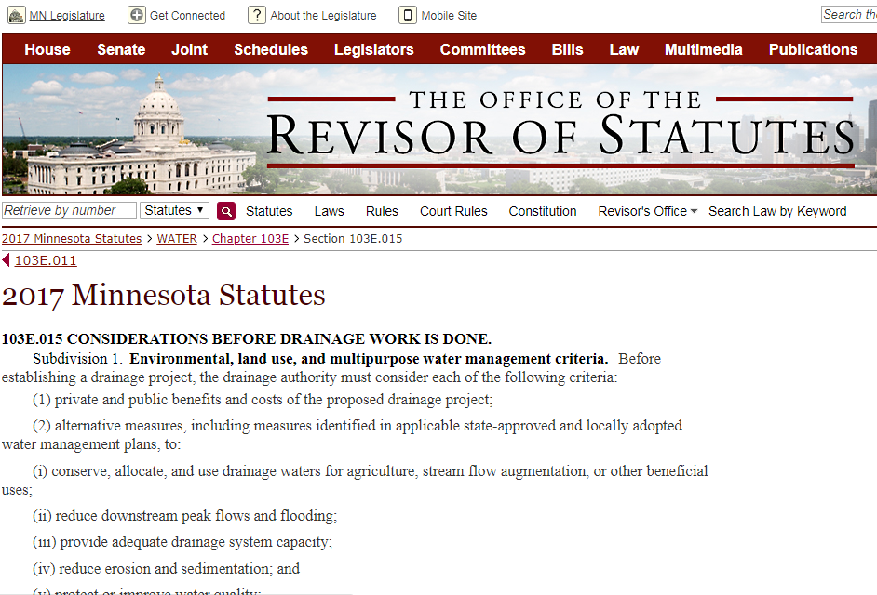
Considerations before drainage work is done; a drainage manual; recommendations for
more legal clarity

Slide 15
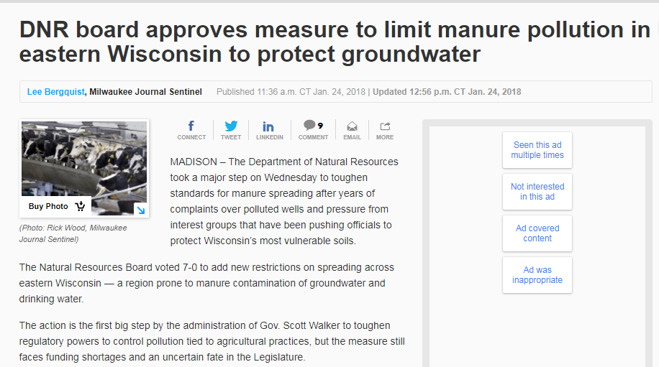
“The action is the first step by the administration of Gov. Scott Walker to toughen regulatory powers to control pollution tied to agricultural practices
. . . “
Special protections for vulnerable landscapes.
Balancing multiple benefits on the landscape

Slide 16
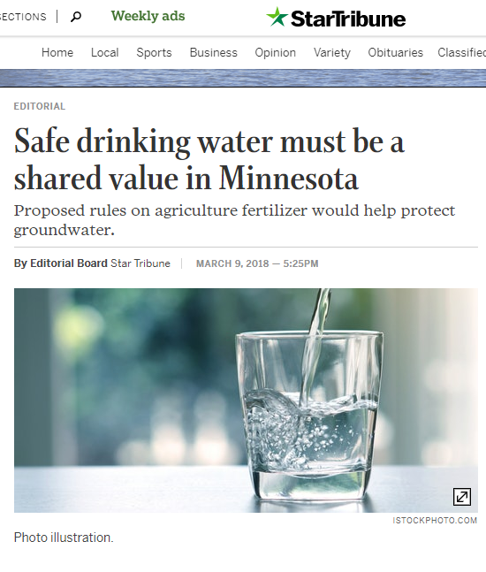
“A system of voluntary and mandatory mitigation practices in vulnerable areas and in locations that have high nitrate level in public water supplies.”
“We literally have a moral obligation.”
MN Agriculture Commissioner

Slide 17
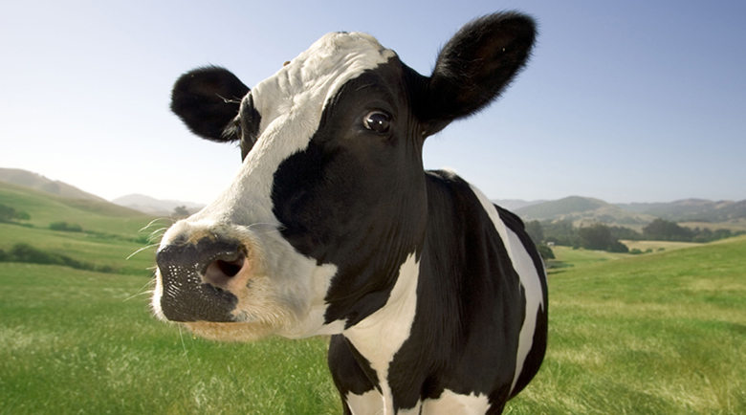
Bold Vision #2: Happier Pigs, Cows, and People.
Land Use Management for Multiple Benefit

Slide 18
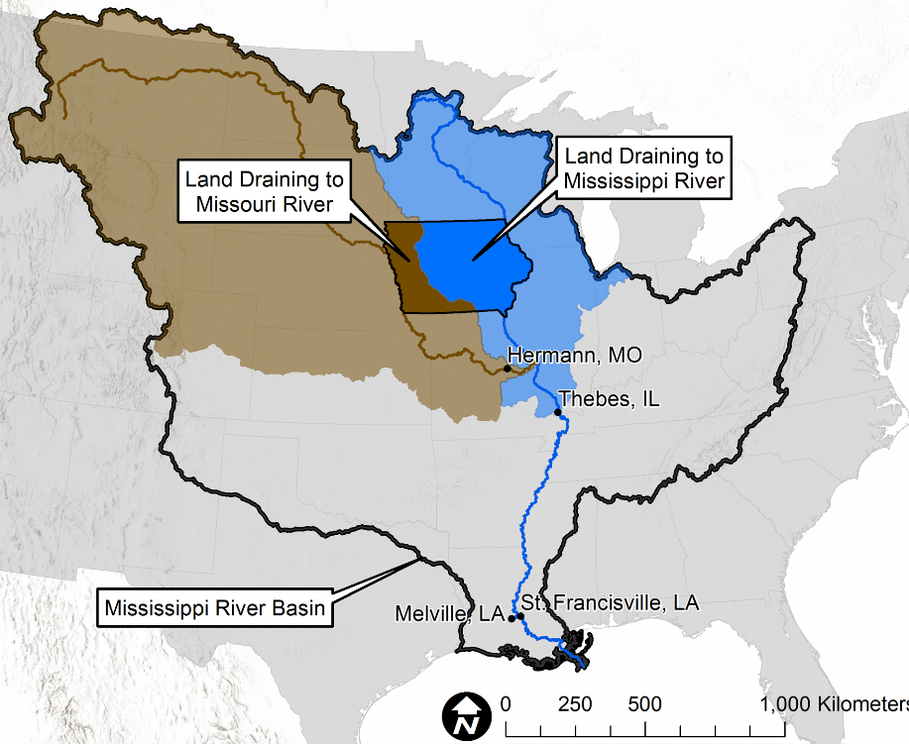
“It’s not okay to sacrifice one person’s living for another’s.” Louisiana Shrimper on NPR
Solve Iowa, We Solve the Gulf.
(Oh and, by the way,
Iowa Waters as Well)
Iowa stream nitrate and the Gulf of Mexico, April 2018
Christopher Jones, Jacob Nielsen, Keith Schilling, Larry Weber
Notes:
University of Iowa study: “Gulf hypoxic goals will be very hard to reach if nitrate retention cannot be improved in Iowa.”
“An opportunity exists . . .”

Slide 19
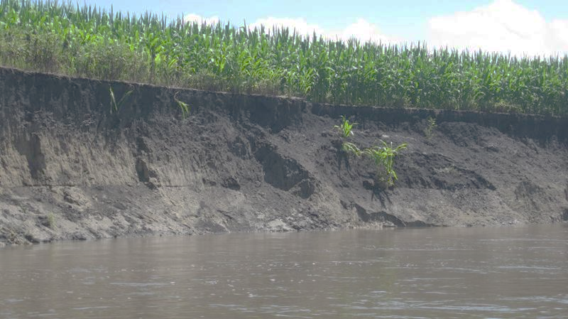
Establish a shared understanding about the definition of ‘stewardship’

Slide 20
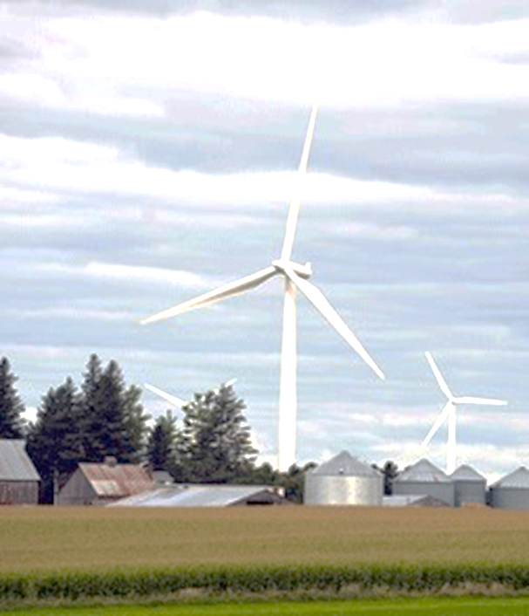
Ensure a Healthy Climate for the Future – Support Clean Energy
Land lease payments
$20-25M in land lease payments every year.
In some cases payments that have allowed farmers to stay on the land.
Local tax revenues support schools, hospitals, roads and other infrastructure
Protect Iowans from the health, enviromental impacts of coal
Notes:
Land lease payments
$20-25M in land lease payments every year.
In some cases, over what has been a hard period for farmers, it is these payments that have allowed them to stay on the land.
Local tax revenues from wind projects
Taxes support schools, hospitals, roads and other infrastructure and in some counties, revenue from wind has become the largest source of revenue.
Protect Iowans from the health, enviro impacts of coal

Slide 21
Bold Vision #3: Collective Strategic Thinking

Slide 22
We All Live in a Watershed
Farmers are not villains and urban dwellers are not out to get them.
Change funding mechanisms
“Large scale planning project” - how law and policy are constructed
Change the actors – invite/seek out diversity
Notes:
Farmers are not villains and urban dwellers are not out to get them. Someday, the “urban-rural divide” myth is eradicated.
Change in funding mechanisms – think creatively
“Just a large scale planning project” - how law and policy are constructed, e.g. Des Moines MPO water trails plan: invest $108 million, 150 miles of stream – manage runoff and flows
Change in actors – invite/seek out diversity

Slide 23
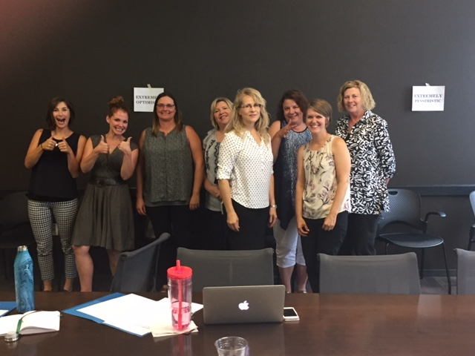
Example: Amplify Women’s Voices
Women for Water
Emphasizes shared experiences
Diversity of thought and demographics
Recruit, hire, and elect women
Notes:
Example:
Women for Water
Originated in 2017 during contentious water quality debates at Statehouse
Diversity of thought and demographics
Recruit, hire, elect women to lead boards, commissions, municipalities, agencies

Slide 24
Obstacles to Achieving the Visions
Lax environmental laws
Starving the regulators
EPC fails to support appropriate regulation and enforcement
Failure for legislature to allow meaningful local controls
Local and regional opposition to clean energy and energy efficiency
Lack of price and market supports
Notes:
Lax environmental laws even when compared to other ag states
Starving the regulators who oversee and enforce
Environmental Protection Commission fails to support appropriate regulation and enforcement
Failure for legislature to allow appropriate, meaningful local controls – home rule
Lack of price and market supports

Slide 25
Obstacles to Achieving the Visions
Resistance from IDNR leadership to enforce Clean Water Act – Numeric Nutrient Criteria
EPC fails to support Numeric Nutrient Criteria
Failure to balance rights with commodity production resulting in over-nutrification of waters
Voluntary/optional policy for 23 million acres of crop production
Doesn’t address that lion’s share of nutrient pollution comes from farm ground (92% of nitrogen)
Notes:
Resistance from IDNR leadership to meaningfully enforce Clean Water Act – Numeric Nutrient Criteria for lakes *See 2013 IEC, ELPC Petition.
Environmental Protection Commission fails to support Numeric Nutrient Criteria *See 2013 IEC, ELPC Petition.
Failure to balance equity/diversity of rights with commodity production which results in over-nutrification of waters
State policy is voluntary/optional for 23 million acres of crop production – fails to address the elephant in the room – lion’s share of nutrient pollution comes from farm ground (92% of nitrogen)

Slide 26
Taking Action to Achieve the Visions
Support state and federal policy that supports happy animals AND happy people
Farm Bill – move from production-based to regenerative-based
Overhaul Concentrated Animal Feeding Operation regulations and aggressively enforce compliance
Fund DNR to oversee and enforce permits
Fund and promote private well testing
Notes:
Support state and federal policy that supports happy animals AND happy people – e.g. grazing incentives
Farm Bill – move from production-based to regenerative-based
Overhaul Concentrated Animal Feeding Operation regs and aggressively enforce compliance – halt new and expanded construction until IDNR is adequately funded to oversee and enforce permits
Fund and promote private well testing for bacteria and other harmful pollutants to protect health
Partner with urban/suburban recreation and habitat groups, agencies, campaigns, municipalities to clean up the bacteria

Slide 27
Taking Action to Achieve the Visions
Fulfill legal responsibility by establishing and enforcing Numeric Nutrient Criteria in lakes.
Ramp up funding for targeted source water protection efforts
Implement Basic Standards of Care on agricultural ground.
Balance equity and diversity with agricultural commodity interests
Notes:
Fulfill legal responsibility to Iowans by establishing and enforcing Numeric Nutrient Criteria in lakes.
Ramp up fed/state funding for aggressive, targeted source water protection efforts with plans that allow for mandatory compliance for key water polluters.
Implement Basic Standards of Care on agricultural ground.
Ensure equity, diversity representation is balanced with agricultural commodity interests.

Slide 28
Bold Visions for a
Brighter Future:
Kindergarten Rules Apply
Don’t mess up other people’s stuff.
Leave some cookies for the other kids.
Help the neighbor next to you.

Slide 29
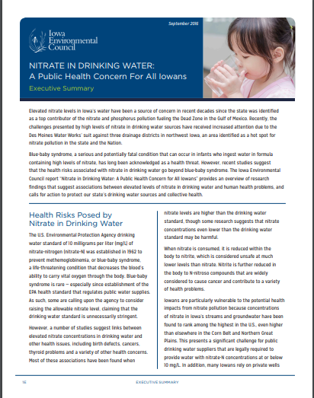
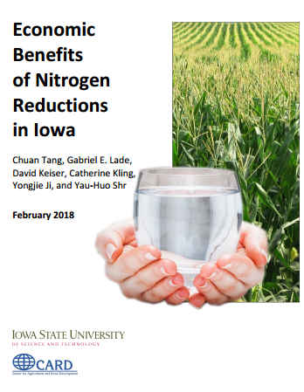
Thank you for inviting us to share our message!
505 5th Avenue, Suite 850
Des Moines, IA 50309
515-244-1194
Jennifer Terry, terry@iaenvironment.org
www.iaenvironment.org
Facebook.com/IAEnvironmentalCouncil@Iowa_Env

