Slide 1
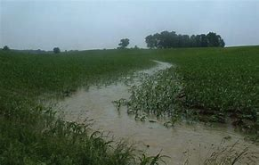
A Vision for Iowa’s Soil Health

Slide 2
Vision
No erosion
Infiltration rates in excess of 4 inches per hour
Healthy soil biology
Reduced need for fertilizers and pesticides
Enhanced production efficiency

Slide 3
Characteristics to Obtain that Vision
Cover throughout the year
Diverse crop rotations
Reduced tillage
Change our attitude toward soil

Slide 4
Reality
Produce 2 crops (23,300,000/26,256,357 acres in corn and soybean)
Consider the current practices acceptable in terms of soil management
Tolerate erosion
Think because yields have continued to increase, we are doing a good job
Consider any change beyond what we currently doing as being a “fringe” idea

Slide 5
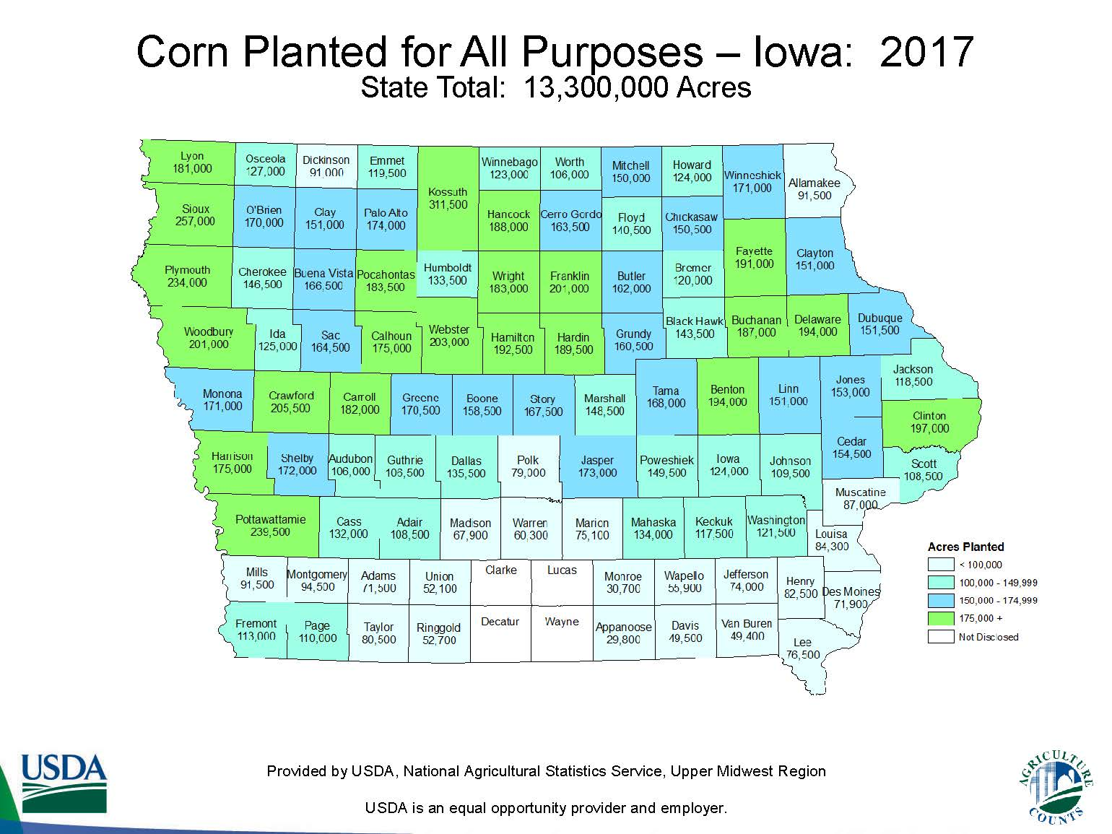

Slide 6
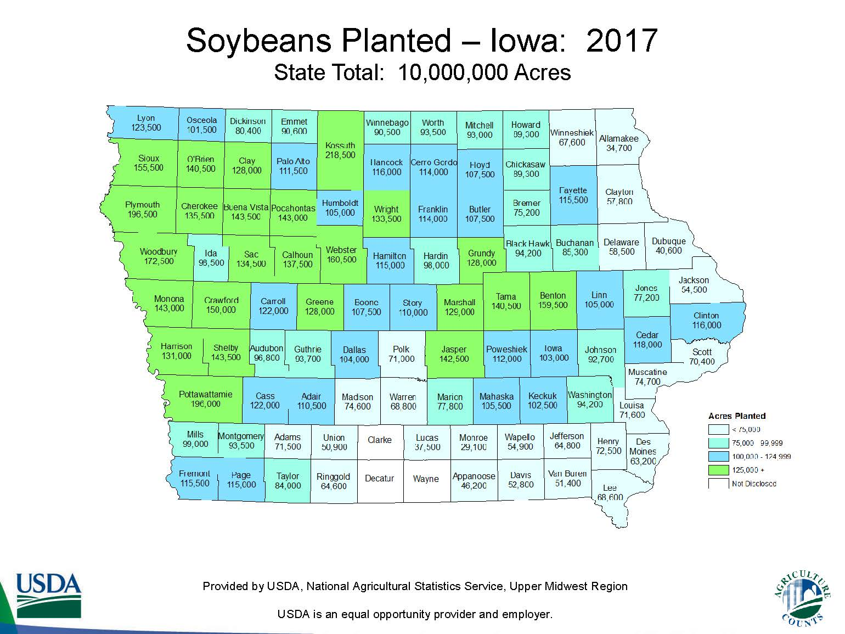

Slide 7
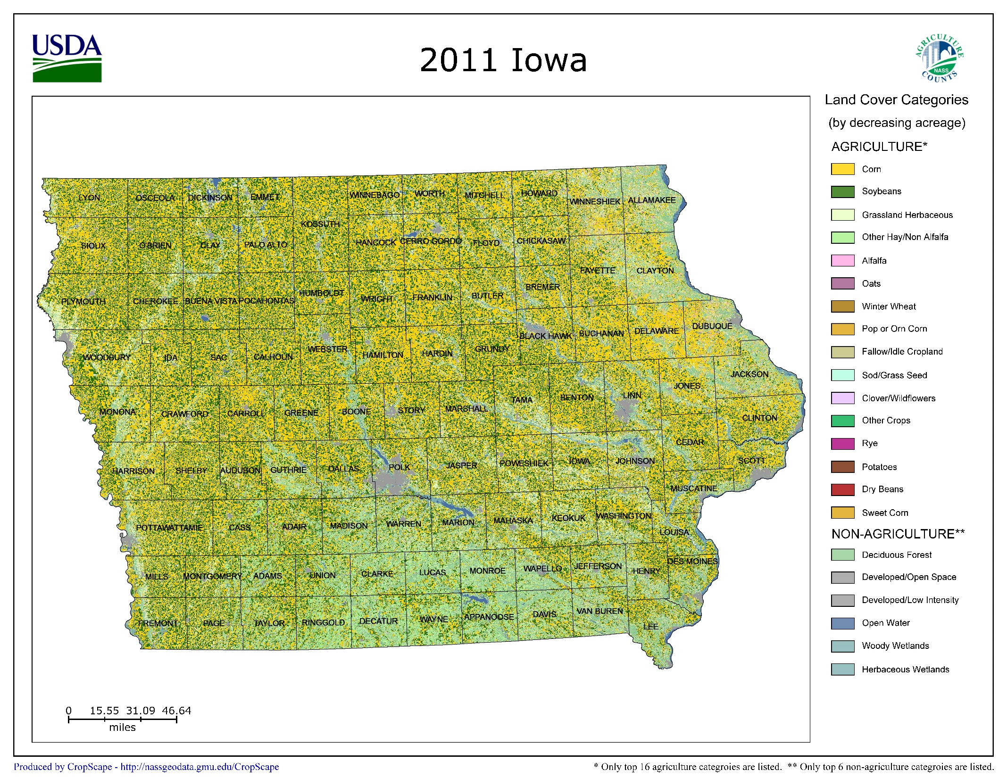

Slide 8
Soil Degradation Spiral
Poor Land Management
Aggregation Degradation
Compaction
& crusting
Water & Wind Erosion
Plant Growth
Soil Biology
Yield
Reduced Soil Productivity

Slide 9
Variation of Water Holding Capacity within production fields

Slide 10
Carbon Balance in Corn-Soybean Fields 2000-2016
Rates (Mg C ha⁻¹ yr⁻¹) | Field | Footprint
ΔTC | -1.52 ± 0.78 | -1.54 ± 0.76
C budget | -1.70 ± 0.01 | -1.72 ± 0.02

Slide 11
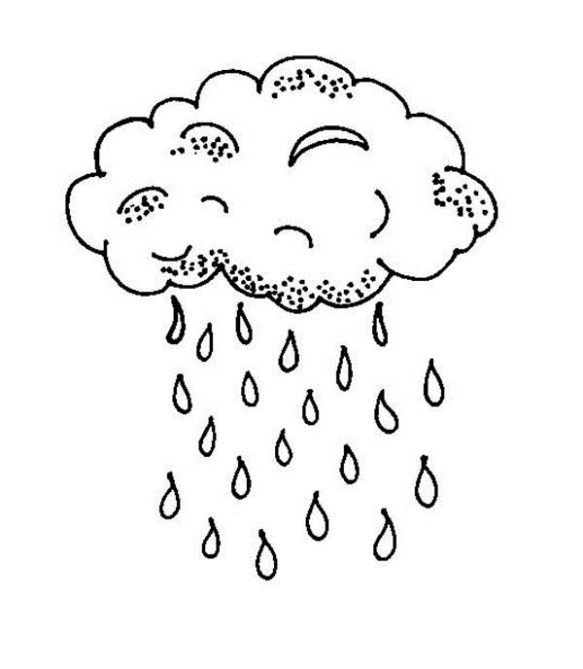
Low Biological Activity
High Biological Activity
Low stability
High Stability
Entrained material
Stable microclimate
Slow infiltration, fast time to runoff
Slow infiltration, fast time to runoff
Unstable microclimate
High infiltration,
Delays runoff
Assessing the Dynamics of the Upper Soil Layer Relative to Soil Management Practices

Slide 12
Management impact on soil aggregates
Contour Ridge Till
(CRT)
Reduce Till- Parallel Rows
(RT-PAR)
Spring till corn, fall till soybean (STC-FTB)
Wacha, K.M., Papanicolaou, A.N., Wilson, C.G., Abban, B.A., Giannopoulos, C., Zhou, S., Hatfield, J.L., Filley, T., and Hou, T. (2018). The Role of Management and Topography on Small Aggregates in the Clear Creek Watershed, Iowa. Geoderma,

Slide 13
Path Forward

Slide 14
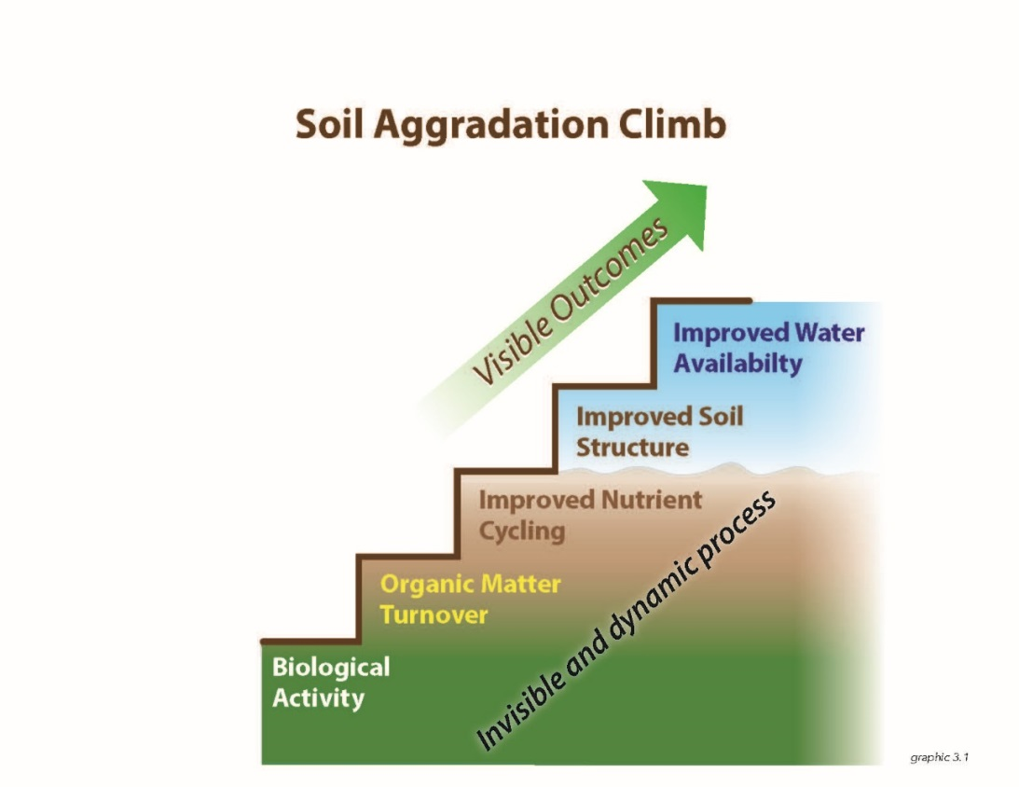
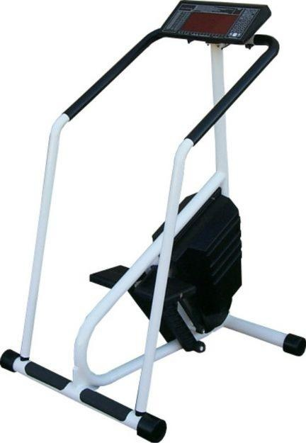

Slide 15
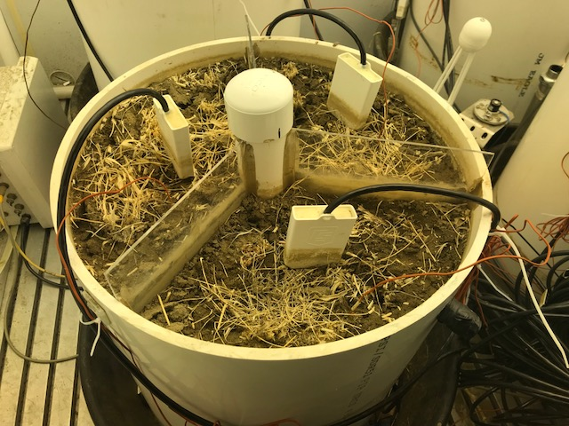
Growth Chamber Experiments
Diameter =2 ft
Height =3.5 ft
Dry weight= 600lbs
Continuous data being monitored: soil moisture, temperature,CO₂, Soil O₂

Slide 16
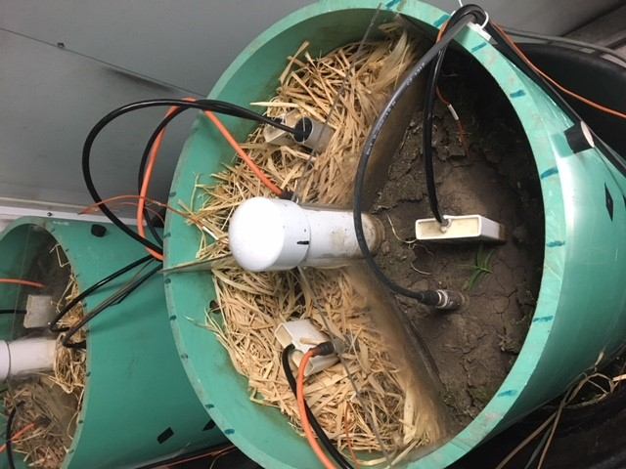
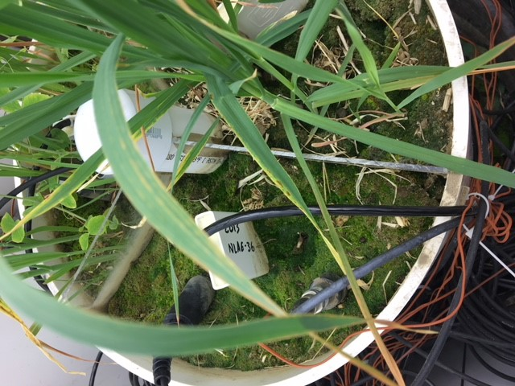
Soil Experiment – Laboratory
Evaluation of cover crop mixtures on changes in soil properties and gas exchange (CO₂ and O₂)

Slide 17
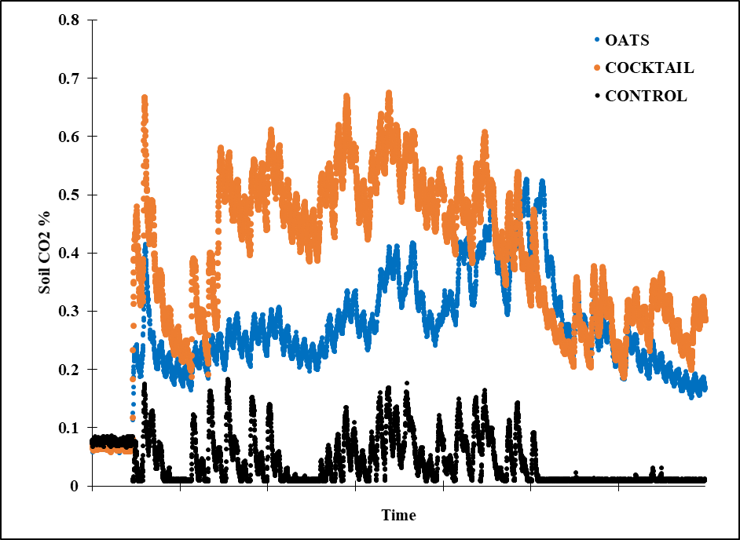
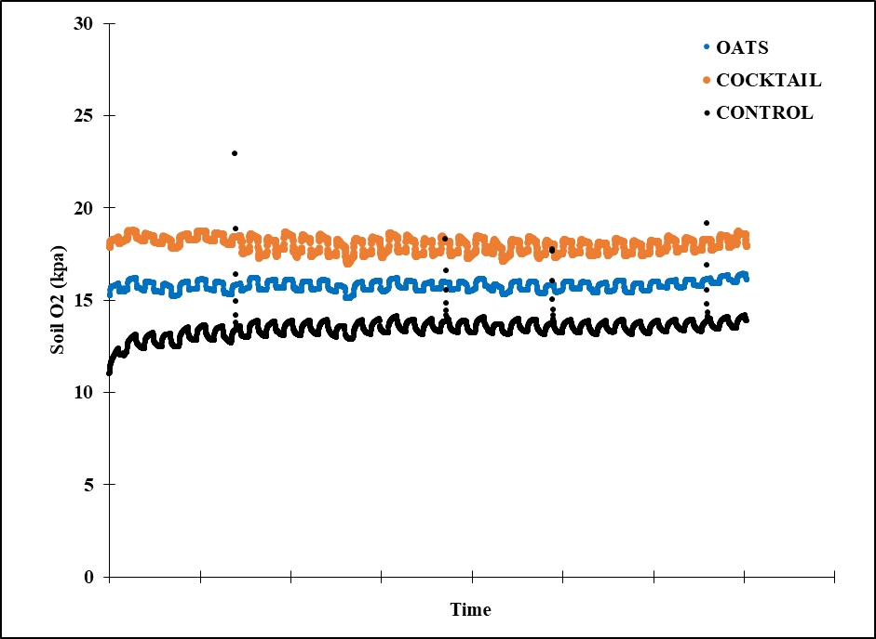
Growth Chamber Experiments
Soil CO₂
Soil O₂
Highest activity (soil CO₂) observed in the cover crop cocktail
Higher soil O₂ concentrations observed in cover crop systems with the cocktail being highest

Slide 18
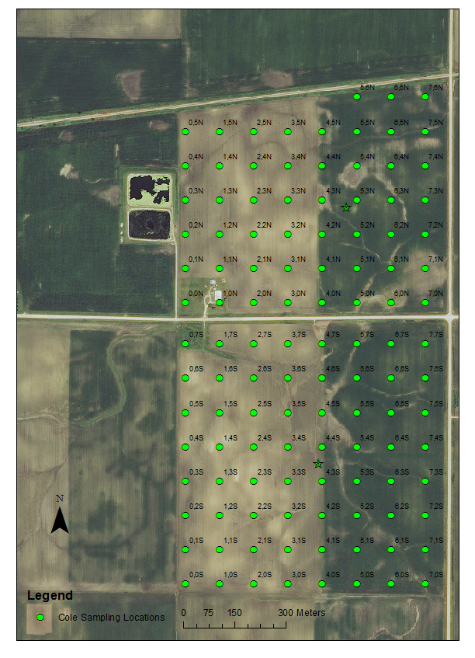
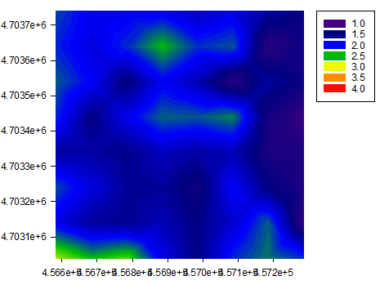
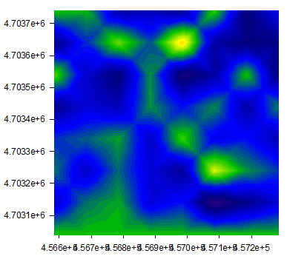
Gridded soil sampling
Dry Aggregate Size Distribution
DMWD
At each sampling location:
-1.2 m deep core
-5,10 cm surface sample
Conversion to strip till w/cover crop

Slide 19
Agricultural Systems
Convert water, light, nutrients into a usable product
This is in the context of the ecosystem

Slide 20
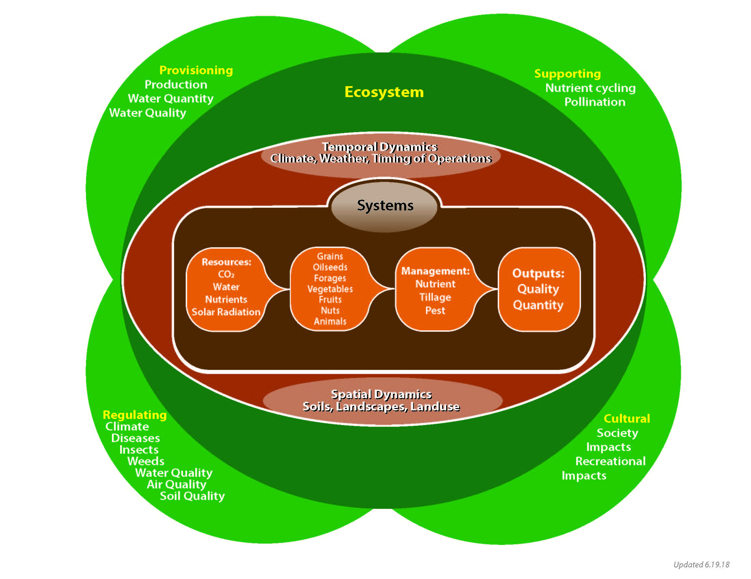
How we need to think about agriculture

